Slide 1


Sustainability at UCSB
Freshman Orientation
Summer 2020

Slide 2
UCSB Sustainability
Sustainability colleagues work with staff, students, administrators, and faculty across the campus
Focus on “culture of sustainability”
Through projects and initiatives, UCSB Sustainability aims to integrate the three pillars of sustainability into everything we do on campus.
www.sustainability.ucsb.edu

Slide 3
What is Sustainability?
People
Environment
Economy
Building strong local economies
Establishing financial incentives and disincentives to support our values
Improving Quality of Life
Living Wages
Human Dignity
Social Equity
Sustainability
Biodiverse and dynamic ecosystems
Lifecycle accounting

Slide 4
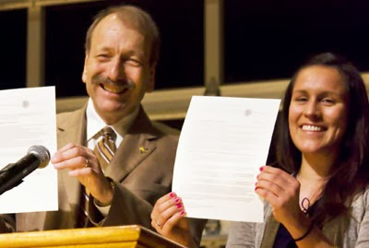
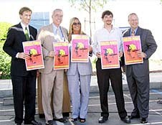
Engagement: Students Creating Policy
UC Policy on Sustainable Practices
Inspired by Greenpeace
Driven by students
Successful statewide policy
The campaign that started the California Student Sustainability Coalition

Slide 5
Waste Reduction Goal
The University will achieve zero waste through prioritizing waste reduction in the following order: reduce, reuse, and then recycle and compost or anaerobically.
Minimum compliance for zero waste, at all locations other than health locations, is as follows:
Reduce per capita total municipal solid waste generation:
  by 25% per capita from FY2015/16 levels by 2025
  by 50% per capita from FY2015/16 levels by 2030
Divert 90% of the municipal solid waste generated from landfills
69%

Slide 6
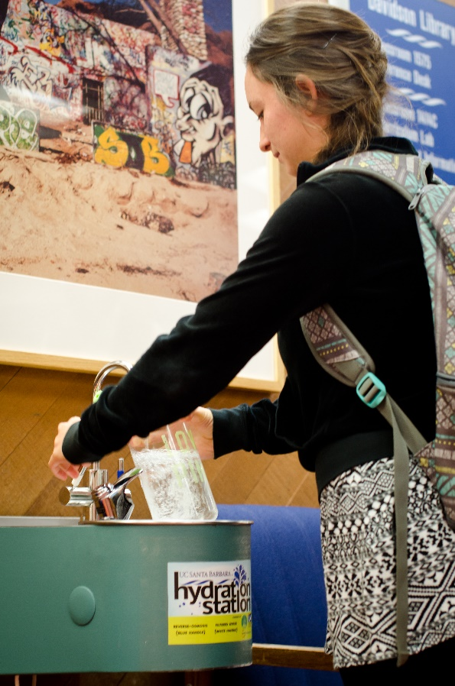
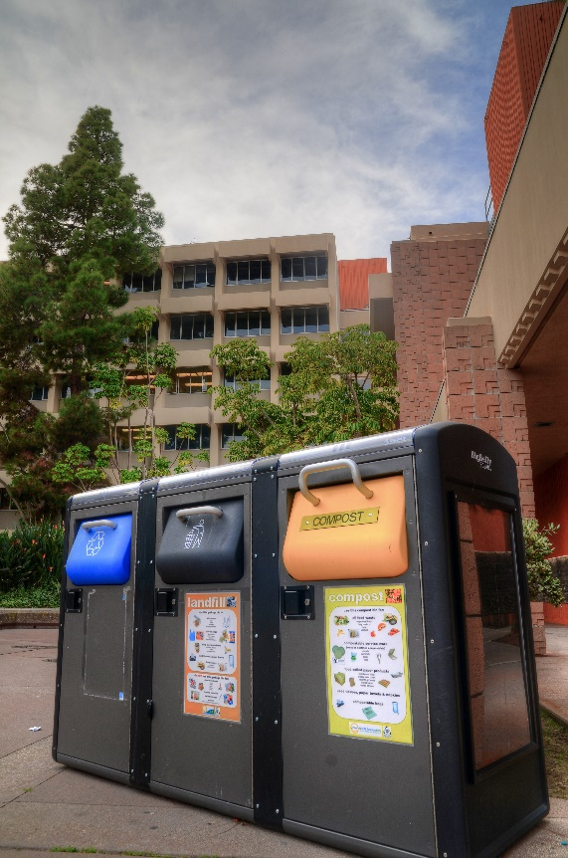
WASTE REDUCTION
Have over 40 UC Santa Barbara Hydration Stations
With another 22+ being installed through the HBI
Composting Organic Waste
Eco-to-Go container program at Coral tree
San Clement Compost Pilot
Source Reduction
Policies that restrict use of virgin paper, Expanded Polystyrene (EPS), and single use items (phased ban of plastic bag, straws, water bottles, etc.).
#MYLASTTRASH

Slide 7
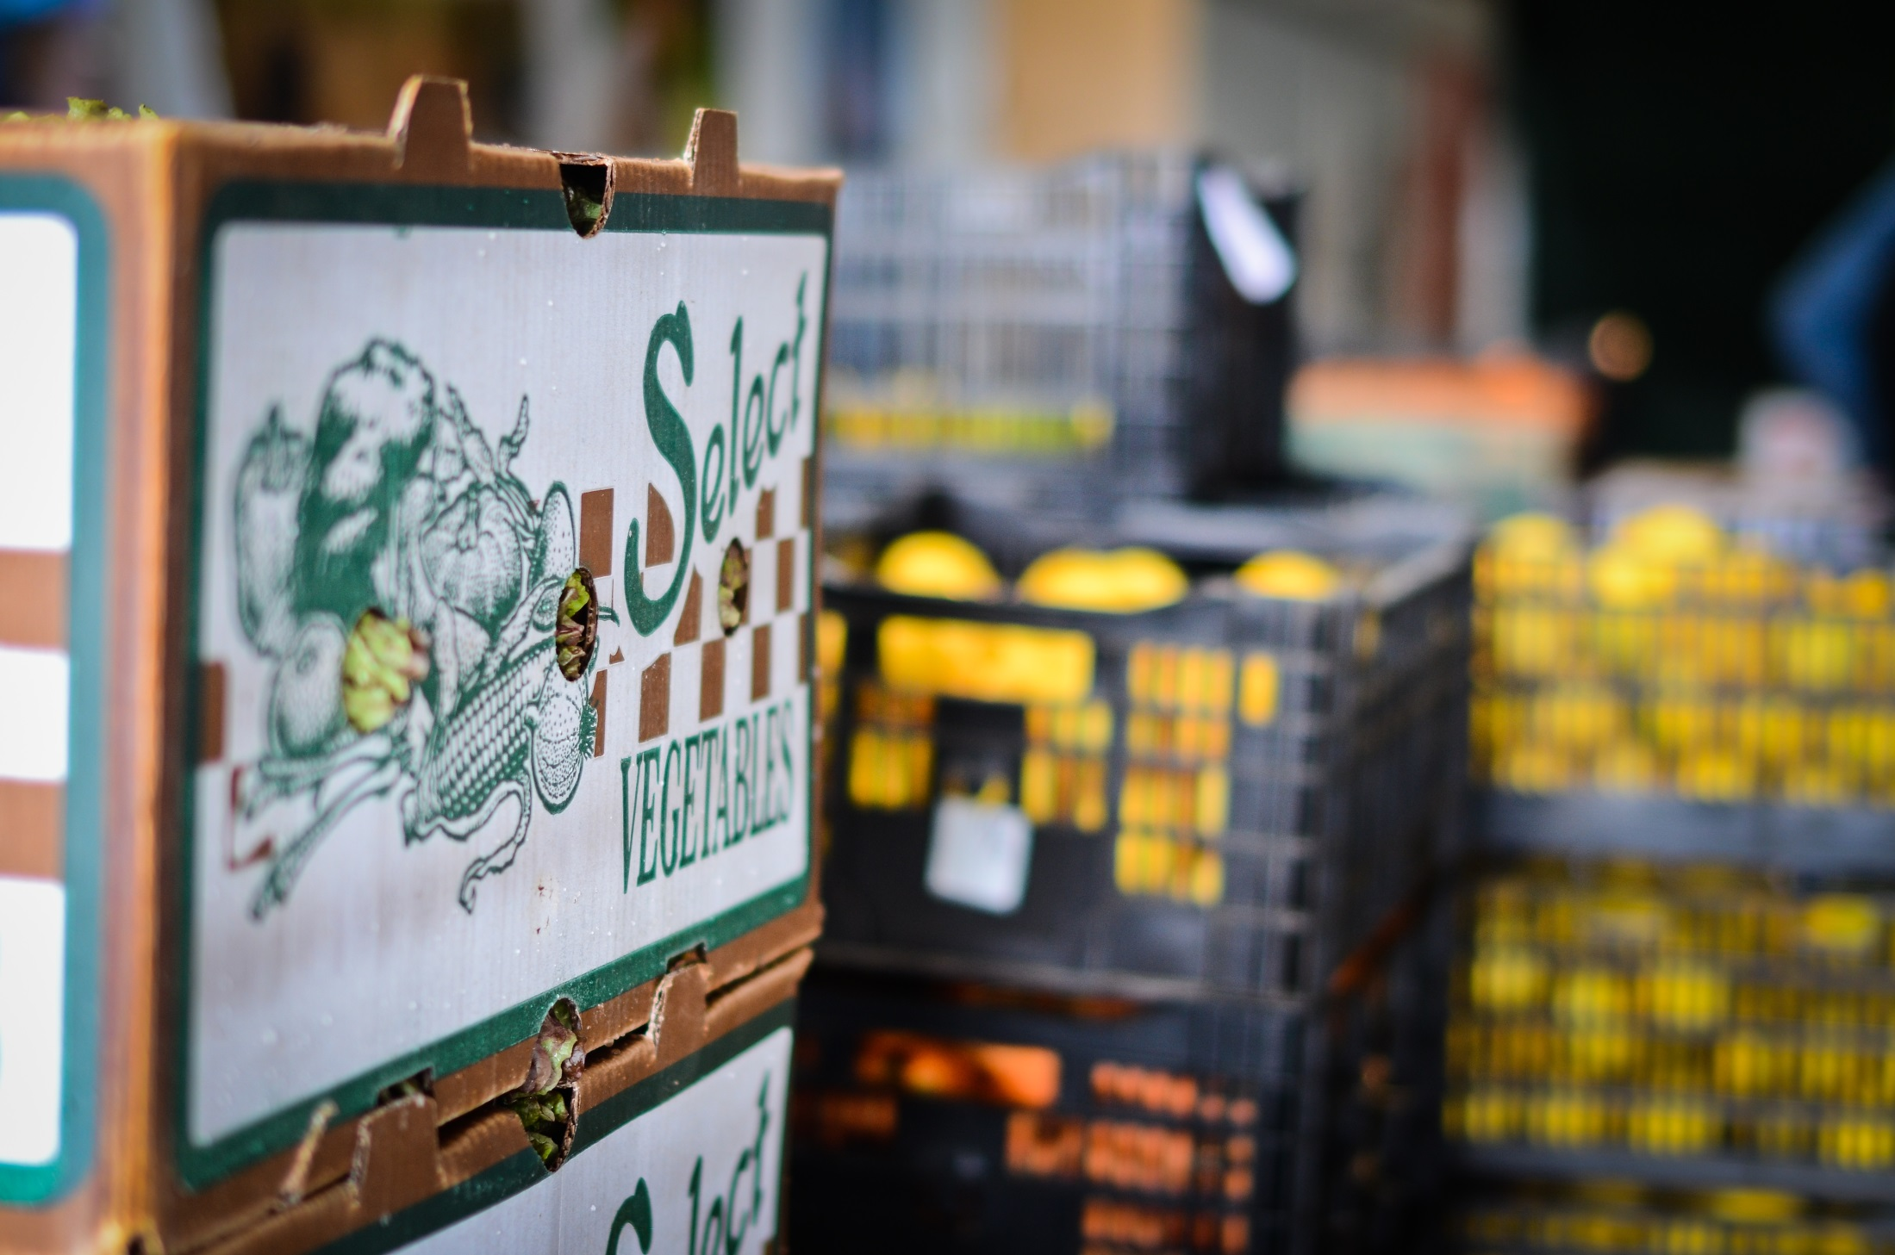
UC Global Food Initiative
A Presidential Initiative in Development

Slide 8
FOOD FOR THOUHT
Programs
  Growing Food:
    The Greenhouse and Garden Project
    West Campus Student Family Housing Garden
    Storke Family Student Housing Garden
    The American Indian and Indigenous Garden Alliance Gardens.
    Student Farm
  Healthy Campus Network
  Food Security Task Force
Resources
  Food Nutrition and Basic Skills workshops
  SNAP Program - UCSB helped registered 2,976 students in CalFresh in 2017-2018.
  Information on food security and basic needs can be found at food.ucsb.edu

Slide 9
Resources Available
The Associated Students Food Bank located on the second floor in the University. The Food Bank distributes brown bags of groceries to students
The Miramar Food Pantry is another resource available to students that meet the same qualifications for the AS Food Bank.
The Edible Campus Program’s Student Farm - The farm is a partnership of the AS Department of Public Worms, UCSB Sustainability, and AS Food Bank. The farm has been recognized as an essential service and been permitted to continue growing healthy fruits and vegetables to feed our students.

Slide 10
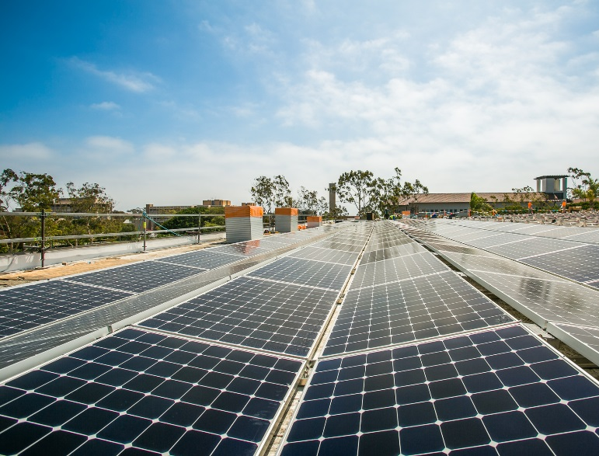
Carbon Neutrality
We are committed to becoming climate
neutral by 2025
UCSB’s total operational greenhouse gas emissions are ~25% below 1990 levels, despite a near doubling in GSF. This is largely due to on going investments in energy efficiency and our 6.2 MW of on campus solar energy. Both of which are saving our campus money.
UC divested from all fossil fuels, removing them from its $126-billion investment portfolio
Notes:
UCSB completed third party verification of its 2018 GHG emissions and total operational greenhouse gas emissions were ~25% below 1990 levels, despite a near doubling in GSF

Slide 11
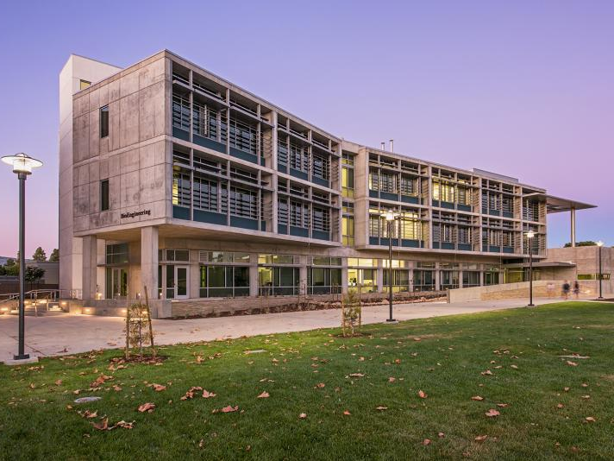
Built Environment
Home to the first double platinum Leadership in Energy and Environmental Design (LEED) certified lab building in the nation and the first residential complex (Sierra Madre Village) in the UC system to attain Platinum certification, the highest possible rating for sustainable design under the category LEED for Homes.
We also received LEED Platinum Certification in New Construction for our new Bioengineering building and our Portola Dining Commons.

Slide 12
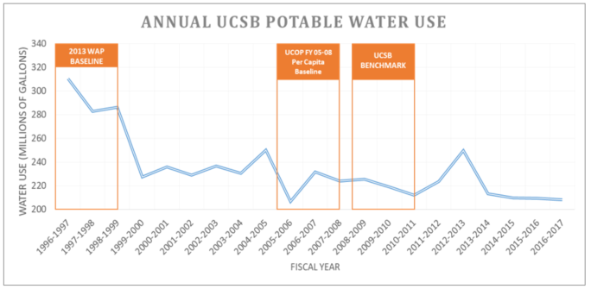
Water Conservation
Policy Goal: Reduce growth-adjusted potable water consumption 20% by 2020 and 36% by 2025, when compared to a three-year average baseline of FY2005/06, FY2006/07, and FY2007/08.

Slide 13
Water Conservation
Replacing turf with drought tolerant landscape
Removed single pass cooling units in campus laboratories which saved approximately 2.93 million gallons of water/year.
Conserving drinking water by utilizing recycled water for landscape (90%) and plumbing.
Upgraded automated irrigation software to a new system that allows for the customization of plant and soil types, as well as flow rates to ensure water conservation and efficiency practices in landscaping efforts.
Updated inventory of restrooms aerators throughout campus, partnering with the Environmental Affairs Board to conduct the audit. The audit results were provided to the Facilities Management plumbing staff to replace inefficient aerators.

Slide 14
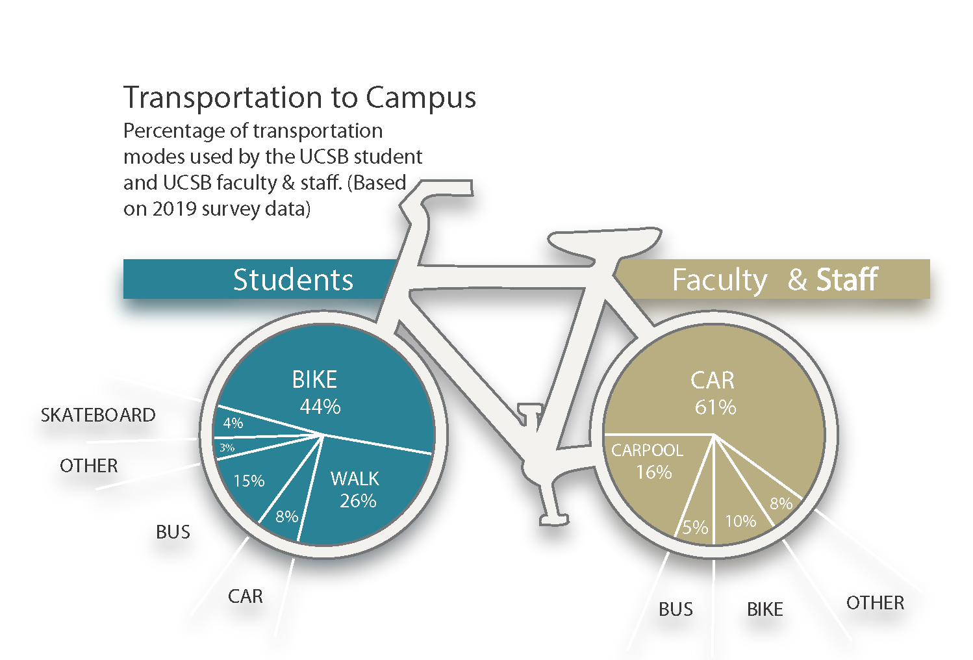
Transportation
7 Miles of class “A” bike paths
Bike Shop and Bike Committee
Electric Vehicle Stations
Bus Passes

Slide 15


Student Organizations
Over 45 student environmental/sustainability organizations at UCSB!
Wide variety of organization cultures and campaign goals to choose from

Slide 16

Student Organizations
Advocacy Groups
  California Student Public Interest Research Group (CalPIRG)
  Isla Vista Surfrider Foundation
Volunteer Groups
  Community Affairs Board
  Isla Vista Adopt-A-Block
Professional Associations
  United States Green Building Council (USGBC) Student Chapter
    LEED Labs class

Slide 17
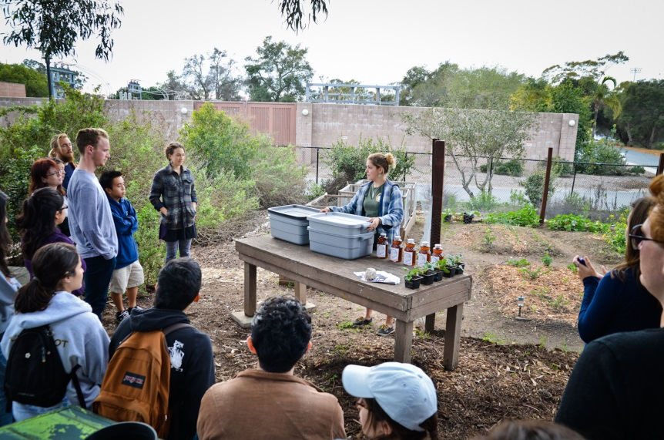
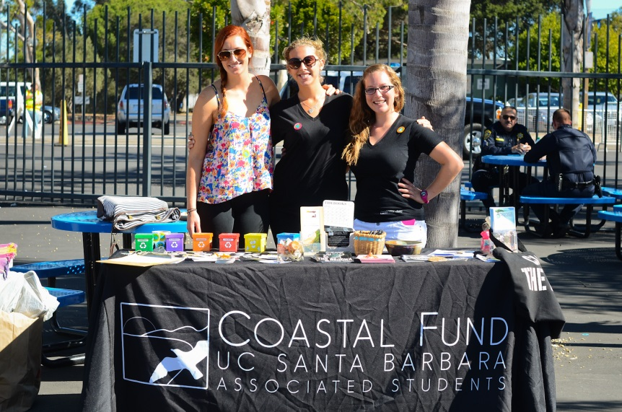
Student Organizations
Campus Sustainability
  Associated Students Recycling
  LabRATS & PACES, Green Lab & office Certification
  Associated Students Bike comm & Shop
Philanthropy
  The Green Initiative Fund
  Coastal Fund
  Renewable Energy Initiative
Food/Waste/climate
  Greenhouse and Garden Project
  Associated Students Food Bank
  Fossil free
  Zero Waste Committee
  Food Cycling
Environmental Justice
  Associated Students Human Rights Board
  Educating Leaders for the Future
  (a partnership with the Early Academic Outreach Program)

Slide 18
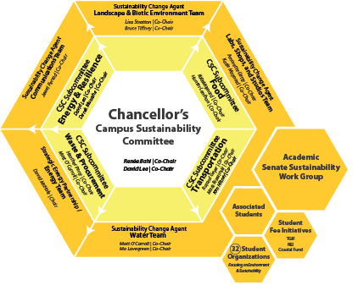
Chancellor’s Sustainability Committee

Slide 19
Be a Change Agent!
Participate on committees which develop and implement sustainability plans for the campus
Meetings every 3-4 weeks
Opportunity to engage with campus stakeholders without a large time commitment
Chance to influence campus policy

Slide 20
Take a Class!
47% of academic departments on campus offer at least one course related to sustainability. Professors have access to the New Leaf Grant Program to help infuse sustainability concepts into courses across all disciplines.
Some cool courses:
  Films of the Natural and Human Environment (FILM ST 83)
  Living with Global Warming (GEOG 8)
  Introduction to Architecture and the Environment (ARTHI 5A)
  Introduction to Global Studies: Politics and Economics (GLOBAL 2)
  Building Sustainable Communities (ES 116)
  Small-Scale Food Production (ES 166FP)
  World Agriculture, Food, and Population (ANTH 149)

Slide 21
Become an Intern!
UCSB Sustainability Interns
Health & Wellness Internship Program
Dining Commons Internship Program
The Interactive Campus Map
Service Learning Program
Sustainable Research
Educating Future Leaders Program
Gaucho Certified Farmers Market
Communications & Outreach
LabRATS
And many more!
Notes:
The Sustainability Internship Program, based in the Department of Geography, offers students opportunities to gain experience in sustainability projects and make a difference on campus as well as in the local community. These include paid, academic credit, and volunteer-based internships and volunteer activities. The program also serves as a resource center for finding internships with other campus offices and off campus programs related to sustainability. The staff is very dedicated to helping each student find an opportunity best suited to them.

Slide 22
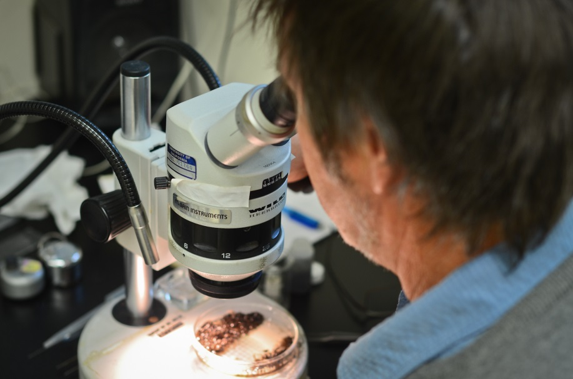
Research
UC Santa Barbara has a reputation for having a strong undergraduate research program
45% of departments at UC Santa Barbara have at least one faculty who does research on sustainability
Funding is available through the Undergraduate Research and Creative Activities Program
  https://www.sustainability.ucsb.edu/get-involved-students

Slide 23
Thank you
For more information on programs, internships, and other ways to get involved with campus sustainability, please visit us at:
www.sustainability.ucsb.edu

