Slide 1
Human Resources
Sustainability & Climate Action Plan
Composed and Presented
By PACES
March 2016

Slide 2

Overview
This presentation illustrates the findings from the assessment that PACES (Program for the Assessment and Certification for the Environment and Sustainability) Program completed and includes recommendations for future action.

Slide 3
Energy and Atmosphere

Slide 4
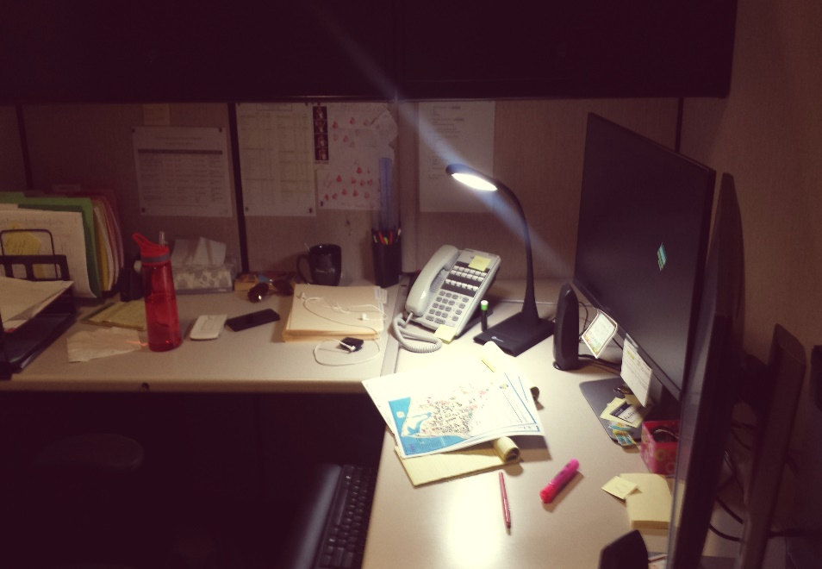
Natural Light & Task Lamps
Mix of overhead and natural lighting
We encourage the use of task lamps to mitigate the use of overhead lighting and centralize lighting
Signage for lighting conservation was found in offices and PACES congratulates your department in promoting better energy practices

Slide 5
Electronic Equipment
Your department makes great use of centralized printers
Unplug electronic equipment when not in use
  Power strips are a great tool for efficiently turning equipment on and off, as long as they are placed in easily accessible areas

Slide 6
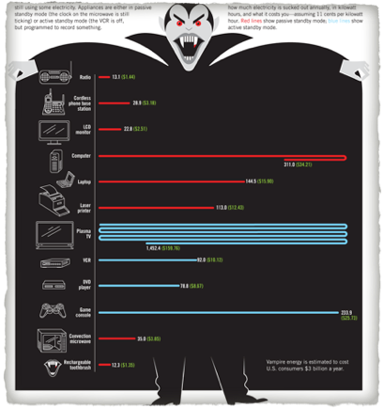
Electronic Equipment
DID You Know??
  Known as “vampire plugs,” electronic equipment plugs can consume energy even when turned off.
  A cell phone charger can consume 0.26 watts when not in use while computer chargers can consume 66 watts!

Slide 7
Communications and Training

Slide 8
Communication & Training
Many occupants have never received any training or education regarding environmental sustainability
Discuss sustainability during meetings and via e-mail
Solicit feedback from staff, students, and faculty in your department about sustainability policies

Slide 9
Communication & Training
Encourage employees to play an active role in helping department reduce impact on the environment
Increase knowledge of where materials can be recycled - Signage

Slide 10
Communication & Training
Department Sustainability Plan
    Invite PACES to help facilitate a more in-depth departmental discussion on how to collectively practice sustainability – training
    Set realistic goals for the next quarter, year, and decade with timelines
    Consider communicating the department’s sustainability goals to the team planning the departmental renovation
Resources
PACES can gladly give a presentation on specific sustainability topics to the staff

Slide 11
Indoor Environmental Quality

Slide 12

Invest
  Reduce exposure to toxic chemicals like bleach and ammonia that can cause skin irritation
  Make sure the cleaning chemical is Green Seal certified to avoid potential green washing
  Clear out chemical cabinet of
  chemicals no longer needed

Slide 13
Invest
Use Environmentally friendly cleaning solutions in office spaces (such as Green Star Spray)
  volatile organic compounds (VOCs) are the substances that vaporize at room temperature and can cause a variety of health issues from eye and nose irrigation to cancer.
  Often found in paints, cleaning supplies, pesticides, office equipment (ex copiers and printers), etc.
  Instead of bleach, use Suprox-D, Oxivir tb, Oxivir Five 16, and Quat-64 (companies: Hillyard, Diversey or Buckeye International)

Slide 14
Invest
  Resources:
    Green Star cleaning spray is available for free from Facilities
    These bottles can be
    refilled by request,
    Contact Byron Sandoval
    (805) 893-2661 x2407
    byron.sandoval@pf.ucsb.edu

Slide 15
Knowing What to Look for in Purchasing Sustainable Products
Many companies have found that sustainability sells and are branding their products as sustainable even if they do not meet core criteria (“greenwashing”).
Some issues to look for include:
Trade-offs. Is the green label focusing on one specific topic and not taking into account other significant concerns?
Lack of third party certification (verification from an organization that does not have personal commercial interests).
Vagueness. Some companies use terms like “all natural” which tells the consumer very little. Did you know that arsenic is all natural?
Irrelevant Labels. Have you noticed “fat-free” appearing on candies? This can give the impression that a high sugar candy is still good for you.

Slide 16
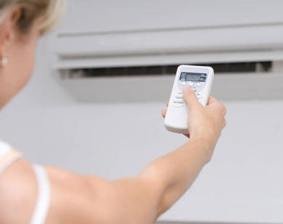
Thermal Conditions
  Temperature comfort impacts employee productivity and satisfaction
  Regularly communicate temperature needs to Facilities Management
  Ensure that personal heaters and fans are less than 500W

Slide 17
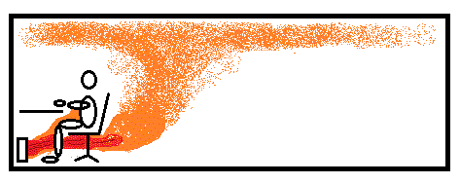
Personal Heaters
PACES discourages the use of ceramic space heaters or any personal space heaters that use convection (i.e. hot coil and fan). These are the greatest energy user and fire hazard.

Slide 18
Personal Heaters
A better option is the circulating oil type heater
  This works as a true radiators

Slide 19


Computer Energy Settings
Set energy savings settings as the default when establishing computers for new employees
Avoid using “screen savers” these actually waste energy instead of saving it.
Consider using Google Black (blackl.com) and having a dark background image for your desktop.

Slide 20
Computer Energy Savings
  PACES recommends that staff set their computers to move go to either hibernate or sleep mode after 10-15 minutes of inactivity.

Slide 21
Ergonomics
Information on stretching should be made available to the department occupants
Staff should participate in stretching exercises and ergonomics
  Partner with UCSB Ergonomics Program to promote stretching exercises and healthy living
  http://www.ehs.ucsb.edu/training
Ergonomically, it is recommended to take a short walk, stretch, or relaxation break every hour

Slide 22
Resources:
Contact the Ergonomics Coordinator for an ergonomic workstation evaluation
  Contact: Julie McAbee
  Phone: (805) 893-3283
  Email:julie.mcabee@ehs.ucsb.edu

Slide 23
Materials and Resources

Slide 24
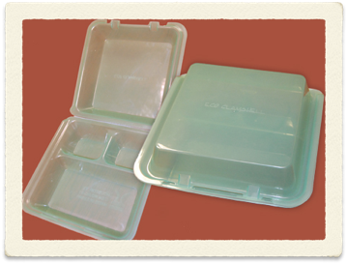
Food Systems
Eco-Clamshell program
  BPA-free reusable clamshell containers
  Purchase at Coral Tree Café and Courtyard Café
  Pay a one time fee of $5 and receive a reusable to-go box
  When you are done, they will swap your container for a sanitized one

Slide 25
Food Systems
Invest in sustainable catering and food options for events
  USDA Certified Organic?
  Local (Within 150-250 miles)?
  Compostable Dishes
IV Food Co-Op (certified caterer) instead of Costco

Slide 26
Recycling
Most occupants expressed that they are unfamiliar with recycling guidelines
Post more consistent signs to inform occupants what materials are recyclable (PACES can provide)
Pair Trash and Recycling Bins
Consider purchasing 100% post-consumer recycled paper

Slide 27
Composting
AS Recycling can provide your department with composting bins and bags
  Three times a week, AS Recycling will remove all HR compost materials
  PACES will request AS Recycling to reserve one composting bin for HR

Slide 28
Resources
Contact AS Recycling to dispose off large amounts of paper waste, such as extra research journals or faculty phone catalogs. It also provides great services for holding events.
  http://recycling.as.ucsb.edu/zero-waste-event-services/
    Email: ucsbrecycling@gmail.com
    Phone: (805) 893-7765
Contact Facilities Management about recycling broken furniture
  Phone: (805) 893-8300

Slide 29
Transportation

Slide 30
TAP program
Promote the TAP program to the staff
  57 hours complimentary campus parking per quarter
  Discounted 30 day MTD bus passes and other monthly transit passes
  Emergency Ride Home Program
  For further information: www.tap.ucsb.edu

Slide 31
ZipCar
An electric vehicle car-sharing service:
three cars on campus
two in Isla Vista
Reserve a car:
for hours or the entire day, online or through your mobile device

Slide 32
Bus
For days that have no planned departures, one can use the MTD bus service
Schedule: http://www.sbmtd.gov/maps-and schedules/index.html).
If off-campus appointments arise, one can use the transit option on the Google Maps Directions Module (https://www.google.com/maps/) to find the most efficient bus route to get to a destination by a certain time.

Slide 33
PACES Scorecard
The PACES Scorecard is a point system to keep track of the department’s practices and to gauge the overall impact of the department.
5 sections:
  Energy and Atmosphere
  Communication and Training
  Indoor Environmental Quality
  Food Systems
  Material and Resources
  Transportation and water
  Bronze 25%, Silver 50%, Gold 75%
  HR earned 47/86 (59%)

Slide 34
Congratulations!
The department of
Business & Financial Services is
Silver
Certified

Slide 35

PACES Assessment Checklist
Next Steps

Slide 36
Thank you
For questions, comments, or inquires, please contact:
Kristyn Payne
Green Office Coordinator
UCSB Sustainability- PACES
kristyn.a.payne@gmail.com
(707) 498-4935

