Slide 1


Sustainability & Climate Action Plan
Composed and Presented
By PACES
May 2016

Slide 2

This presentation illustrates the findings from the assessment that PACES (Program for the Assessment and Certification for the Environment and Sustainability) completed and includes recommendations for future action.

Slide 3
Energy and Atmosphere

Slide 4
Natural & Overhead Light
Mix of overhead and natural lighting
Window tinting and blinds - PACES congratulates your department in promoting better energy practices

Slide 5

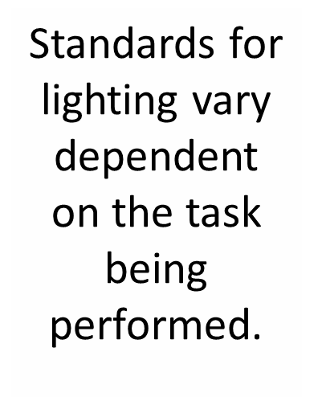
Areas for Improvement
Request to have a more detailed energy audit to ensure spaces are being lit with the proper amount of light.
Task lamps are more energy efficient because they focus the light to where it is needed most.
Delamp areas with ambient lighting

Slide 6
Electronic Equipment
Your department makes great use of centralized printers
Unplug electronic equipment when not in use
Power strips are a great tool for efficiently turning equipment on and off, as long as they are placed in easily accessible areas

Slide 7
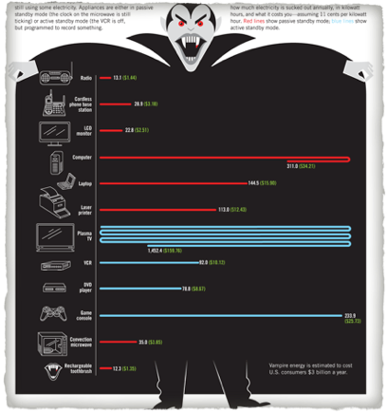
Electronic Equipment
DID You Know??
  Known as “vampire plugs,” electronic equipment plugs can consume energy even when turned off.
  A cell phone charger can consume 0.26 watts when not in use while computer chargers can consume 66 watts!

Slide 8


Computer Energy Settings
Set energy savings settings as the default when establishing computers for new employees
Avoid using “screen savers” these actually waste energy instead of saving it. Instead let your screen hibernate.
Consider using Google Black (blackl.com) and having a dark background image for your desktop.

Slide 9
Communications and Training

Slide 10
Communication & Training
Most occupants have not received training on office sustainability
  Campus waste management resources
Discuss sustainability best practices during meetings and via e-mail
Solicit feedback from staff, students, and faculty in your department about sustainability policies

Slide 11
Communication & Training
Department Sustainability Plan
    Invite PACES to help facilitate a more in-depth departmental discussion on how to collectively practice sustainability – training
    Set realistic goals for the next quarter, year, and decade with timelines
Resources
PACES can gladly give a presentation on specific sustainability topics to the staff

Slide 12
Indoor Environmental Quality

Slide 13
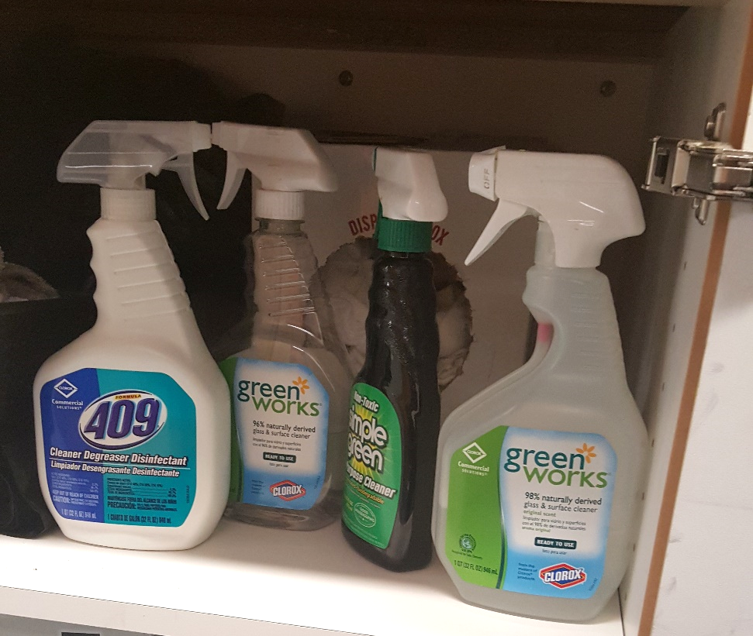
Invest
  Make sure the cleaning chemical is Green Seal certified to avoid potential green washing
  Green Works sets their own standards to ensure that their cleaners are at least 99% natural
    Coming from renewable resources, being biodegradable and free of petrochemicals.

Slide 14
Invest
Use Environmentally friendly cleaning solutions in office spaces (such as Green Star Spray)
  Volatile organic compounds (VOCs) are the substances that vaporize at room temperature and can cause a variety of health issues from eye and nose irritation to cancer.
  Often found in paints, cleaning supplies, pesticides, office equipment (ex copiers and printers), etc.

Slide 15
Invest
  Resources:
    Green Star cleaning spray is available for free from Facilities
    These bottles can be
    refilled by request,
    Contact Byron Sandoval
    (805) 893-2661 x2407
    byron.sandoval@pf.ucsb.edu

Slide 16
Knowing What to Look for in Purchasing Sustainable Products
Many companies have found that sustainability sells and are branding their products as sustainable even if they do not meet core criteria (“greenwashing”).
Some issues to look for include:
Trade-offs. Is the green label focusing on one specific topic and not taking into account other significant concerns?
Lack of third party certification (verification from an organization that does not have personal commercial interests).
Vagueness. Some companies use terms like “all natural” which tells the consumer very little. Did you know that arsenic is all natural?
Irrelevant Labels. Have you noticed “fat-free” appearing on candies? This can give the impression that a high sugar candy is still good for you.

Slide 17
Ergonomics
PACES congratulates you for working with the Ergonomics Coordinator
Staff should also participate in stretching exercises and ergonomics
  Partner with UCSB Ergonomics Program to promote stretching exercises and healthy living
  http://www.ehs.ucsb.edu/training
Ergonomically, it is recommended to take a short walk, stretch, or relaxation break every hour

Slide 18
Materials and Resources

Slide 19
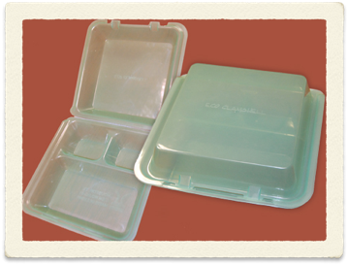
Food Systems
Eco-Clamshell program
  BPA-free reusable clamshell containers
  Purchase at Coral Tree Café and Courtyard Café
  Pay a one time fee of $5 and receive a reusable to-go box
  When you are done, they will swap your container for a sanitized one

Slide 20
Recycling
Occupants expressed that they are familiar with recycling guidelines
Post more consistent signs to inform occupants what electronic materials are recyclable
Pair Trash and Recycling Bins
Consider purchasing 100% post-consumer recycled paper

Slide 21
Transportation

Slide 22
TAP program
Promote the TAP program to the staff
  57 hours complimentary campus parking per quarter
  Discounted 30 day MTD bus passes and other monthly transit passes
  Emergency Ride Home Program
  Staff receive a free account with ZipCar
  For further information: www.tap.ucsb.edu

Slide 23
Overall…

Slide 24
PACES Scorecard
The PACES Scorecard is a point system to keep track of the department’s practices and to gauge the overall impact of the department.
5 sections:
  Energy and Atmosphere
  Communication and Training
  Indoor Environmental Quality
  Food Systems
  Material and Resources
  Transportation and water
  Bronze 25%, Silver 50%, Gold 75%
  Office of the Ombuds earned 62/86 (72%)

Slide 25

Silver Certified

Slide 26

PACES Assessment Checklist
Next Steps

Slide 27
Thank you
For questions, comments, or inquires, please contact:
Ashley Stewart
Green Office Coordinator
UCSB Sustainability- PACES
ashley.ng.stewart@gmail.com
(951) 440-4719
Or
Kristyn Payne
Green Office Coordinator
UCSB Sustainability- PACES
kristyn.a.payne@gmail.com
(707) 498-4935

