Slide 1
Sedgwick Reserve Sustainability & Climate Action Assessment Results
Composed and Presented
By PACES
April 2016

Slide 2
Overview
This presentation illustrates the findings from the assessment that PACES (Program for the Assessment and Certification for the Environment and Sustainability) Program completed and includes recommendations for future action.

Slide 3
Energy and Atmosphere

Slide 4
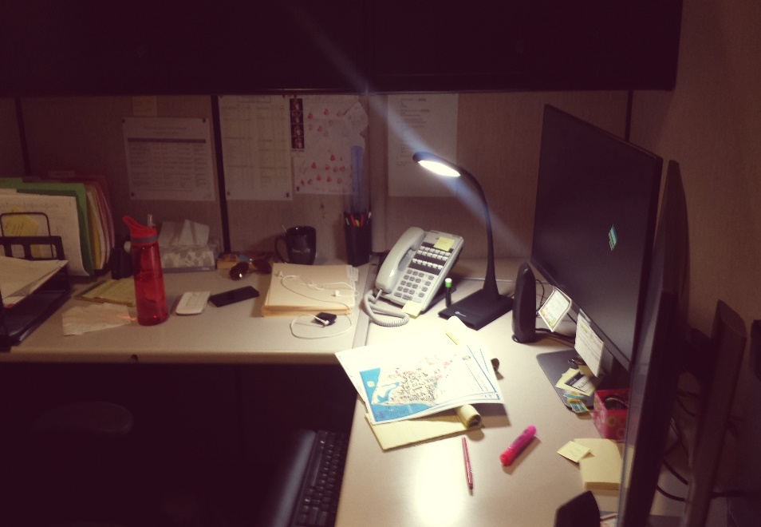
Natural Light & Task Lamps
Mix of overhead and natural lighting
We appreciate the use of task lamps to mitigate the use of overhead lighting and centralize lighting
Signage for lighting conservation was found in offices and PACES congratulates your department in promoting better energy practices

Slide 5
Electronic Equipment
Your department makes great use of centralized printers
Unplug electronic equipment when not in use
Power strips are a great tool for efficiently turning equipment on and off, as long as they are placed in easily accessible areas

Slide 6
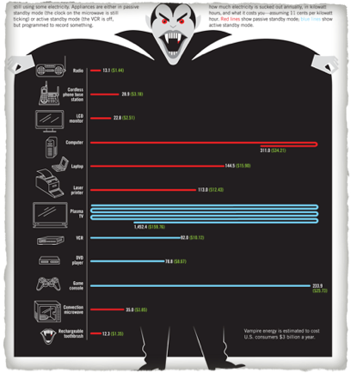
Electronic Equipment
DID You Know??
Known as “vampire plugs,” electronic equipment plugs can consume energy even when turned off.
A cell phone charger can consume 0.26 watts when not in use while computer chargers can consume 66 watts!

Slide 7
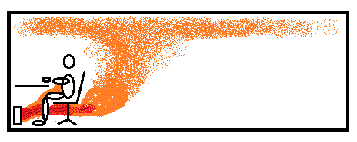
Personal Heaters
PACES discourages the use of ceramic space heaters or any personal space heaters that use convection (i.e. hot coil and fan). These are the greatest energy user and fire hazard.

Slide 8
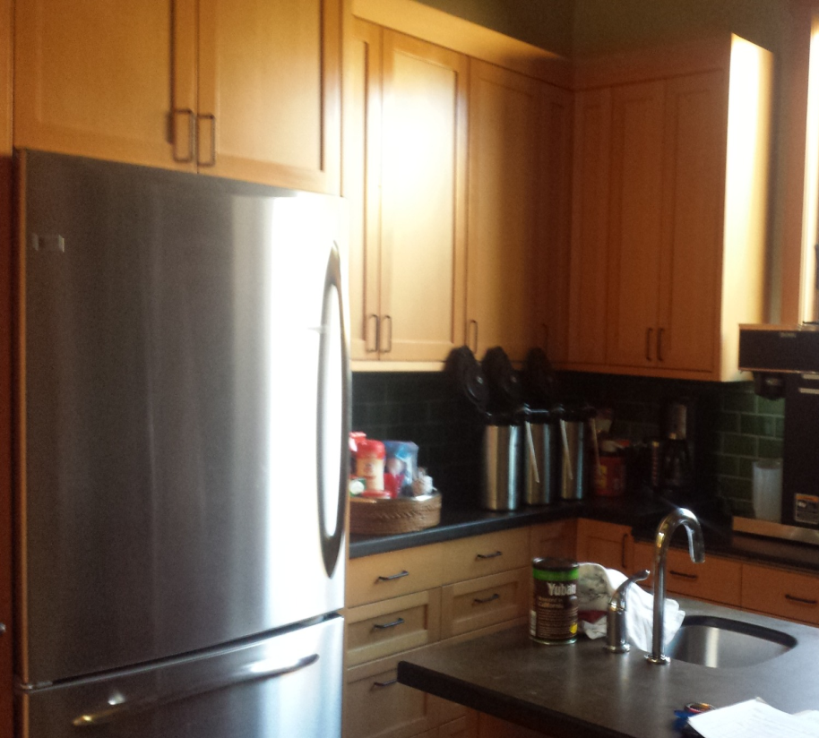
Refrigerators
Energy Star Refrigerator in Kitchen
Be sure to unplug refrigerators not in use
Apartment mini fridge
Garage Fridge

Slide 9
Renovations
Area of Leadership
Contact with multiple sustainability professionals
Sustainable furniture in previous renovations
LEED Gold
UCSB precedent

Slide 10
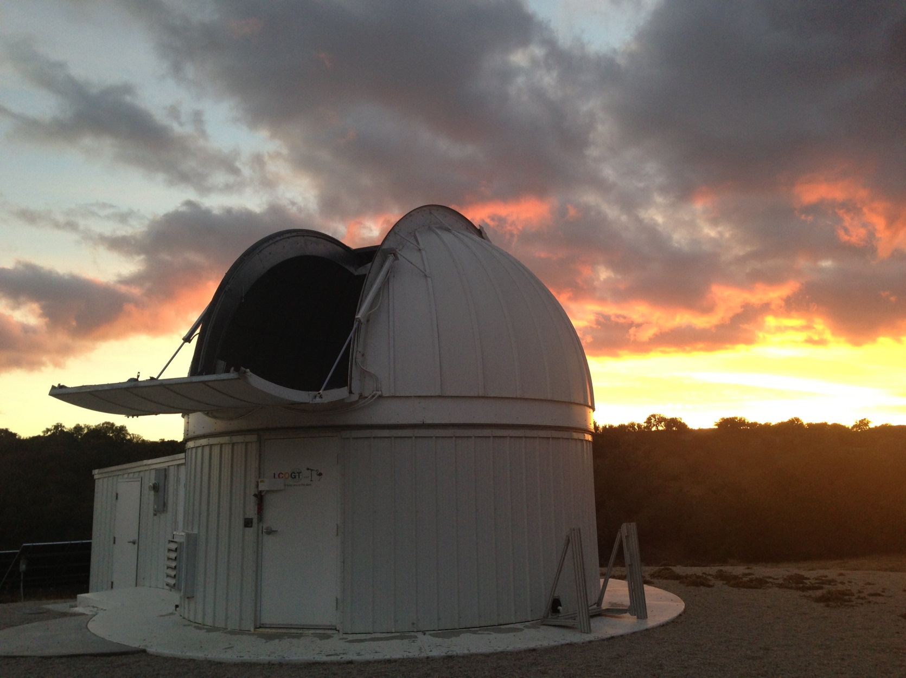
LCOGT Observatory

Slide 11
LCOGT Observatory
Climate Control
Constant Climate Control at 60ᵒ F
even when the dome is open
Meter reading on: March 22: 76,843 Meter reading on April 6: 77,981
= 1138 kilowatt hours in 16 days
More than 2x the monthly energy use of the average CA home

Slide 12
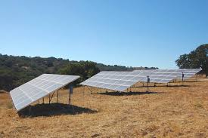
LCOGT Observatory
Recommendations
- Refrain from air conditioning when dome is open
- Add to the PV Grid to offset electrical use

Slide 13
Communications and Training

Slide 14
Communications & Training
Areas of Leadership
Conservation and education facility
Santa Ynez Valley Environmental Watch
Green Building Architect
Facilities Management Plan

Slide 15
Communication & Training
Encourage occupants and employees to play an active role in helping reserve reduce impact on the environment
Provide educational resources to occupants
- Energy Use
- Waste

Slide 16
Indoor Environmental Quality

Slide 17
Invest
Reduce exposure to toxic chemicals like bleach and ammonia that can cause skin irritation
Make sure the cleaning chemical is Green Seal certified to avoid potential green washing
Clear out chemical cabinet of
chemicals no longer needed

Slide 18
Invest
Use Environmentally friendly cleaning solutions in office spaces (such as Green Star Spray)
volatile organic compounds (VOCs) are the substances that vaporize at room temperature and can cause a variety of health issues from eye and nose irrigation to cancer.
Often found in paints, cleaning supplies, pesticides, office equipment (ex copiers and printers), etc.
Instead of bleach, use Suprox-D, Oxivir tb, Oxivir Five 16, and Quat-64 (companies: Hillyard, Diversey or Buckeye International)

Slide 19
Bleach Alternative
Suprox-D
EPA Certified Disinfectant
Cleaning power of peroxide
Bactericidal & Virucidal
Versatile; cleans glass, floors and restrooms.
Neutral pH when diluted properly
Dye-free and fragrance-free

Slide 20
Invest
Resources:
Green Star cleaning spray is available for free from Facilities
We brought some with us today!
Please contact us when empty – See Report

Slide 21
Knowing What to Look for in Purchasing Sustainable Products
Many companies have found that sustainability sells and are branding their products as sustainable even if they do not meet core criteria (“greenwashing”).
Some issues to look for include:
Trade-offs. Is the green label focusing on one specific topic and not taking into account other significant concerns?
Lack of third party certification (verification from an organization that does not have personal commercial interests).
Vagueness. Some companies use terms like “all natural” which tells the consumer very little. Did you know that arsenic is all natural?
Irrelevant Labels. Have you noticed “fat-free” appearing on candies? This can give the impression that a high sugar candy is still good for you.

Slide 22
Ergonomics
Information on stretching should be made available to the department occupants
Staff should participate in stretching exercises and ergonomics
Ergonomically, it is recommended to take a short walk, stretch, or relaxation break every hour

Slide 23
Resources:
Contact the Ergonomics Coordinator for an ergonomic workstation evaluation
Contact: Julie McAbee
Phone: (805) 893-3283
Email:julie.mcabee@ehs.ucsb.edu

Slide 24
Materials and Resources

Slide 25
Food Systems
Invest in sustainable catering and food options for events
USDA Certified Organic?
Local (Within 150-250 miles)?
Seasonal
Compostable Dishes
IV Food Co-Op (certified caterer) instead of Costco

Slide 26
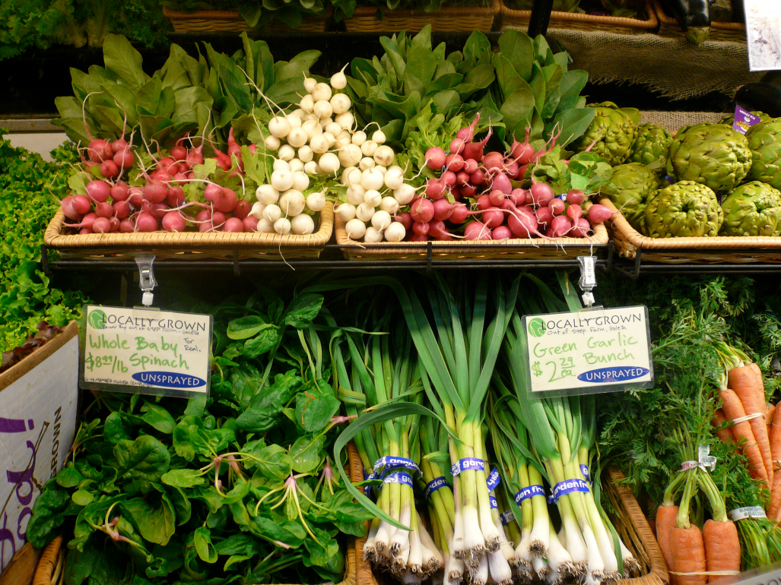
IV Food CO-OP
50 minute drive
Discount for nonprofit and university events
Let them know what you need in advance (2 weeks)
Bulk order
Price Comparable to Costco

Slide 27
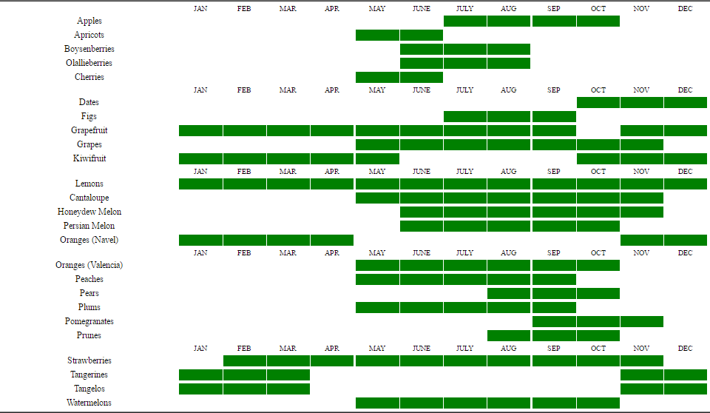
Seasonal

Slide 28
Other Food Options
Strategize between Lassens and Costco
Balance between budget needs and sustainability
What places would you like to see added to the approved caterers list?
Written Sustainable Food Guide specific to the Reserve

Slide 29
Recycling
Post more consistent signs to inform occupants what materials are recyclable (PACES can provide)
Pair Trash and Recycling Bins
Consider purchasing 100% post-consumer recycled paper

Slide 30
Composting
The Need : 45 gallons a month
Contamination
Travel ( annually 0.13 tons of CO₂ )
Landfill (annually 1.56 tons of CO₂ )
Standard Aerobic Composting techniques
Pest Management
Staff Time
Limited types of material

Slide 31
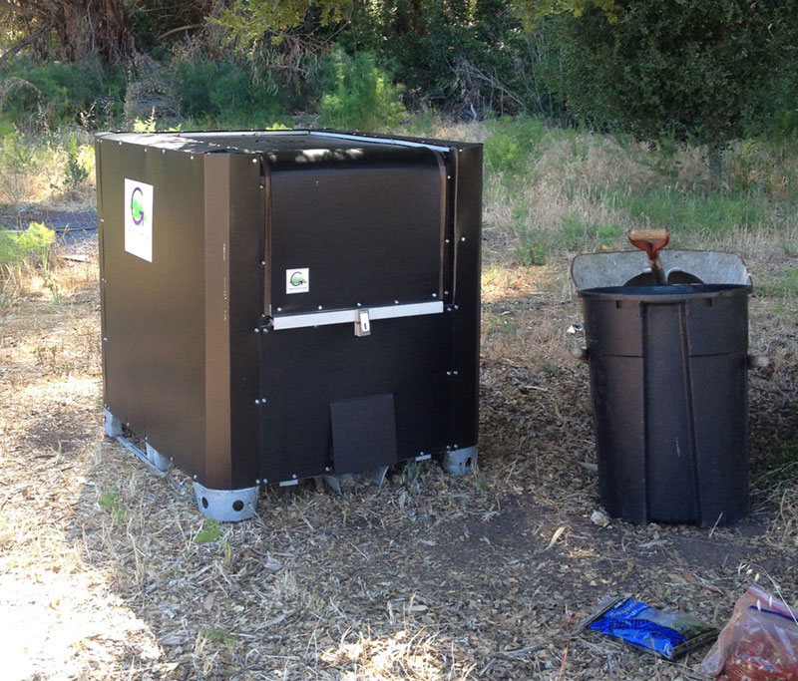
In-Vessel Composting Solutions
GMT Earth Cube
Fully Enclosed
No odor, no pests
285 gallons : 50 lbs/day
Accepts meats, dairy, oils, containers
21 to 30 days in-vessel
Off-Grid : 50 MW PV
Funded by

Slide 32
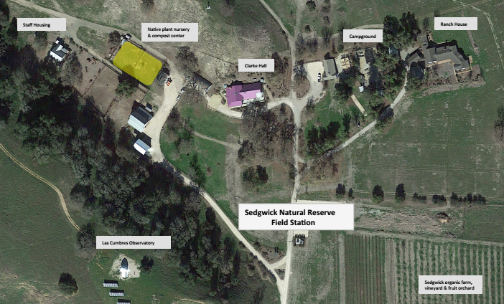

Slide 33
Composting Next Steps
Compost Management Plan
Mandatory: Compostable utensils & containers
Compost bin system
Education for permanent and temporary occupants
Usage plan: nursery, orchard?
Updating policy for other waste types
Student Partnerships
PACES
Environmental Affairs Board
Zero Waste Committee
Facilities Interns
Others

Slide 34
Transportation

Slide 35
ZipCar
Promote Zipcar to day visitors from main campus:
An electric vehicle car-sharing service:
three cars on campus
two in Isla Vista
Reserve a car:
for hours or the entire day, online or through your mobile device. All UCSB Staff & Faculty have no application fee or membership fee

Slide 36
Incentivize Carpooling
Active encouragement and praise for carpooling
Reduce a price
Rewards
Raffle for the carpoolers of the month
Charge a “per car” fee

Slide 37
Congratulations!
The department of
Sedgwick is
Gold
Certified

Slide 38
PACES Assessment Checklist
Next Steps

Slide 39
Thank you
For questions, comments, or inquires, please contact:
Kristyn Payne
Green Office Coordinator
UCSB Sustainability- PACES
kristyn.a.payne@gmail.com
(707) 498-4935

