Slide 1
November 13, 2014
Central Coast Sustainability Summit

Slide 2
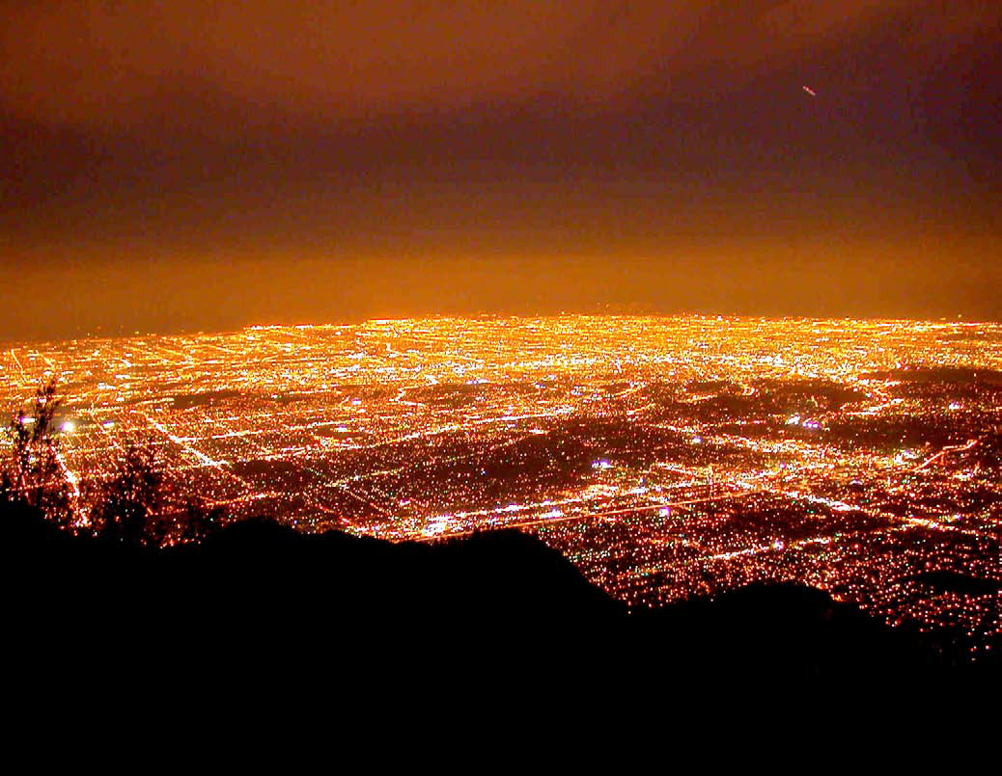
Major Opportunity to Change the World!
Los Angeles, CA (2008-2012)
BEFORE - HPS
Notes:
Kevin to Walk Major Projects
City from Mount Wilson Before & Three Years after City of LA LED Upgrade Project – 2012.

Slide 3
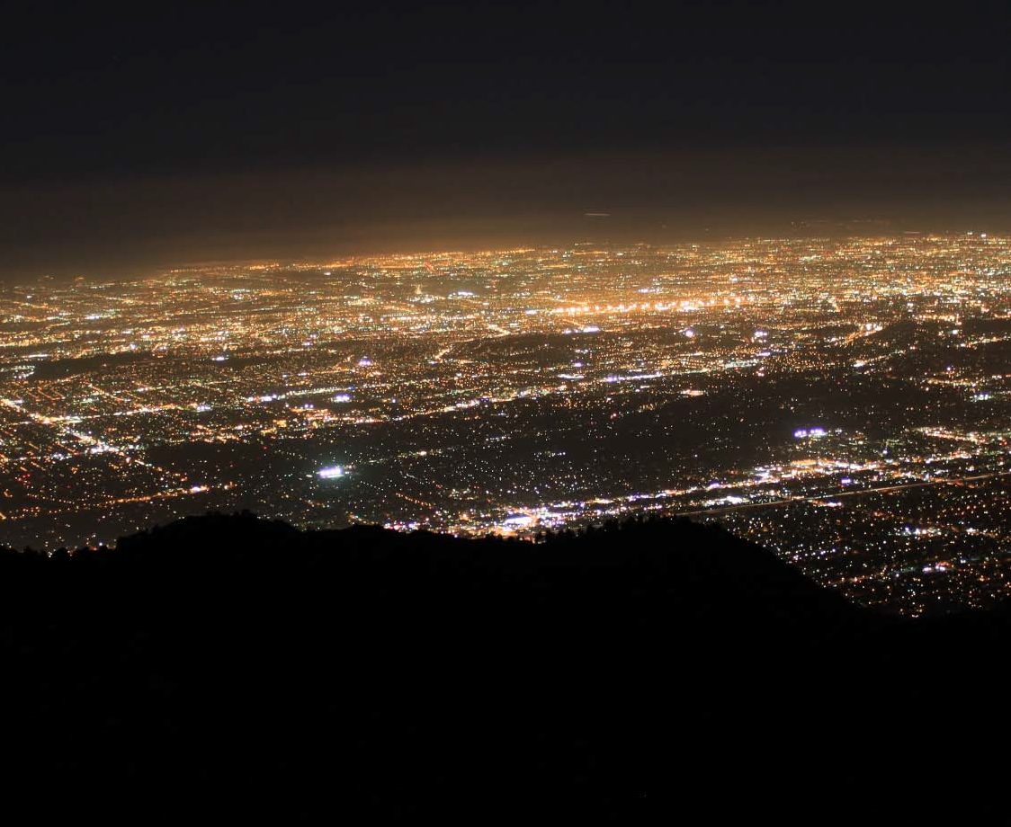
Major Opportunity to Change the World!
Los Angeles, CA (2008-2012)
Notes:
City from Mount Wilson Before & Three Years after City of LA LED Upgrade Project – 2012.

Slide 4
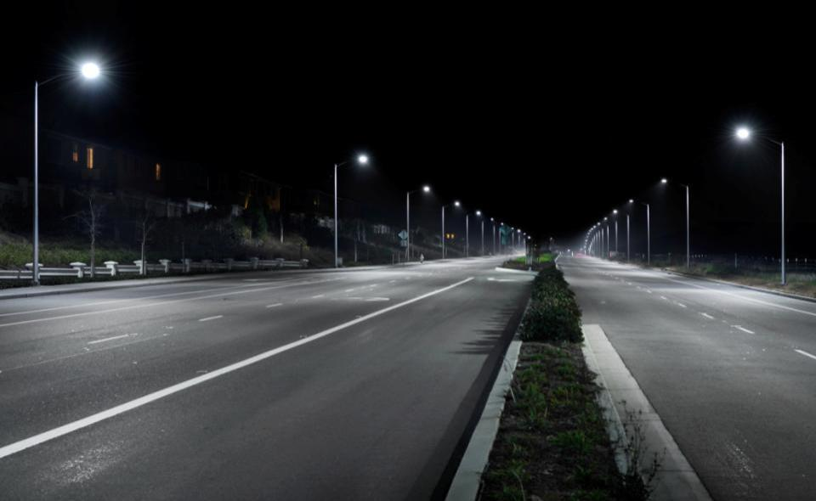
CREE Company Mission and Market Leadership
LEAD THE LED LIGHTING REVOLUTION to obsolete energy-inefficient lighting
Our products are sold in > 80 countries
Greater than 6,000,000 LED luminaires sold
Our Indoor and Outdoor luminaires have surpassed 55 Billion burn hours
Hundreds of Thousands of LED Street Lights Sold and Installed Since 2007
Over 15,000 Cree Roadway Products Sold in Michigan
Over 2,000 Cree Roadway Products Installed by MDOT
© 2014 Cree, Inc. All rights reserved.
4
Notes:
Kevin to Walk Credibility

Slide 5
Cree Company Overview
GLOBAL SCALE
15 global locations
6,100 employees
Headquarters: Durham, NC USA
CREE FACTS
Fiscal 2013 Revenues . . . . . . . . $1.39B
Fiscal 2013 Op. Cash Flow . . . . $285M
June 2013 Cash & Eq . . . . . . . . $1B
Long-term Debt . . . . . . . . . . . . . . . . . . 0
© 2014 Cree, Inc. All rights reserved.
5
Notes:
With over 6,000 employees in 15 locations around the world and a strong balance sheet – Cree provides peace of mind in knowing that you’re working with a financially stable lighting industry leader who is committed to LED lighting adoption.

Slide 6
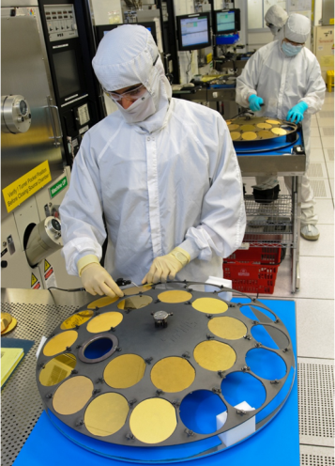
R&D Investments
2010
2011
2012
2013
Note: All totals include exclusively licensed patents
Issued Patents
U.S.
1,100
Non-U.S.
1,980
TOTAL
3,080
Notes:
We continue to reinvest in the development of LED technology. Our issued patents exceed 3,000. Another proof point that Cree is totally focused on LED.

Slide 7
Cree’s History of LED Lighting Leadership
2008
Acquired
LED Lighting Fixtures
(LLF)
2010
Broke 100 LPW for parking fixtures and troffer
2011
Acquired
Ruud Lighting
(BetaLED)
2012
Shortens payback with first $200 LED streetlight
2013
The Biggest Thing
Since the Lightbulb.™
2009
Launched first halogen equivalent LED PAR lamp
2004
First XLamp LEDs brought to market
2006
First lighting class LED components
1987
Cree
founded
’04
’06
’07
’08
’09
’10
’11
’12
’13
’14
1989
Commercialized the first blue LED
2012
Industry Leading 10-Year Warranty
2013
New Luminous troffer
2011
Introduced
next generation LED troffer
2014
Cree Takes Control of Controls
2007
First commercially
viable LED downlight and complete line of exterior products
2008
First LED troffer to surpass fluorescent
2009
Broke
100 LPW
LR6 downlight
1995
Blue LEDs designed into all VW cars
7
Notes:
Proof of the benefits of Cree’s drive toward innovation is our track record of consistent leadership in LED development and performance. Starting with the first blue LED through the first power chips, lighting class LEDs, and record setting efficacy. These improvements make our revolutionary LED Lighting Systems possible, from the first downlight and area light in 2007 to the latest innovations today.
Turning points in history: Key acquisitions of suppliers and customers that brought with it further expertise.
2008 LLF: LED Indoor Fixtures
2011 RUUD Lighting: LED Outdoor Fixtures, Distribution, and customer service
2012: Cree launches an industry leading 10-year warranty
2013: Cree launches the new A19 lightbulb
2014: Cree simplifies controls with SmartCast Technology

Slide 8
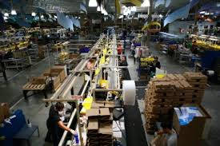
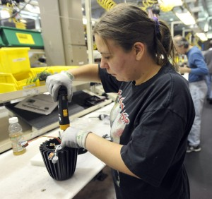
US Manufacturing and Cree Processes
Cree Racine, WI Facility (American Made)
ISO 90001
Internal Quality Auditing for Products, Processes and System
Notes:
Eric to Add Slide Content

Slide 9
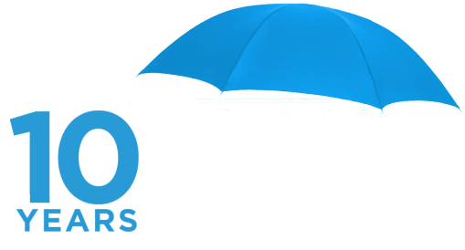
The Cree LED Lighting Difference
25+ years of pioneering innovation and no distractions from other lighting technologies – Cree is completely dedicated to LED lighting
Cree’s vertical integration enables end-to-end development optimization
Our 10-year limited warranty underscores Cree’s commitment to the long-term performance and reliability of our products.
Notes:
Eric-With leading LED research and development, a strong financial balance sheet and some of the industry’s longest-running field LED lighting installations, our10-year limited warranty underscores Cree’s commitment to the long-term performance and reliability of our products. Added to the energy savings LEDs offer over traditional technologies, this warranty is a win-win for everyone.
Cree’s new 10-year warranty covers nearly all Cree globally available commercial-grade indoor and outdoor fixtures. To learn more about products covered under the new warranty, visit http://www.cree.com/lighting/products/warranty.

Slide 10
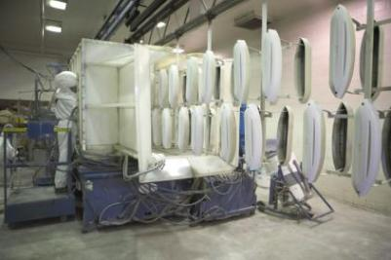
DeltaGuard®
The finest industrial-grade finish available
Industry-leading 10-year warranty features
Six cleaning stages, eight pretreatment stages and an epoxy e-coat before the baked on, ultra-durable powder topcoat is applied
Notes:
DeltaGuard® Finish is the finest industrial-grade finish available, is exclusive to Cree outdoor fixtures and poles, and carries an industry-leading ten-year warranty.
Each outdoor fixture follows an immersion process that includes six cleaning stages, eight pre-treatment states, and an epoxy e-coat before the topcoat is applied.
The baked-on ultra-durable powder topcoat is the last step to a truly outstanding finish that provides ultraviolet-light resistance, corrosion resistance, fade protection and more.

Slide 11
Boston Logan (before)

Slide 12
Boston Logan (during)

Slide 13
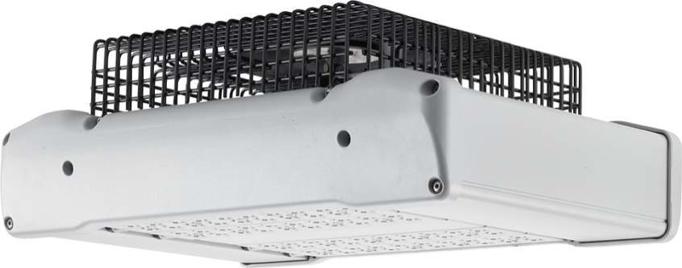
Boston Logan (after)

Slide 14
Healthcare Before (Fresno)

Slide 15
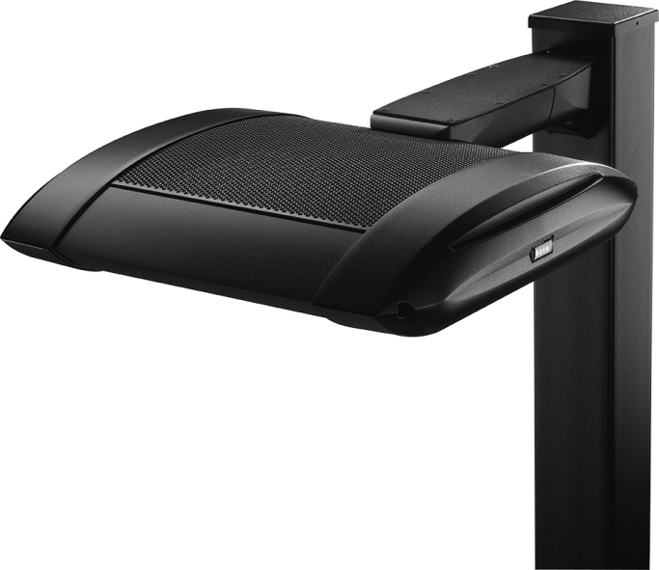
Healthcare after

Slide 16
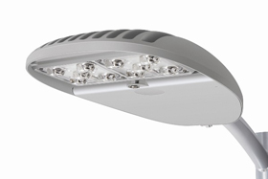
Hollywood Blvd.

Slide 17
Retail Grocery parking lot

Slide 18
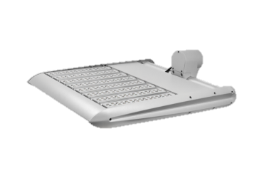
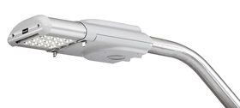
Fort Irwin - Barstow, CA

Slide 19
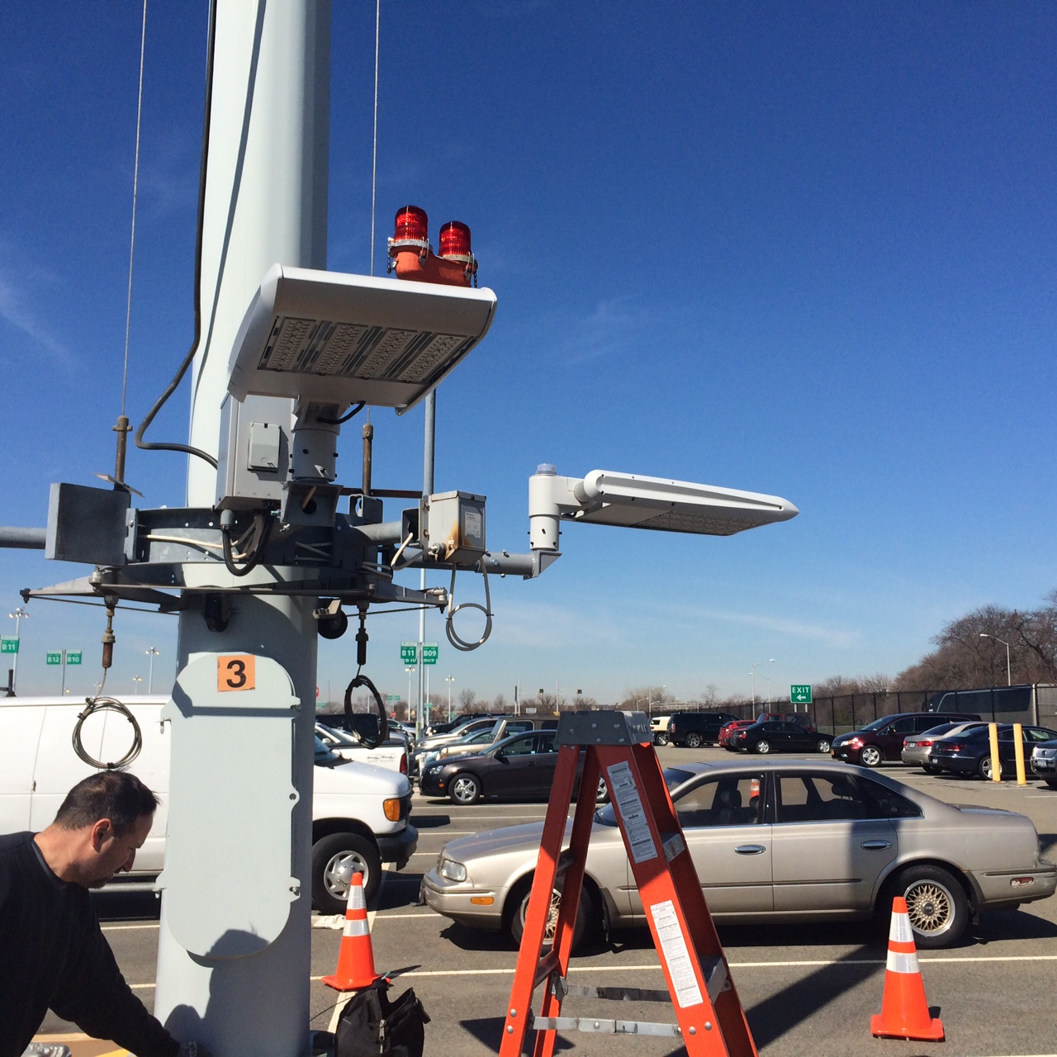
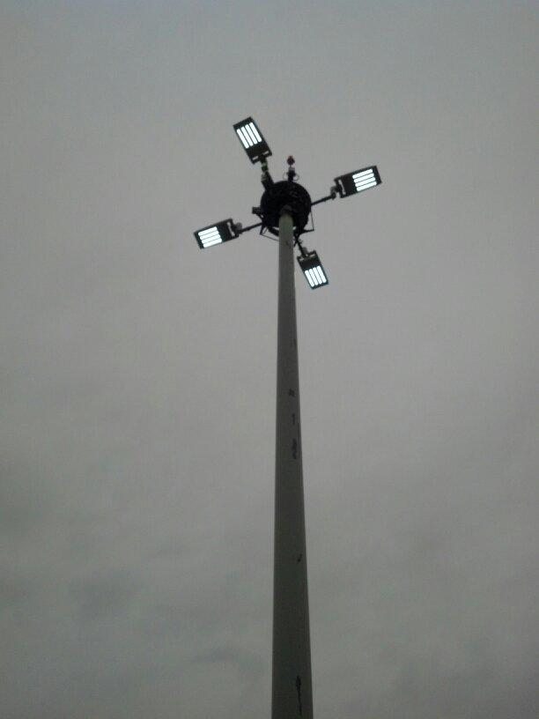
Edge HO High Mast Applications

Slide 20
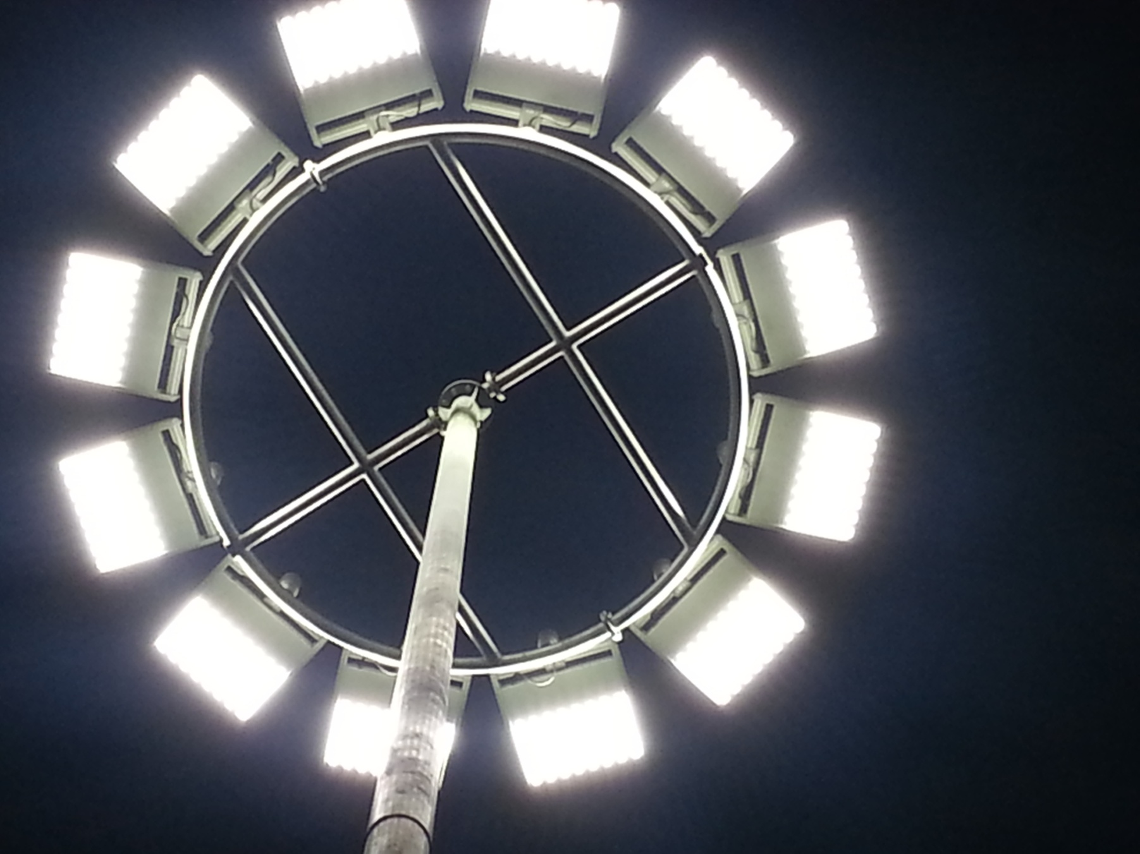
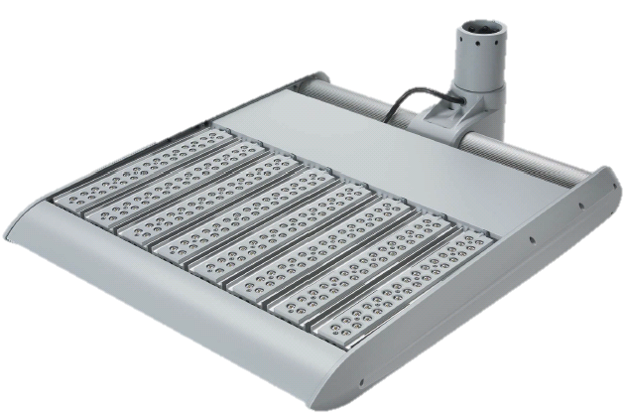
The EDGE HO – High Mast Replacement
Two Sizes / Four Wattages
- 120 LED and 240 LED
- 25,000 to 76,000
Type II, III, IV & V
- UL wet locations
- 10kV surge TVSS
Notes:
Introducing THE EDGE High Output (H.O.) LED luminaire from Cree. Two sizes/four wattages.

Slide 21
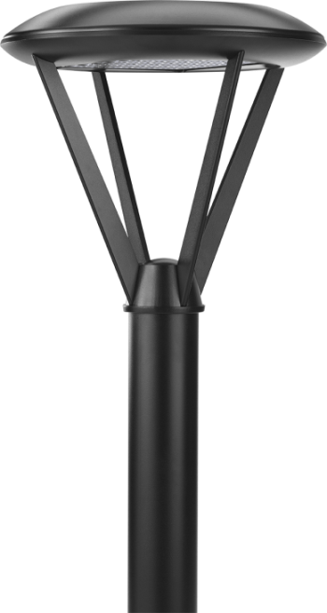
Train Station, Minnesota

Slide 22
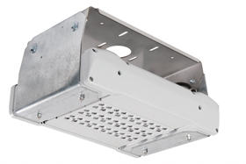
Bridge, Italy

Slide 23
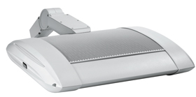

Slide 24
Retail Center on low

Slide 25
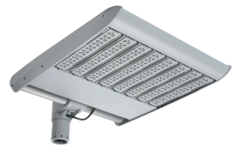
Retail Center - on high

Slide 26
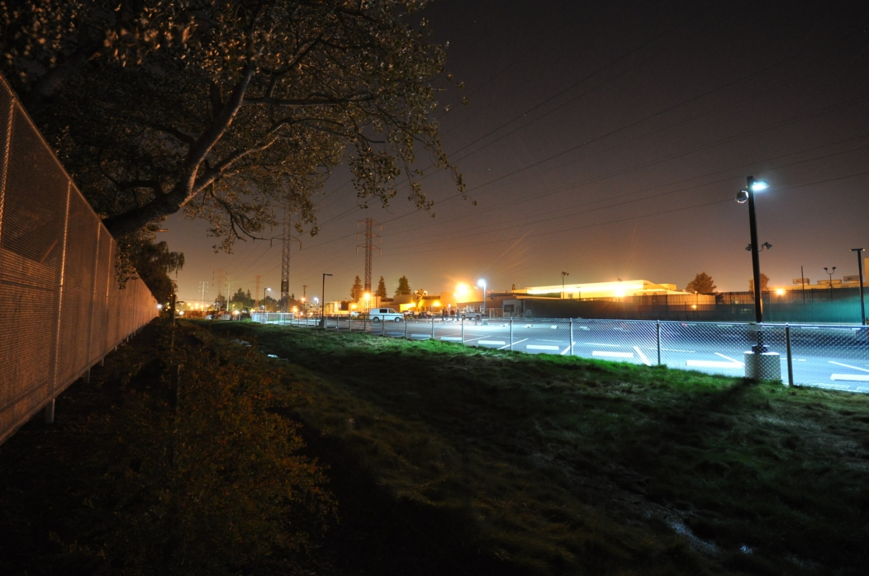
Backlight control…

Slide 27
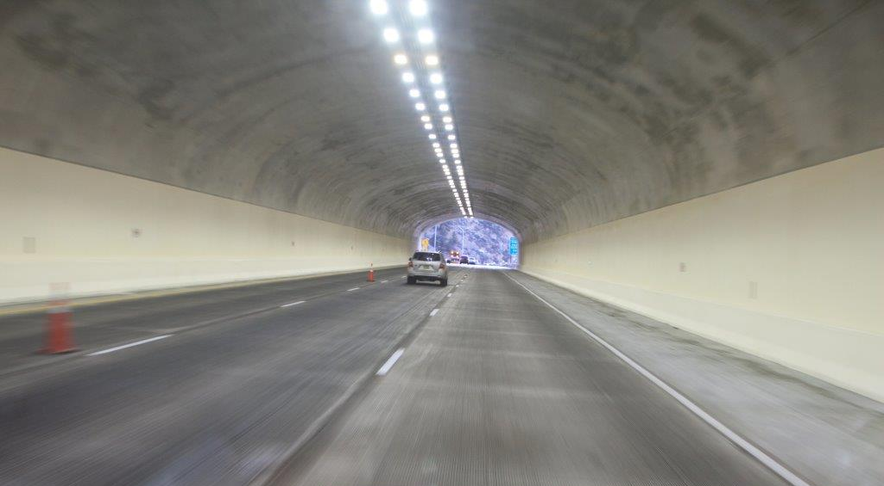
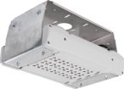
TSP Transportation Mount Tunnel Luminaire

Slide 31
Design to IESNA recommendations
Roadway lighting (ramps, freeways, etc)
Intersection Lighting
Parking lot lighting for Park N Rides
Bike Facility Lighting

Slide 32
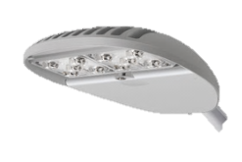
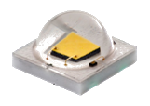
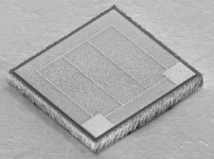
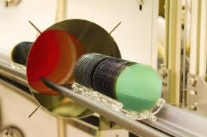
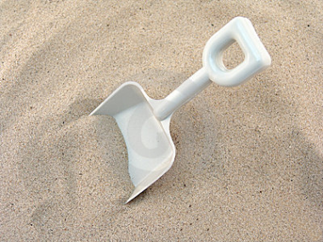
Vertical Integration Has Advantages
Luminaires
Harmonize innovation at all points of development
Optimize the hand-offs, interface points
Eliminate unnecessary time delays and margin stacking
Single point of accountability for end results
Phosphor & Packaging
LED Chips
Wafers
Materials

Slide 33
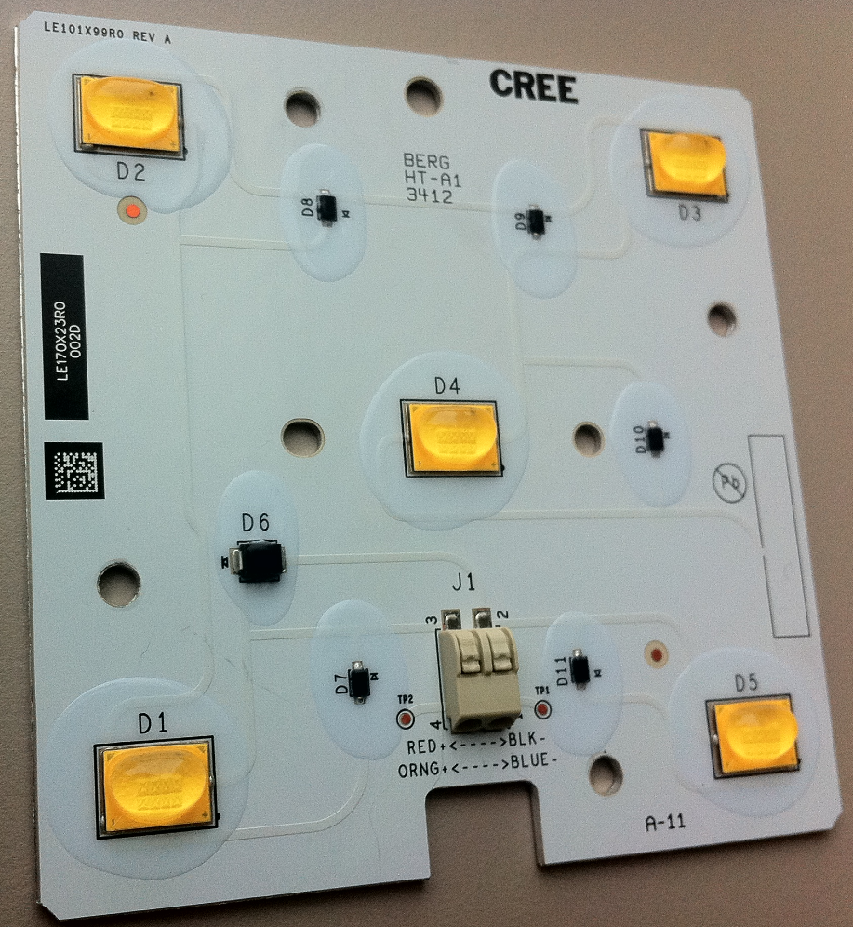
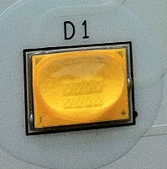
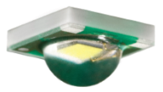
Control of all the Building Blocks
Multiple chips
Custom Asymmetric Primary Optic
Exclusive to Cree Lighting
Cree XSP Custom Array
Optimized Performance
Removes Cost
Leading-edge Technology to Market Faster

Slide 34
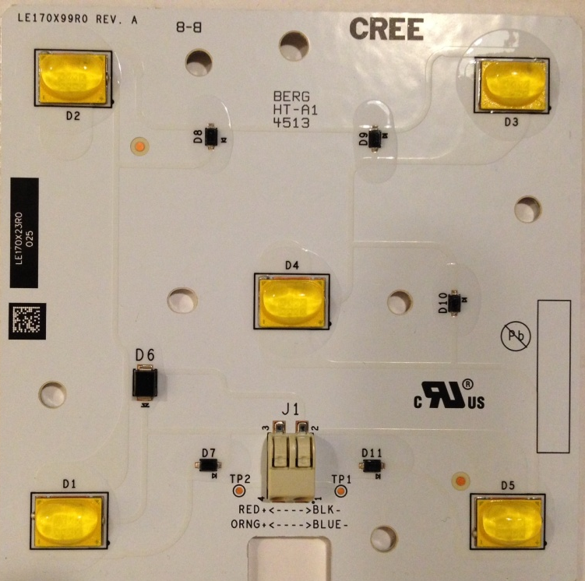
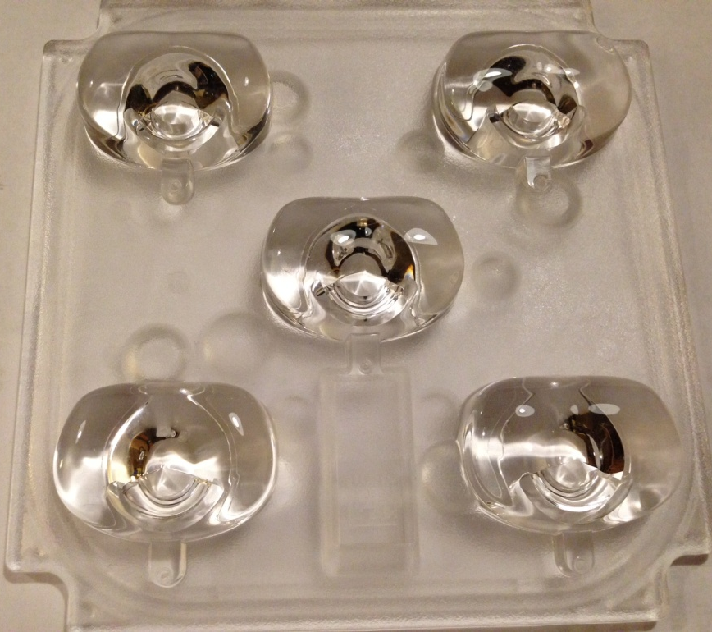
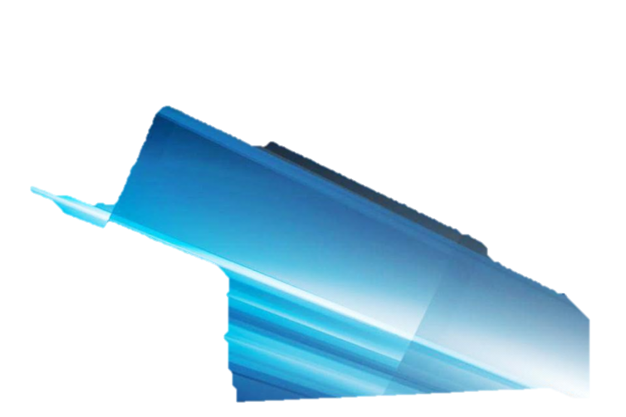
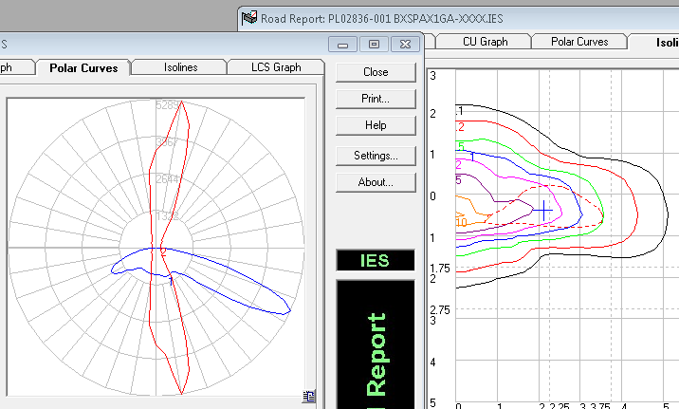
Cree Vertical Integration Advantage in Street Lighting
Notes:
Eric-Cree’s NanoOptic® Technology is best-in-class in the lighting industry.
It gets the light out of the fixture with up to 96% efficiency
Provides increased target efficiency – lighting what you want to be lighted
Available with eyelid technology that provides sharp cutoff on house-side lighting distribution to reduce/eliminate light trespass
Available in multiple lighting distribution types

Slide 35
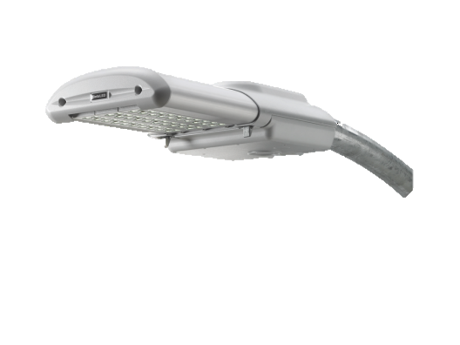
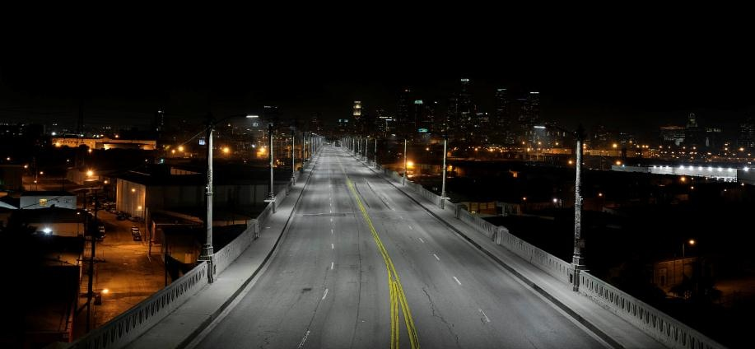
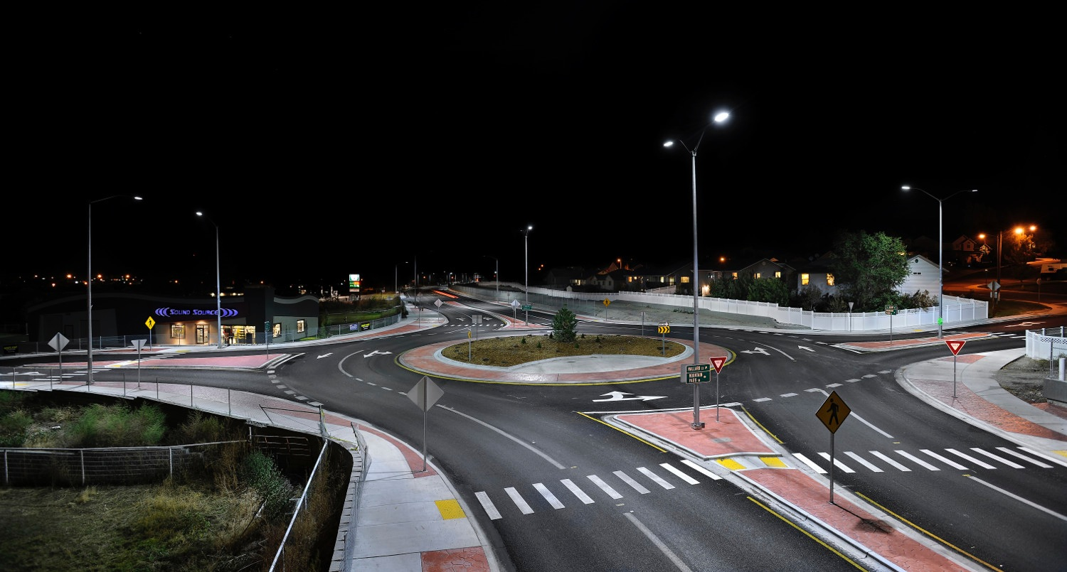
LEDway Series
Notes:
6th Street Bridge - Los Angeles, CA
Chubbuck, ID

Slide 36
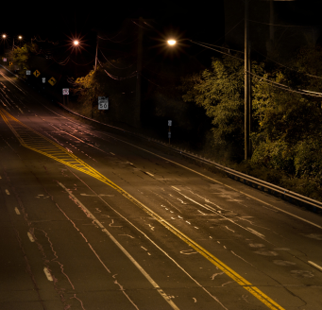
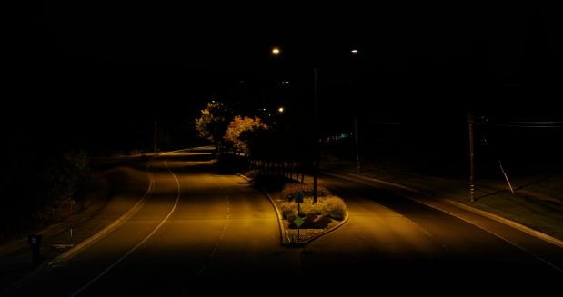
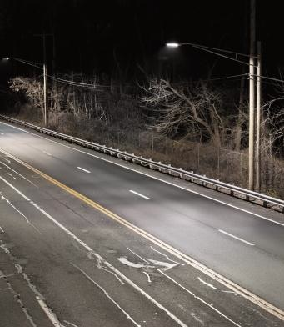
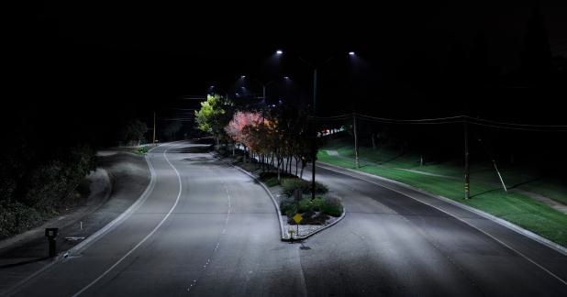
Smithtown, NY
Danville, CA
Before
After

Slide 37
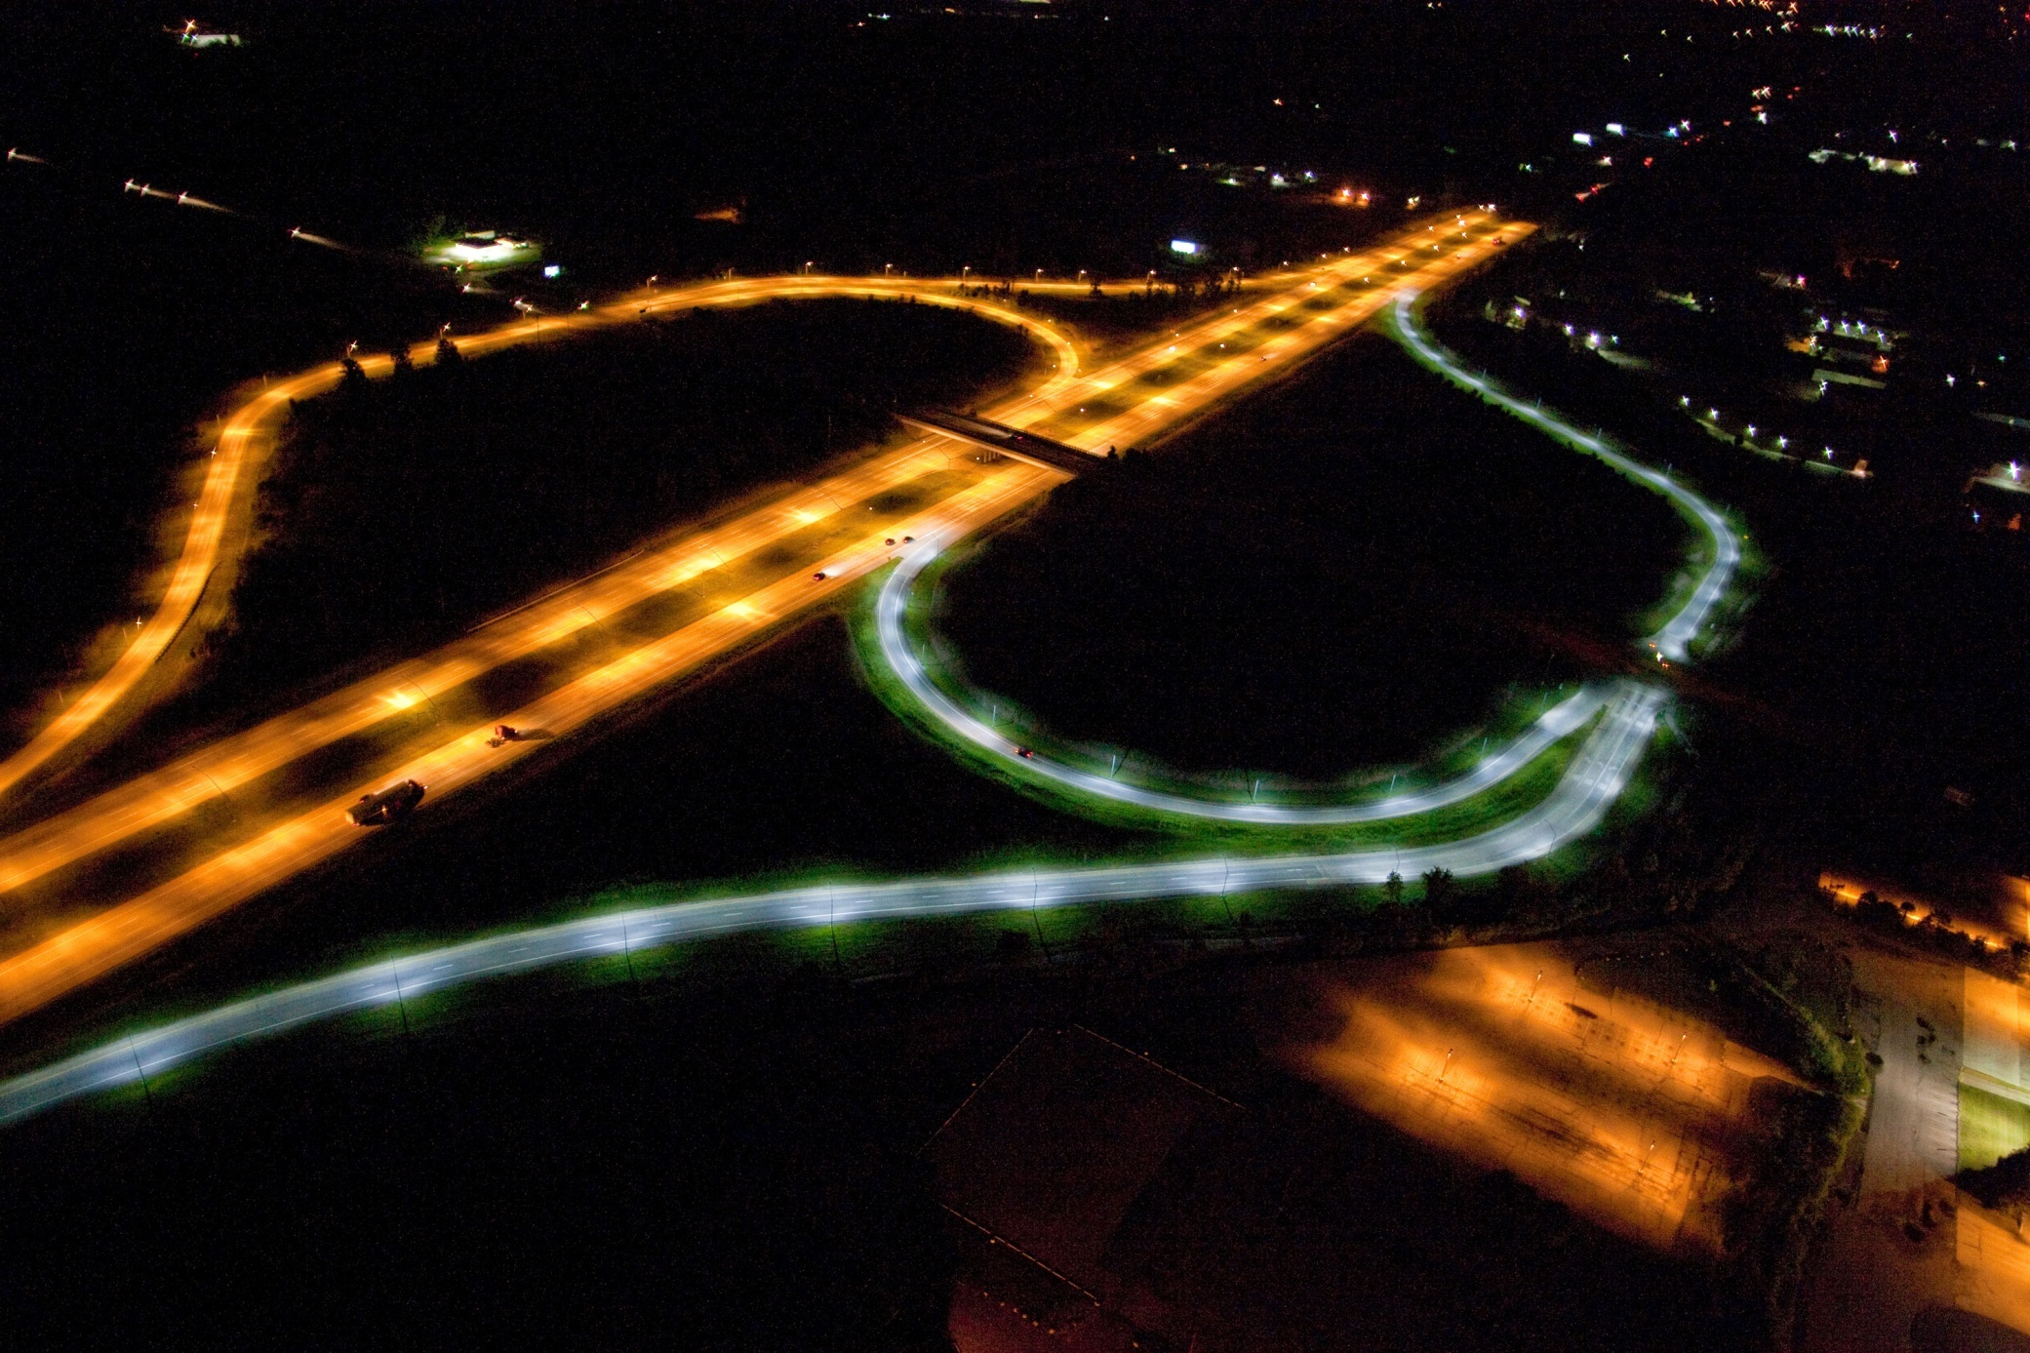
Metro Airport – Eureka Road and I275

Slide 38
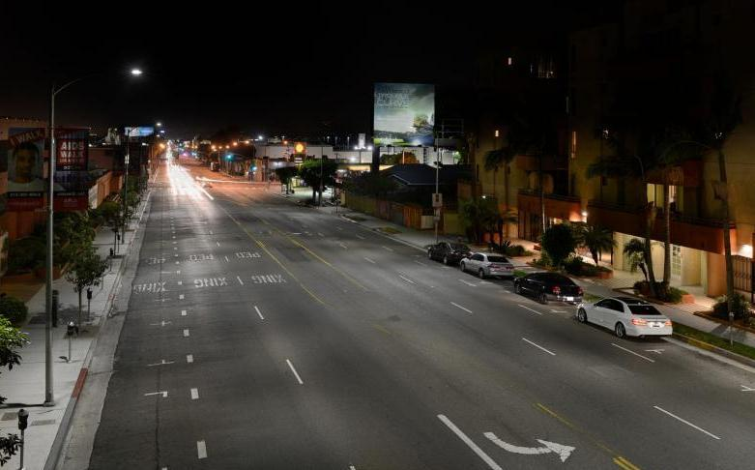
Major Street Lighting Project Partnerships
Anchorage, Alaska First Major US LED Installation
City of Los Angeles, CA 110,000 LEDway and XSP Unit
City of Detroit PLA 12,000 XSP and LEDWay HO Series Units
New York City DOT, NY 2014 contract for 25,000 XSP Units
Cape Light-19 New England Communities 15,000 XSP Series
Portland General Electric, OR 20,000 LEDway and XSP Unit
Pacific Gas and Electric, CA 40,000 XSP Units
Notes:
Kevin to Walk Major Projects

Slide 39
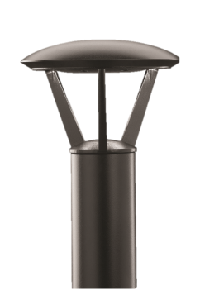
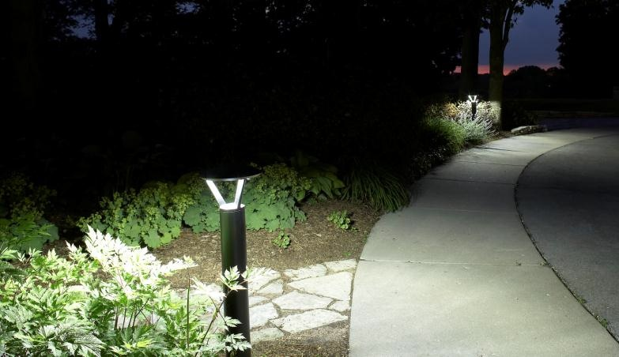
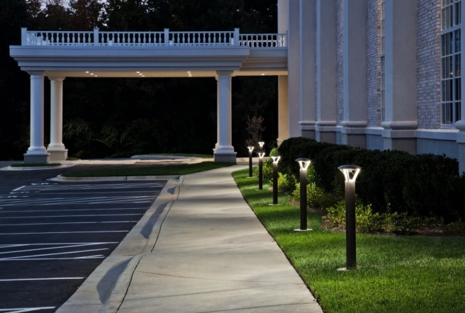
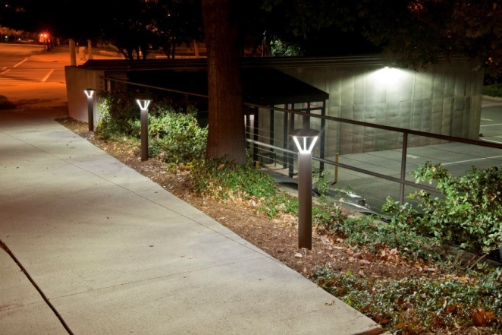
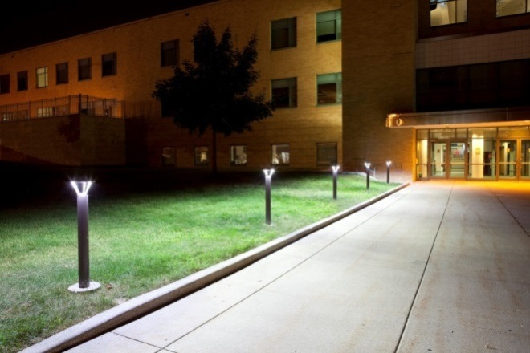
The Edge Pathway
Notes:
24W

Slide 40
Indoors CRI - Comparing Spectral Power Distribution
FLUORESCENT
CREE TRUEWHITE
DAYLIGHT
Mixing LEDs (BSY+R)
Spectral Notching
Phosphor Conversion
METAL HALIDE
INCANDESCENT

Slide 41
200 watts of fluorescent vs 80 watts of CREE True White – which is which?

Slide 42
CR troffers – Car dealerships

Slide 43
High CRI = Vibrant colors…Popping (and it looks better!)

Slide 44
High CRIs for Retail – Visual Acuity

Slide 45
SmartCast™ - “Title 24 in a box”
Classroom:
~ 850 watts of Fluorescent
Vs
264 watts of CREE True White

Slide 46
400w MH replacements for 232 watts or 174 watts… (and Dimming!)

Slide 47
High ceilings (high CRIs) - Dimming

Slide 48
PRICE IS WHAT YOU
PAY…
VALUE IS WHAT YOU
GET.
- WARREN BUFFET
Notes:
Close with a Warren Buffet quote. Price, Performance, Reliability, Color Quality, Warranty (how ever you define warranty) – Nobody provides the Value than Cree.

