Slide 1

Notes:
Introduction

Slide 2
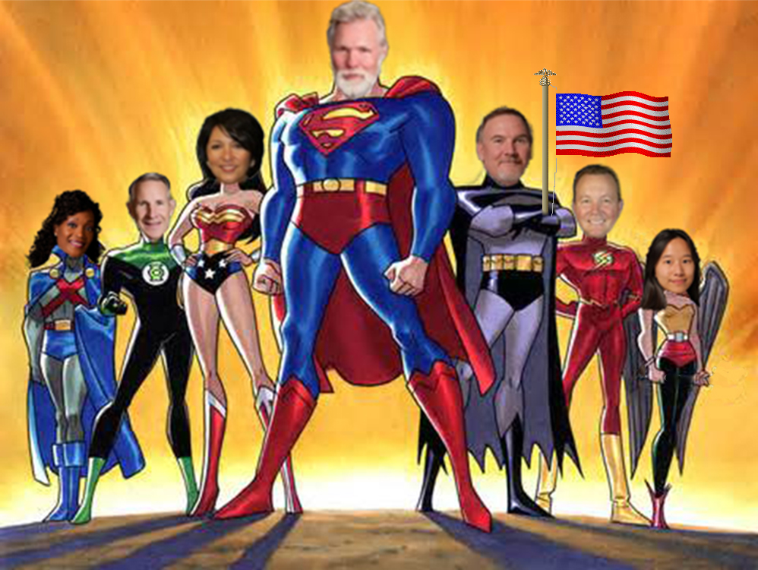
Notes:
Leadership

Slide 3

Notes:
Business Case

Slide 4
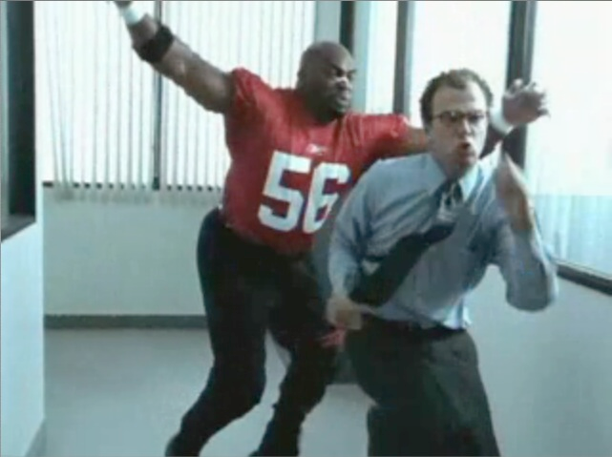
Notes:
Outreach/Blitzing linebacker

Slide 5

Notes:
SCE interaction – what people expect

Slide 6
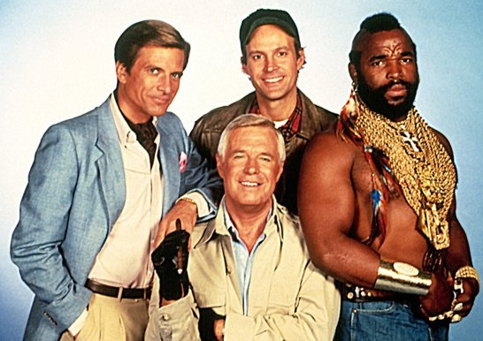
Notes:
SCE interaction – reality is we’re a team

Slide 7

Notes:
It’s all about Choice

