Slide 1
Goleta Water District Conservation is Critical
November 2014

Slide 2
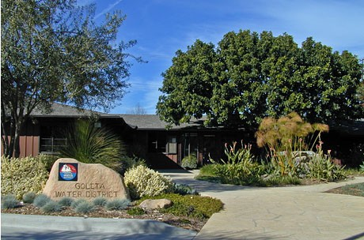
Goleta Water District
Established in 1944
5-member elected Board
Provides water to more than 87,000 people in the Goleta Valley
Complex treatment, distribution, and storage system including 270 miles of pipeline, the Corona Del Mar Water Treatment Plant, 7 active wells, and 8 reservoirs.
Spans approximately 29,000 acres

Slide 3
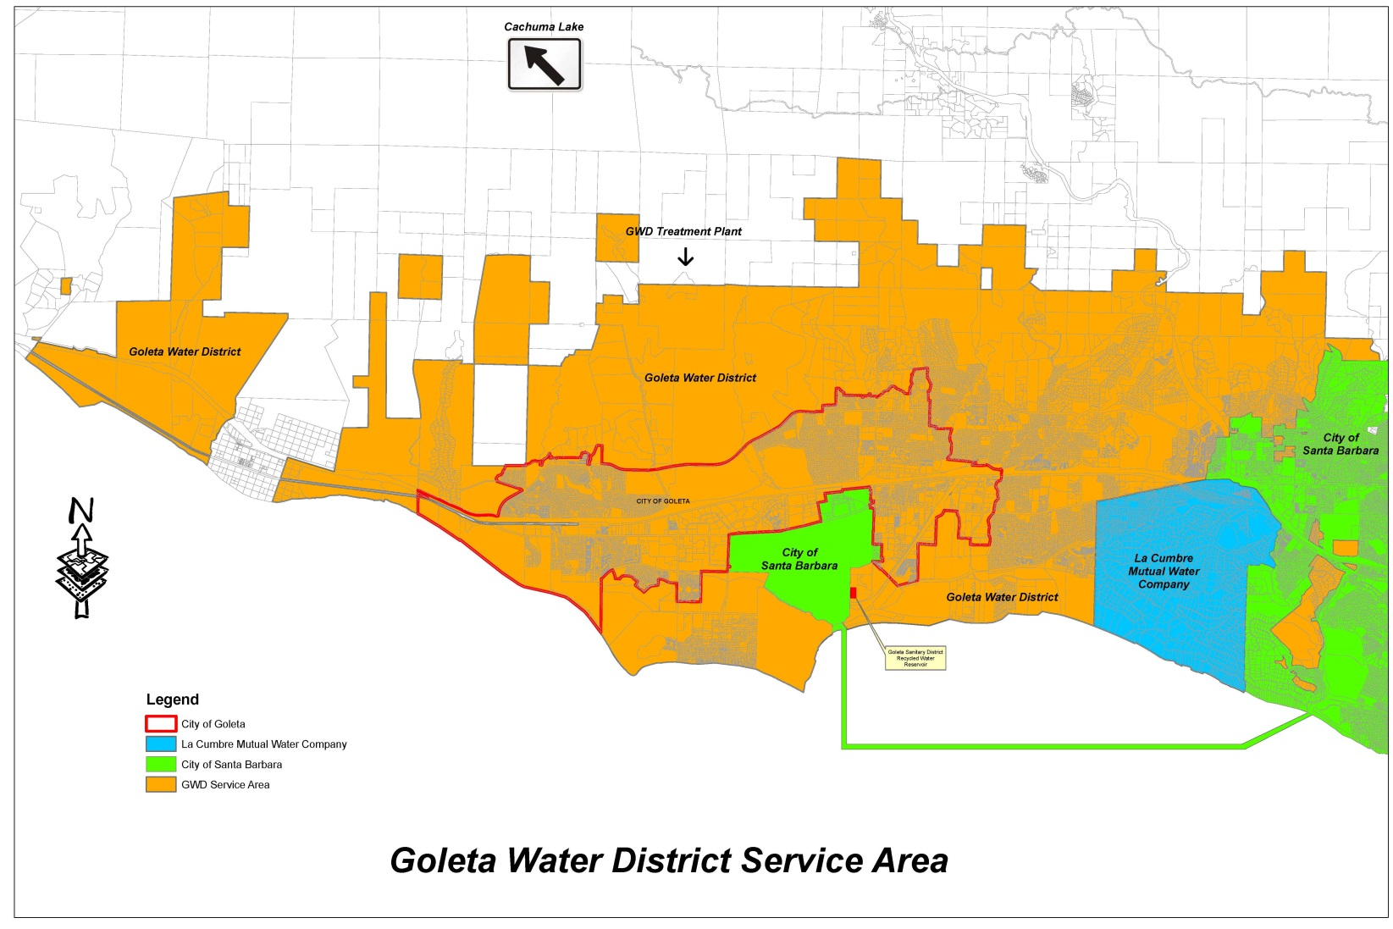
Goleta Water District
Notes:
Our service delivery area spans from the boundary of the City of SB on the East, to El Capitan in the West, from the foothills to the ocean.

Slide 4
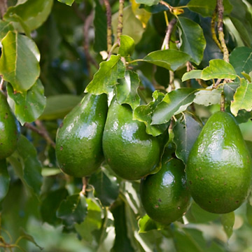
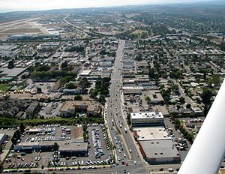
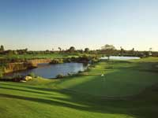
Historic Water Uses in the Goleta Valley
Notes:
Here you can see a breakdown of how water is generally used in the Goleta Valley

Slide 5
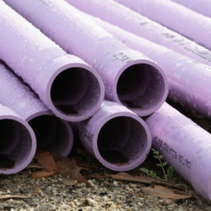
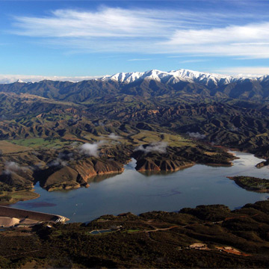
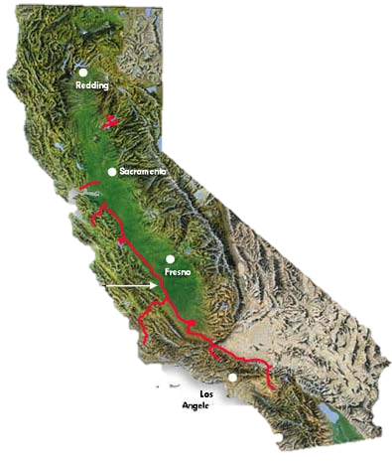
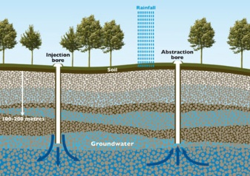
Normal Water Supply Sources*
*Normal Year
Notes:
Snapshot of District water supplies
The District’s water supply portfolio is made comprised of 4 sources: Lake Cachuma, Groundwater, State Water, Recycled Water, and exceeds normal demand which can range from approximately 12,000 AF to 14,000 AF in normal years.
The numbers you see here are normal year supply numbers which can vary in wet or dry years. For example, in the current water year, the District is using approximately 4,000 AF of stored State Water, 3,000 AF of groundwater, and roughly 6,500 AF to meet the higher than normal demand we have seen during this extended dry period. The unused portion of our Cachuma entitlement (almost 3,000 AF) will be available to the District in the next water year.

Slide 6
Diverse Supply Portfolio
Supplies in “normal” years versus drought illustrates adaptability
Notes:
Note difference in years 2013/14 and 2014/15

Slide 7
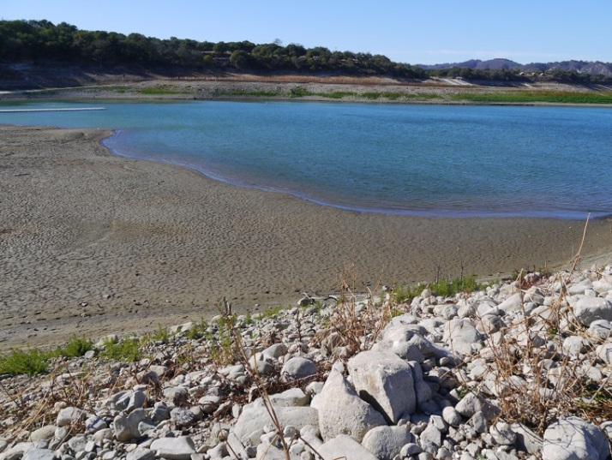
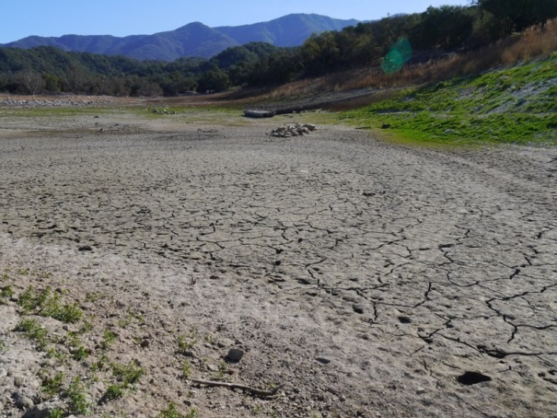
2014 Water Supply Overview
Groundwater
7 wells running
3 wells under rehabilitation
2 new planned wells
State Water
5% allocation for WY 2013-14
100% delivery of banked State Water
Cachuma Reservoir
29% of capacity currently
45% allocation for WY 2014-15
30% allocation for WY 2015-16

Slide 8
Communication Context: A History of Drought

Slide 9
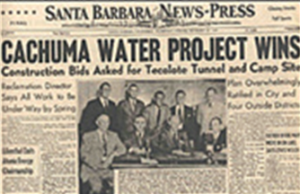
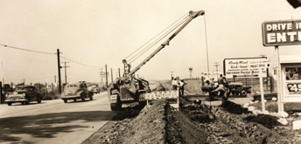
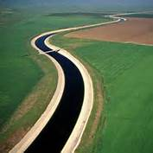
History of GWD Water Supplies
1950s
Tecolote Tunnel
1970’s
Drought
1987-92
Drought
1940
1960
1980
2000
1930
1950
1970
1990
2010
1949
Voter approval of Cachuma Project
1950s & 60s
Vast infrastructure expansion
1991
State Water Project approved by SB County Voters
Notes:
Cachuma project
Tecolote tunnel
Drought of 1970s
Drought of 1980s/90s - Desal
Environmental concerns/fish
State water project
Future / sustainability (groundwater, desal?)

Slide 10
Historical Drought Concerns
1976-1977 Drought
Early water conservation efforts such as cutting back on watering lawns, washing cars, and flushing the toilet, and early ag efficiency projects like drip irrigation techniques.
1980s Water Shortages
Water conservation programs like low-flow shower heads, and landscape efficiency. The District introduced the first low-flow toilet rebate program in the U.S. in 1986.
1990s Drought
Mandatory conservation measures, increased water rates, and increased groundwater pumping. Emergency Pumping Facility at Lake Cachuma.
Notes:
The region’s water policy has also been shaped by a history of Drought. The 1976-77 Drought is credited with launching some of the early water conservation efforts such as cutting back on watering lawns, washing cars, and not flushing the toilet. During the 1980s we see the emergence of conservation programs oriented around low-flow devices. Goleta actually has the historic claim of being the first District to introduce a low flow toilet rebate. Mandatory measures and drought rates were a big part of the drought of the late 80s and early 90s. This history of drought serves as a backdrop to the Wright Judgment, the voter approved S.A.F.E. Water Supply Ordinance and State Water Project, and the Goleta Recycled Water plant.

Slide 11
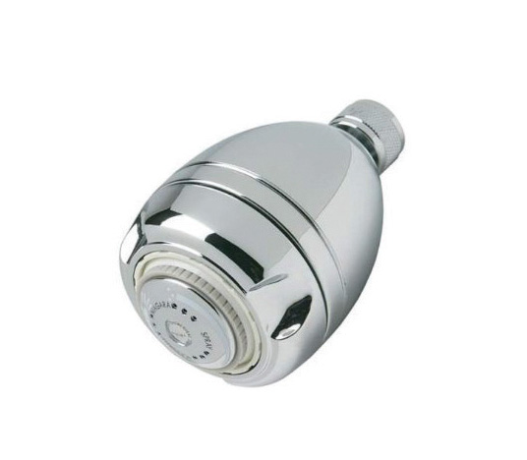
Water Thrifty Customers
Goleta Water District Customers
Residential per capita water use of 64 gallons per day in October, down from 68 gallons per day
High consciousness among customers of the need to conserve water supplies
Wide-spread use of low-flow devices

Slide 12
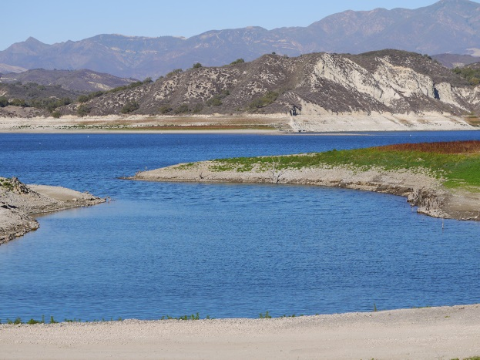
A New Paradigm of Critical Supply Challenges
As agencies plan for future water supply needs there are a number of constraints, many of which we don’t have control over:
Drought
Cost allocation for Cachuma Project between agencies, as well as capital cost allocations including agricultural interests
Environmental concerns on SWP re Monterey Plus Amendments
Steelhead issues
Delta Smelt issues
Capacity fights
Spill water controversies
Notes:
We need to plan for drought (addressing both the current drought, and the potential for future more frequent droughts). There are issues with cost allocation for the Cachuma Project between the agencies, as well as the capital costs for agricultural interests. Environmental issues encompass local steelhead issues, but also Delta issues since we do receive deliveries of State Water. Fights over capacity and who gets what and when, recognizing there are constraints on how much state water can be delivered both due to the limitations of the actual pipeline and the determinations from the State.

Slide 13
2014 Drought Overview
2013 – driest year on record in
California
January 17, 2014 – Governor Brown
declares statewide drought emergency
January 21, 2014 – County of Santa Barbara declares drought emergency
March 11, 2014 – Goleta Water District Board of Directors Declares Stage I Water Shortage and urges customers to conserve 20 %
September 9, 2014 – Goleta Water District Board of Directors Declares Stage II Water Shortage and adopts mandatory water-use restrictions with a targeted 25% District-wide reduction

Slide 14
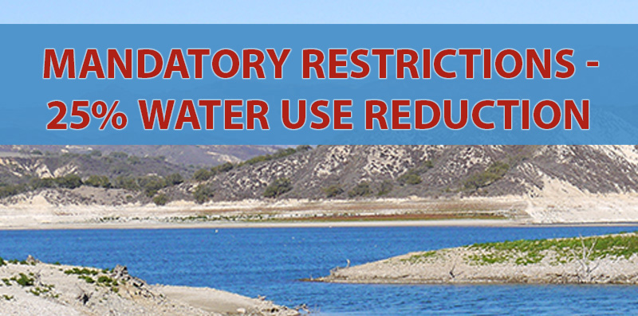
Stage II Water Shortage
Mandatory Water Use restrictions and 25% District-Wide reduction.
Restrictions primarily target outdoor use:
Water no more than two days per week: For fixed irrigation systems Residential customers water Wednesday and Saturday, Businesses Tuesday and Friday, before 7am or after 7pm.
Manual watering is restricted to no more than two days per week before 10 am or after 4 pm.
All hoses must have a shut-off nozzle, and washing of outdoor hard surfaces or runoff is prohibited.

Slide 15
Stage II Demand Reduction Strategy
Stage II Demand Reduction Strategy
Mandatory Water Use Restrictions
Expansive Public Outreach Campaign
Educate customers about drought conditions, water use restrictions, and water use efficiency
Provide useful information and examples
Targeted outreach to specific customer groups
Conservation Incentive Programs
Smart Landscape Rebate Program
Incentive and rebate programs for all customer classes
Recycled Water Hauling Program

Slide 16
Stage II Outreach
Notes:
Information on restrictions

Slide 17
How Do You Save More
Concerns:
Low per capita use
Past success of low-flow rebate programs
Worry people already saving water get “punished”
25% District-wide reduction, not individual allocations
Recognize some customers can cut back more
Focus on outdoor use
Provide information, programs, easy to install and cost-effective options, and demonstrate alternatives
Approach:

Slide 18
Helping Customers Save Water

Slide 19
Single Family Residential Water Use
Residential per capita water use of 64 gallons per day
Notes:
Most water is used outdoors.
Indoors, the flushing uses the most, followed by laundry.

Slide 20
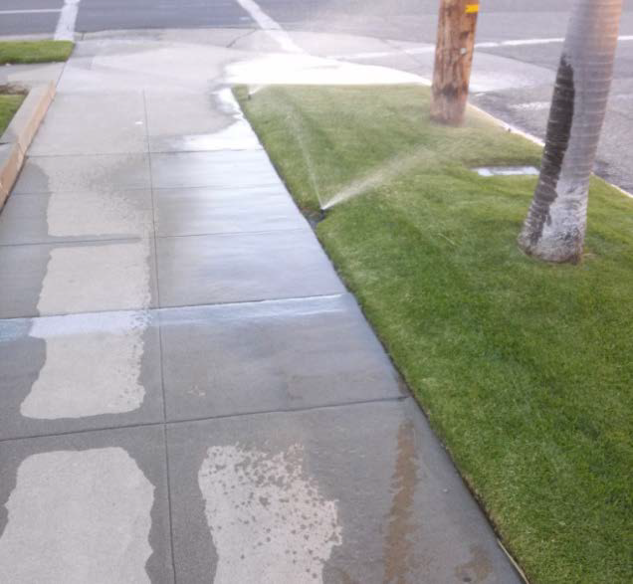
Landscape Irrigation Conservation
~50% of urban water use
countywide is for landscape
watering
Comparison of water use:
5-minute shower = 10 gallons
15-minute lawn watering = 700 gallons!

Slide 21
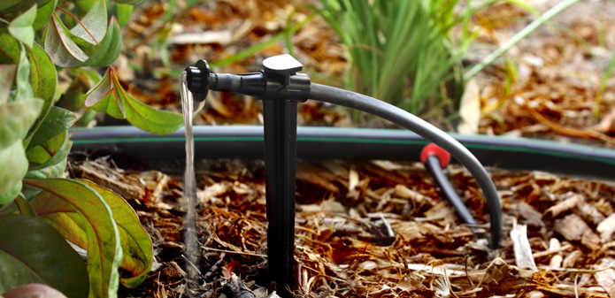
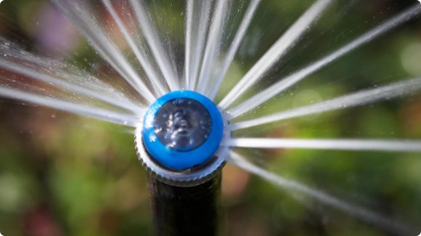
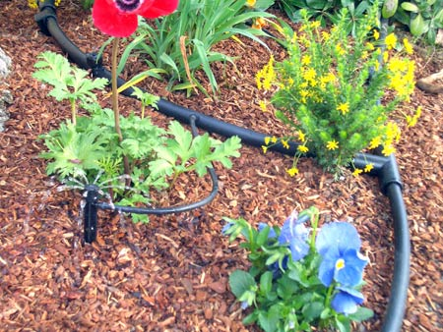
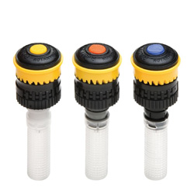
Outdoor Conservation
Drip Irrigation
Rotating Nozzles

Slide 22
Smart Landscape Rebate Program
Up to $1,000 for single family customers, and up to $2,000 per meter for multi-family (HOA), commercial, and dedicated landscape irrigation meter customers (Max $4,000).
Landscape Design: 50% of landscape design cost, up to a maximum of $250
Irrigation Equipment: 50% of the cost of drip irrigation parts, sprinkler system efficiency retrofits, rotating sprinkler nozzles, smart irrigation controller
Water-Wise Plants and Mulch: 50% of the cost of water-wise plants and mulch
Pool Cover: 50% of the cost of a pool cover, up to a maximum of $300 per pool cover
Synthetic Turf and Permeable Surfaces: 50% of the cost
Laundry-to-Landscape Graywater: 50% of the cost of system parts
For more information contact the District at 805-964-6761 or conservation@goletawater.com.
Notes:
And a snapshot of residential use in our service area.
Most water is used outdoors.
Indoors, the flushing uses the most, followed by laundry.

Slide 23
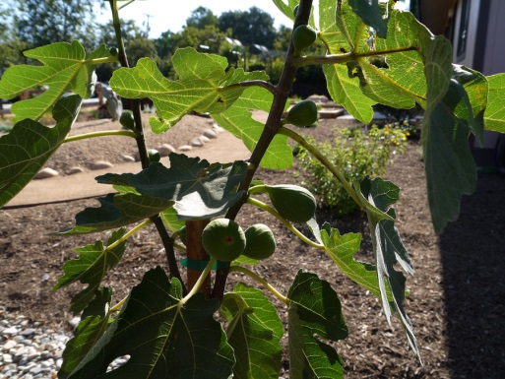
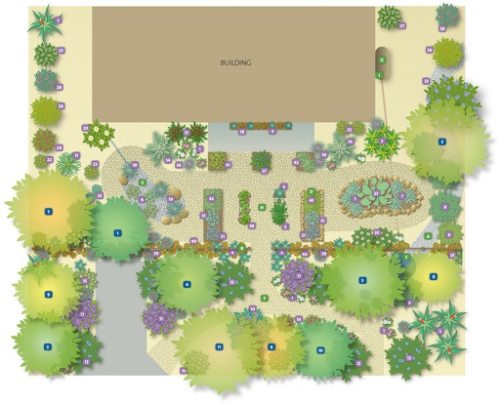
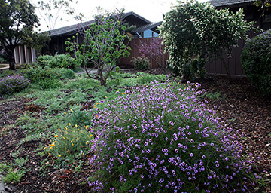
District Demonstration Gardens
Demonstration gardens feature water wise plants and mulch
Rain catchment, Hugelkultur and other innovative permaculture techniques are shown
New Edible Garden featuring plants and trees well-suited to the local environment
Notes:
Water Wise plants and mulch
New low water Edible Garden

Slide 24
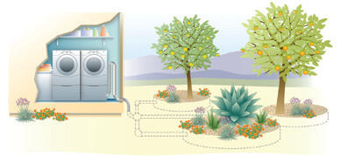
Graywater
Laundry to landscape systems do not require a permit and are simple to install
Laundry to Landscape Graywater DVD available at all libraries

Slide 25
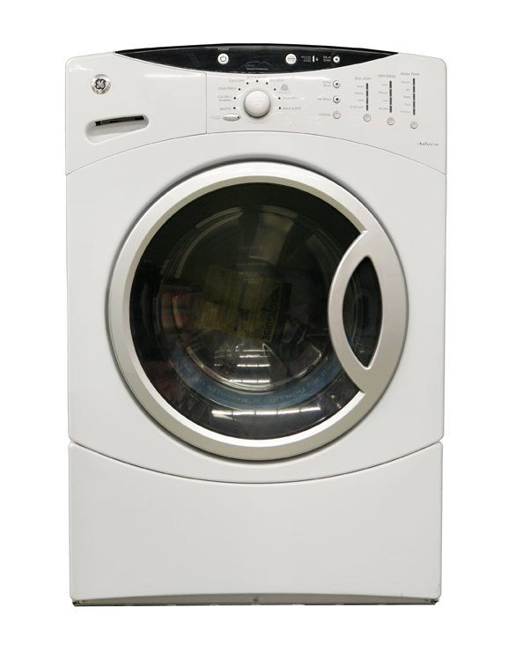
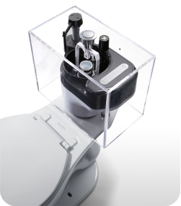
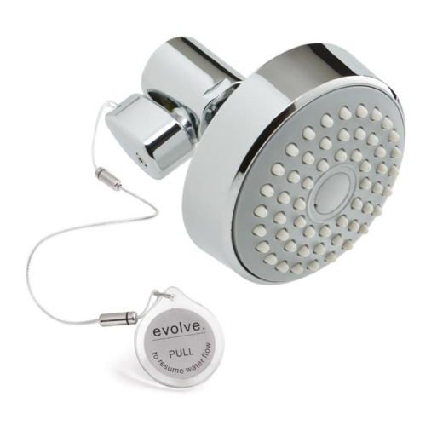
Indoor Conservation
Showerheads
Post 1994 – 2.5 gpm
Toilets
Post 1994 - 1.6 gpf
New - 1.28 gpf
Newest - 0.8 gpf
High Efficiency Washers
Front Loading

Slide 26
Water Saving Devices Distribution Program
Provide easy to install water saving devices for customers
Hose shut-off nozzles: help customers comply with new Stage II/State restrictions
Low-flow shower heads and shut-off valves: help customers save water in the shower
Toilet leak detection kits: help customers detect leaks that can cost them 200 gallons of water a day. Even a low flow toilet isn’t saving water with a leak
For more information contact the District at 805-964-6761 or conservation@goletawater.com.
Notes:
And a snapshot of residential use in our service area.
Most water is used outdoors.
Indoors, the flushing uses the most, followed by laundry.

Slide 27
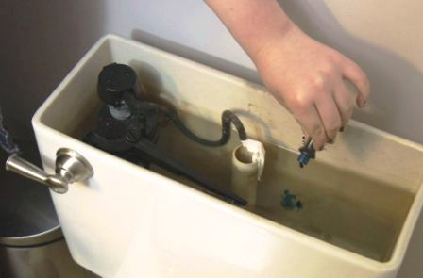
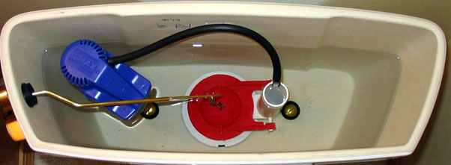
Toilet Leaks
Toilets are the #1 hidden leak in a home and can waste 200 gallons per day
Dye tablet test for flapper leaks:
Place tabs (or food coloring) in tank, wait 10 minutes, check for color, replace flapper if needed and retest
Overflow tube:
Water level in tank should be one inch below the top of the tube.
Overflow tube

Slide 28
Role of Recycled Water
Recycled Water is an important element of the District’s supply portfolio (1,000 AFY)
Recycled water is being used for irrigation and water features such as fountains, offsetting potable water demand
Signs educating the public on the role of recycled water in preserving potable water supplies
Complying with Stage II Emergency Water shortage
Notes:
Especially in a time of drought….

Slide 29
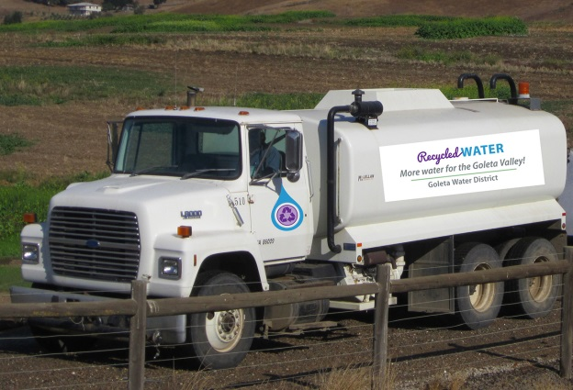
Recycled Water Hauling Program
The RWHP expands opportunities to substitute recycled water for potable water, preserving water for critical uses. The program was approved by the Board in October and will be rolling out in the next few months
Initially deliveries restricted to current GWD customers, but interest in expanding to other areas
The total charge will be determined by the delivery charge based on the customer’s Zone, the commodity charge for amount of RW requested, and the hourly application charge to apply RW
For more information contact the District at 805-964-6761 or conservation@goletawater.com.
Notes:
And a snapshot of residential use in our service area.
Most water is used outdoors.
Indoors, the flushing uses the most, followed by laundry.

Slide 30
Potential Rebate Programs and Incentives
In the next few months the Board will consider a number of additional conservation programs including for Commercial, Industrial, and Agricultural Customers:
Water Saving Incentive Program
Water Budgets and Water Surveys Assistance Program
Notes:
And a snapshot of residential use in our service area.
Most water is used outdoors.
Indoors, the flushing uses the most, followed by laundry.

Slide 31
Ten Simple Actions to Save Water
Plant California-friendly trees & plants with mulch
Shrink your lawn and water it less (once per week)
Adjust sprinklers to avoid runoff
Use a shut-off nozzle on your hose
Use a broom to clean driveways and sidewalks
Fix leaky faucets and toilets
Only full dishwasher &washing machine loads
Take shorter showers; turn off water while lathering
Turn off the faucet when brushing your teeth
Install water wise fixtures and appliances
Notes:
This is just a sample of some of the valuable information you can find on our website and at the regional WaterWise in Santa Barbara County website

Slide 32
More Information Online
www.GoletaWater.com
www.WaterWiseSB.org

