Slide 1
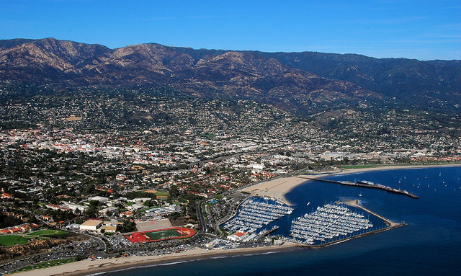
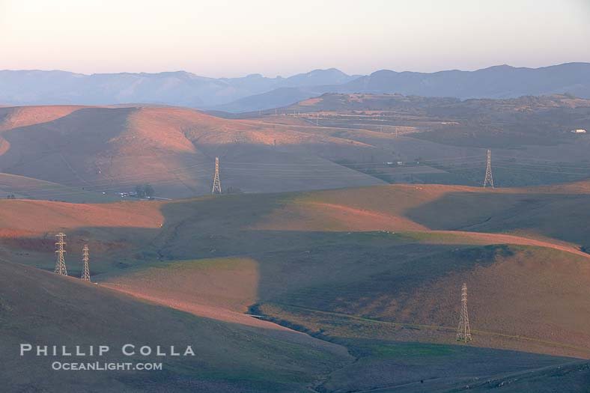
Community Choice on The Central Coast
Central Coast Sustainability Summit November 13, 2014
Jefferson Litten Solarize Program Manager, CEC

Slide 2
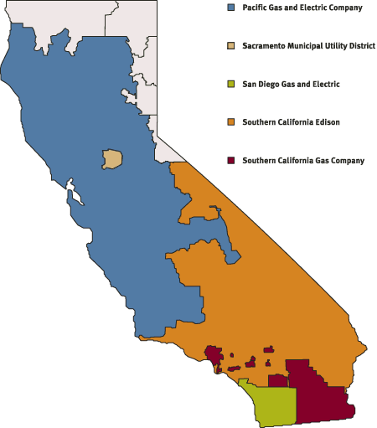
CCA on the Central Coast: Challenges
Split Jurisdiction
Geo-political divide
Leadership

Slide 3
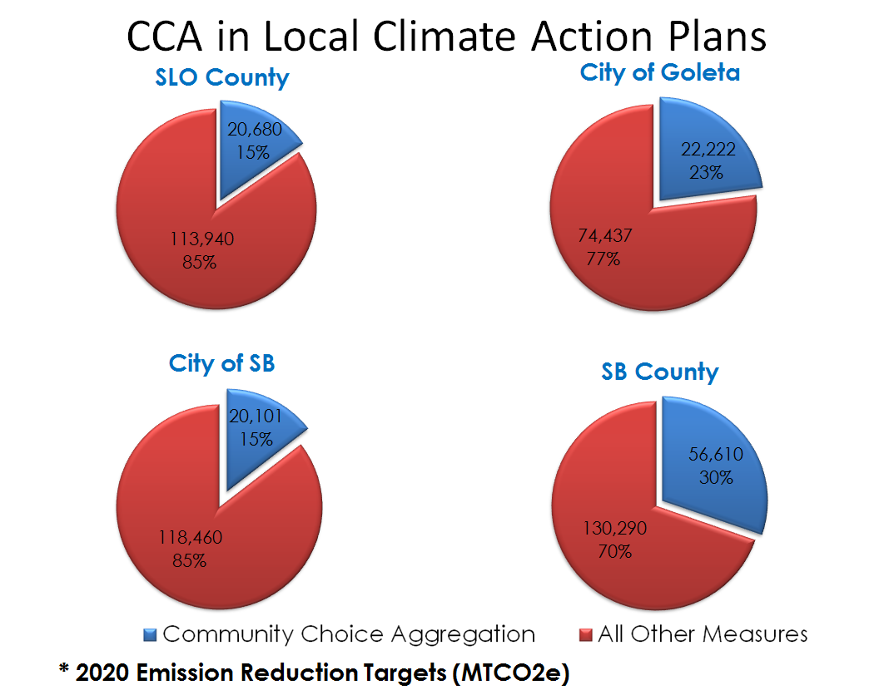
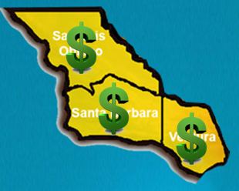
CCA on the Central Coast: The Opportunity
Environmental
Choice
Economic
- Short Term
- Long Term

Slide 4
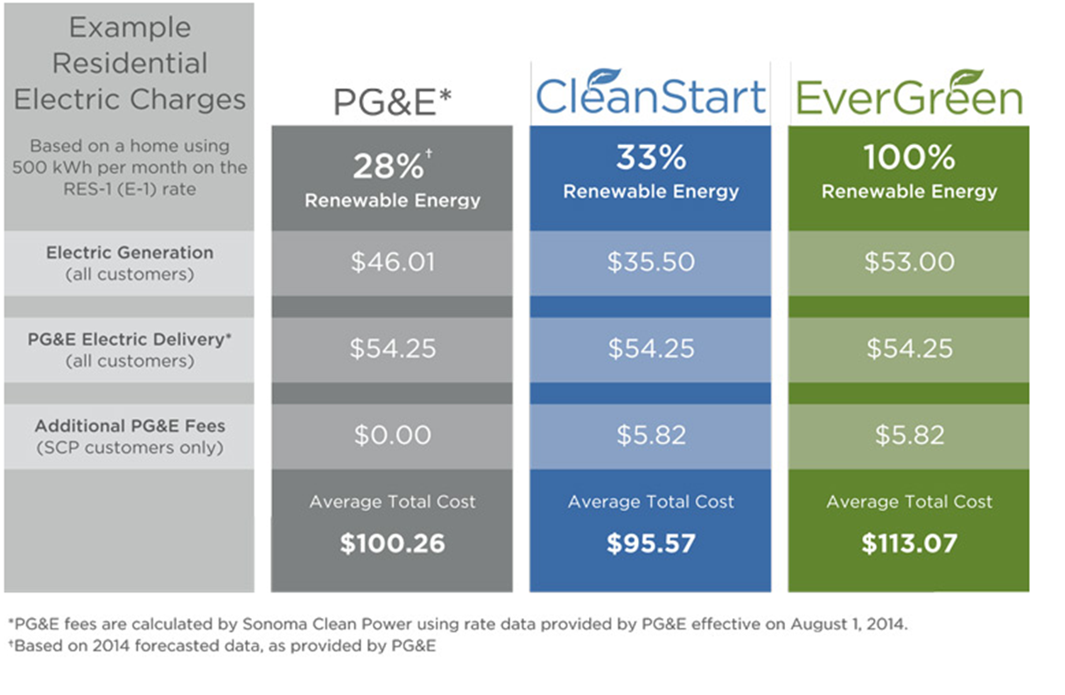
Economic Benefit: Consumer Savings
Notes:
PG& E Fees calculated by SCP using PG&E date from August 1, 2014. 28% was from 2014 forecasted data provided by PG&E
MCE: 508 kWh from 11/1/2014 RES -1 / E -1 Rate Schedule

Slide 5
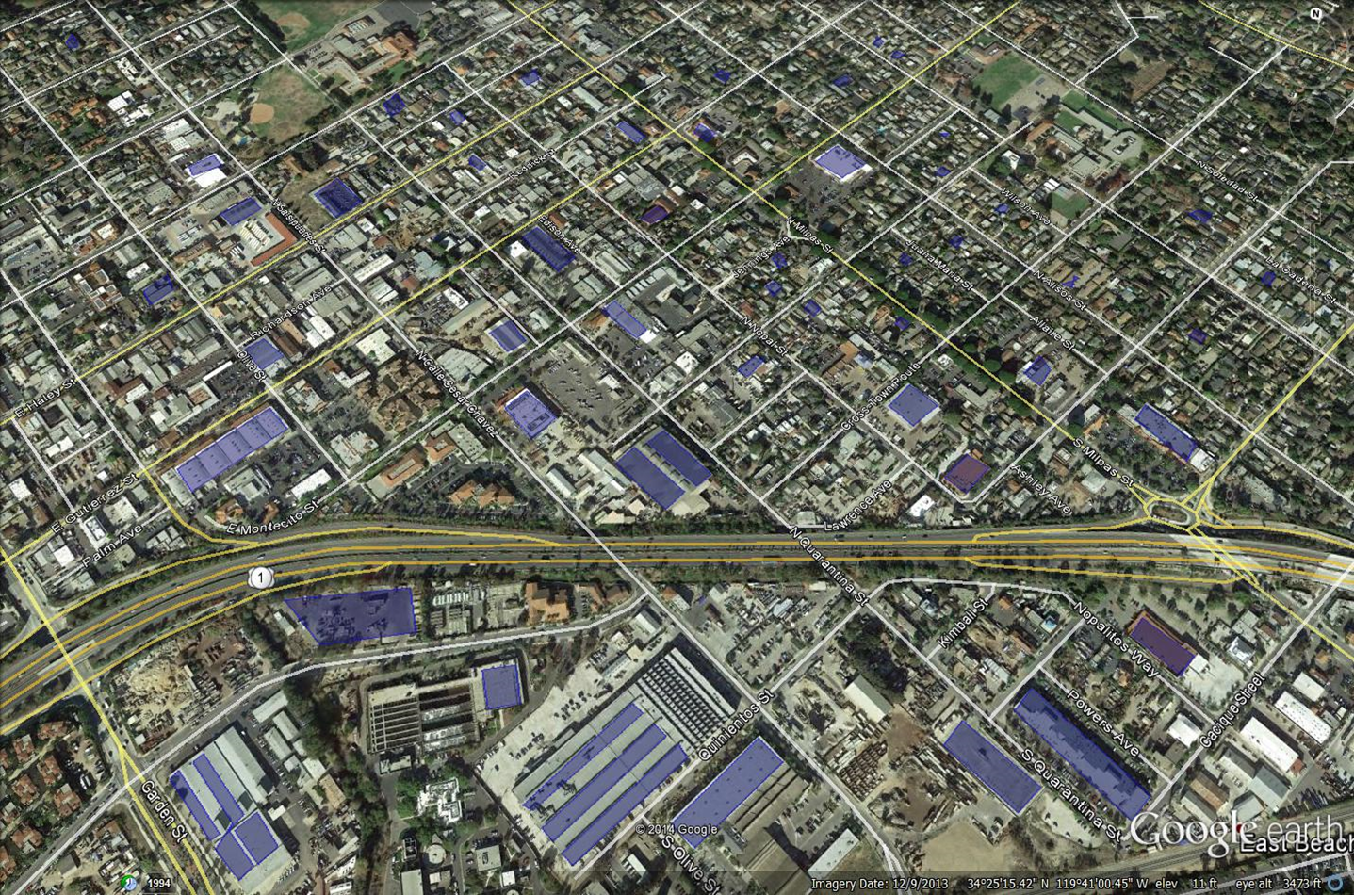
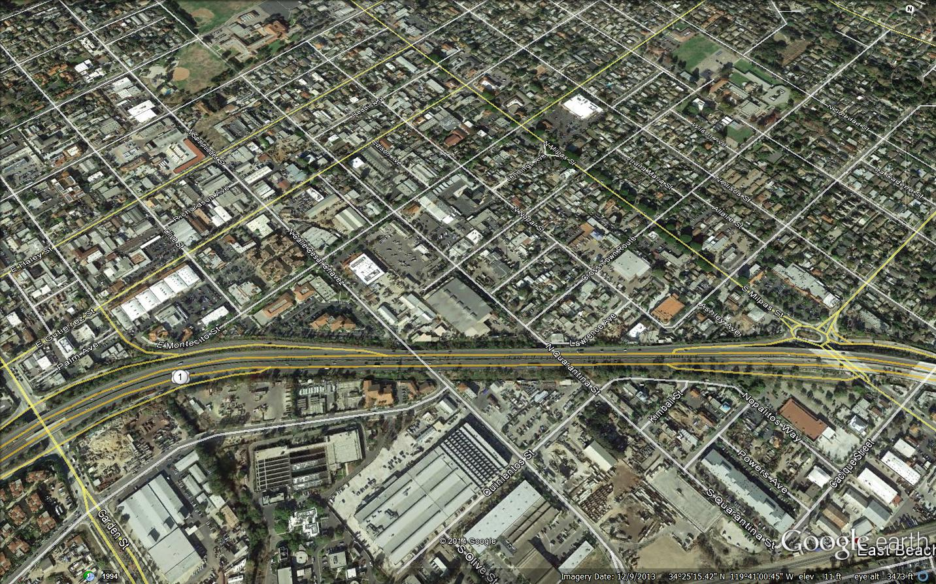
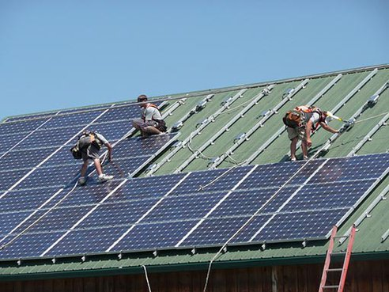
Economic Benefit: Local Renewable Energy

Slide 6
CCA on the Central Coast: The Path Forward
Coalition Building
Business, Political and Community Leadership
Commitment to Evaluating CCA
Government Funded Feasibility Study
Alternate Paths:
Two Central Coast CCAs
Joining An Existing CCA

Slide 7
Questions?
Jefferson Litten
jlitten@cecmail.org
805.963.0583 x 105

