Slide 1
UC Santa Barbara
Water Conservation & Efficiency Efforts
Matthew O’Carroll
Refuse, Recycling, & Water Efficiency Manager, FM
matthew.ocarroll@pf.ucsb.edu
Mark Rousseau
Energy & Environmental Manager, H&RS
mrousseau@housing.ucsb.edu
Central Coast Sustainability Summit - 2014

Slide 2
Overview
Wet years v. Dry years
Water Use Breakdown at UCSB
Housing & Residential Services efforts
Facilities Management efforts
Water Conservation & Efficiency Results
Notes:
Matt

Slide 3
- John Steinbeck, East of Eden
“And it never failed that during the dry years the people forgot about the rich years, and during the wet years they lost all memory of the dry years. It was always that way.”
Notes:
Matt

Slide 4
UCSB Potable Water Use By Sector

Slide 5
Housing & Residential Services
“In the world there is nothing more submissive and weak than water. Yet for attacking that which is hard and strong nothing can surpass it.
- Lao Tzu
Notes:
Matt

Slide 6
Keys to Success
Reduce
Conservation
Efficiency
Reuse
Recycled
Report
Leaks
Waste
Re-educate
Continuous
4 R’s
Notes:
Mark

Slide 7
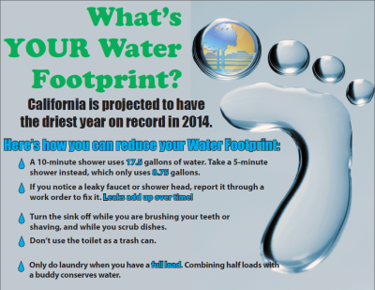
Continuous Education
Notes:
Mark

Slide 8
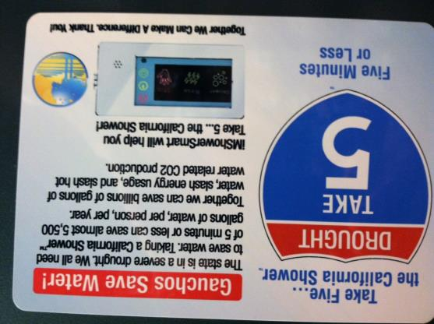
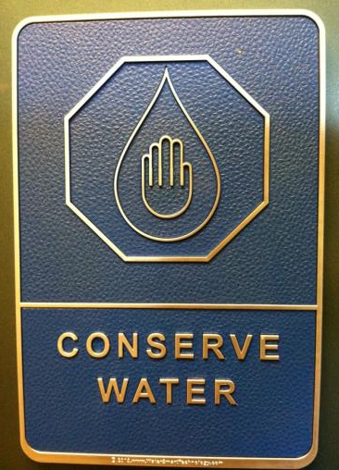
Continuous Education (cont.)
Notes:
Mark

Slide 9
Behavior Change
12 - 15% Water Savings
(+ Gas Savings) < 1 yr payback
Notes:
Mark

Slide 10
PowerSave Green Campus Energy & Water Savings Competition
Notes:
Mark

Slide 11
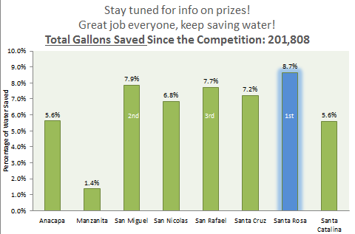
Congratulations Santa Rosa!!!

Slide 12
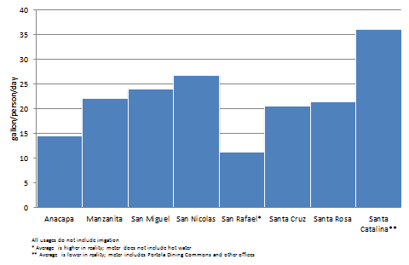
Average Water Use During Contest
Notes:
Mark

Slide 13
Facilities Management
“When the well’s dry, we know the worth of water.”
- Benjamin Franklin
Notes:
Matt

Slide 14
Historical Efforts
Installed:
Aerators, dual-flush toilets, waterless urinals
Efficiency efforts in industrial processes
Recycled water for irrigation
Toilets in Bren Hall
Efficient irrigation practices for potable landscapes
Education and outreach
UCSB Water Action Plan
Notes:
Matt

Slide 15
Water Action Plan
In the environmental realm, crisis often promotes action.
Notes:
Matt

Slide 16
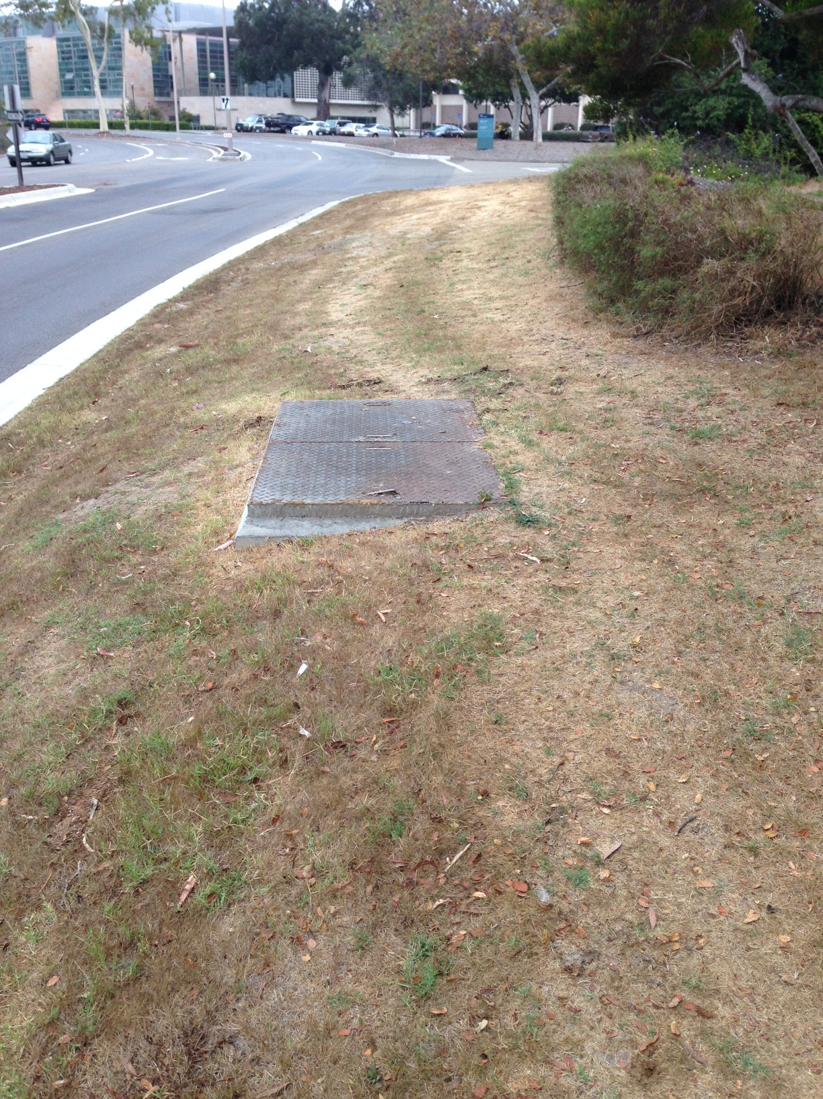
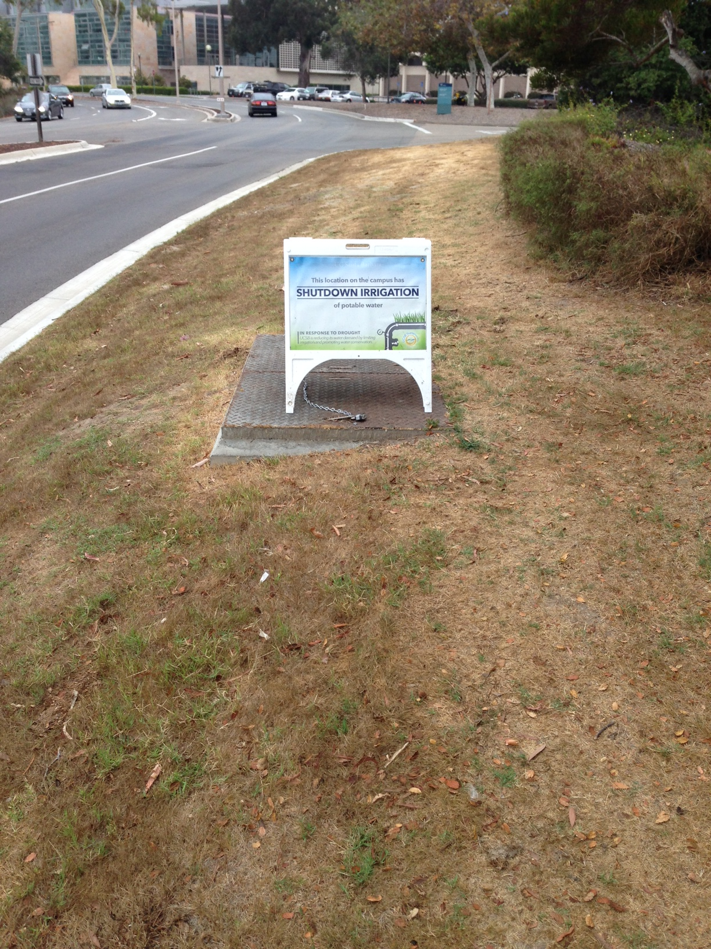
Notes:
Matt

Slide 17
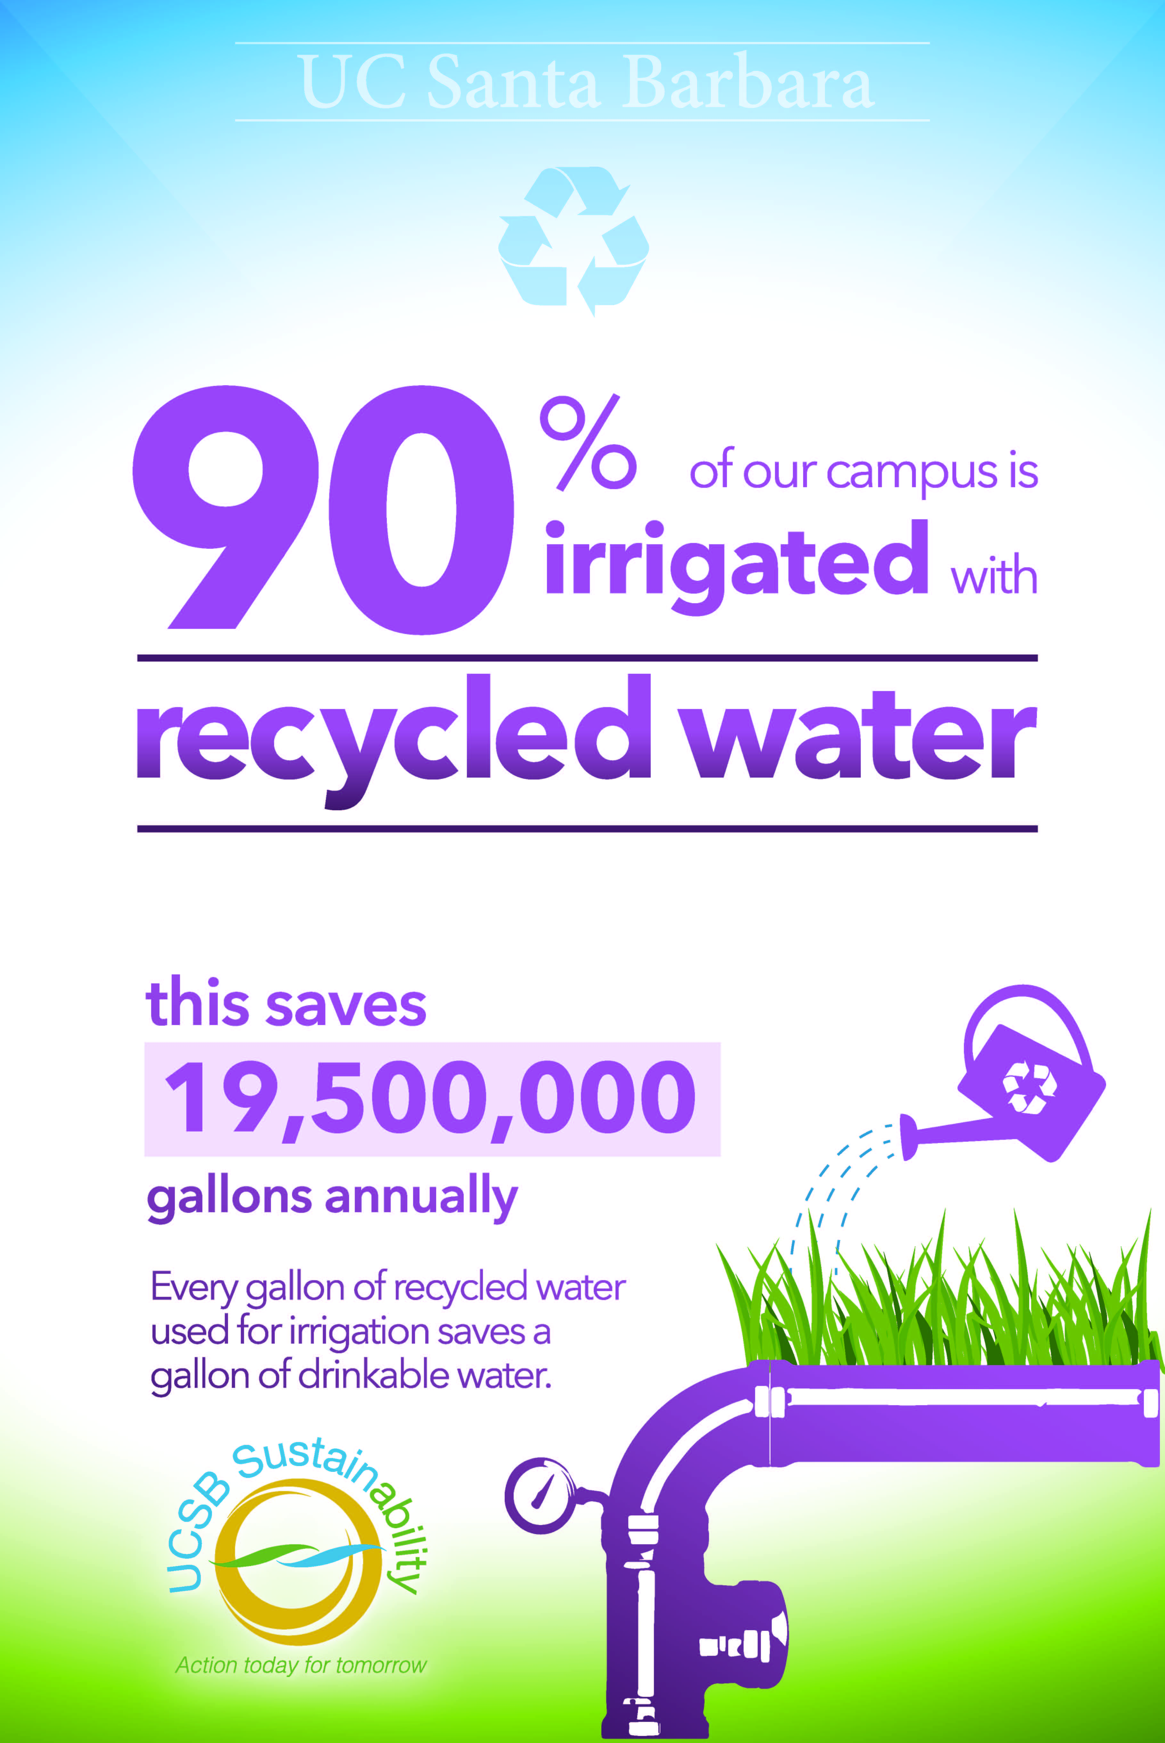
Irrigation Practices
Notes:
Matt

Slide 18
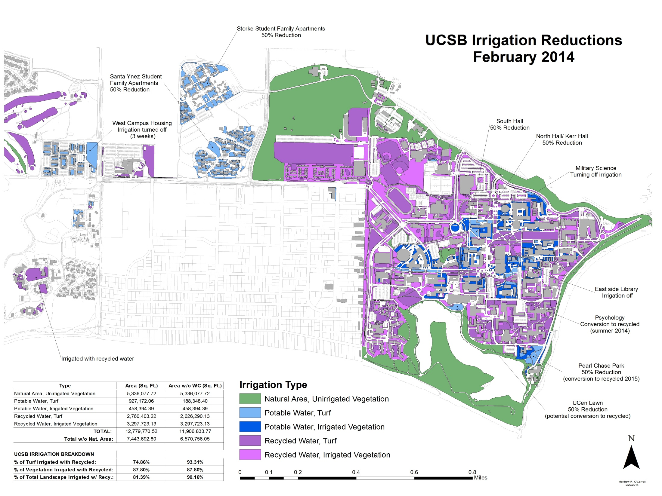
Notes:
Matt

Slide 19
Water (we going to do)? A Community Lecture Series on critical water issues
UC Santa Barbara invites you to learn about California’s most critical resource, water. This community lecture series will address the State of California’s critical water issues, and provide valuable insight on local water conservation and efficiency practices.
Session 2: Act Local, Think Global – Water Conservation Efforts
With the hot summer months upon us, water conservation and efficiency efforts are of the utmost importance. Join us, as UCSB hosts staff from Goleta Water District and the City of Santa Barbara who will provide updates on water supplies, current restrictions, and conservation programs for customers of each agency. This will be an opportunity to learn how you can save water at home during the drought!
Monday, July, 14 2014
7pm – 8pm
Goleta Public Library – Multipurpose Room
Notes:
Matt

Slide 20
Results
“Thousands have lived without love, not one without water.
- W.H. Auden
Notes:
Matt

Slide 21
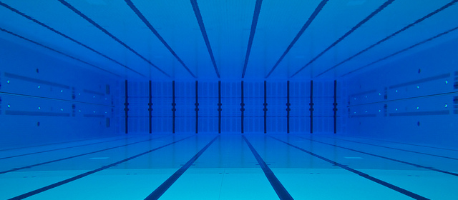
Annual Water Use at UCSB
488 Acre Feet
241 Olympic-size swimming pools
Notes:
Matt

Slide 22
Historical Water Use at UCSB
UCSB Water Allotment (944.5 AFY)
Notes:
Matt
UCSB consumes about 5% of the total amount of potable water distributed by GWD

Slide 23
Per Capita Water Use
Notes:
Matt
Average Person in the US uses 60-100 gallons/person/day

