Slide 1
When in Drought- Conserve!
Madeline Ward
City of Santa Barbara
Acting Water Conservation Coordinator

Slide 2
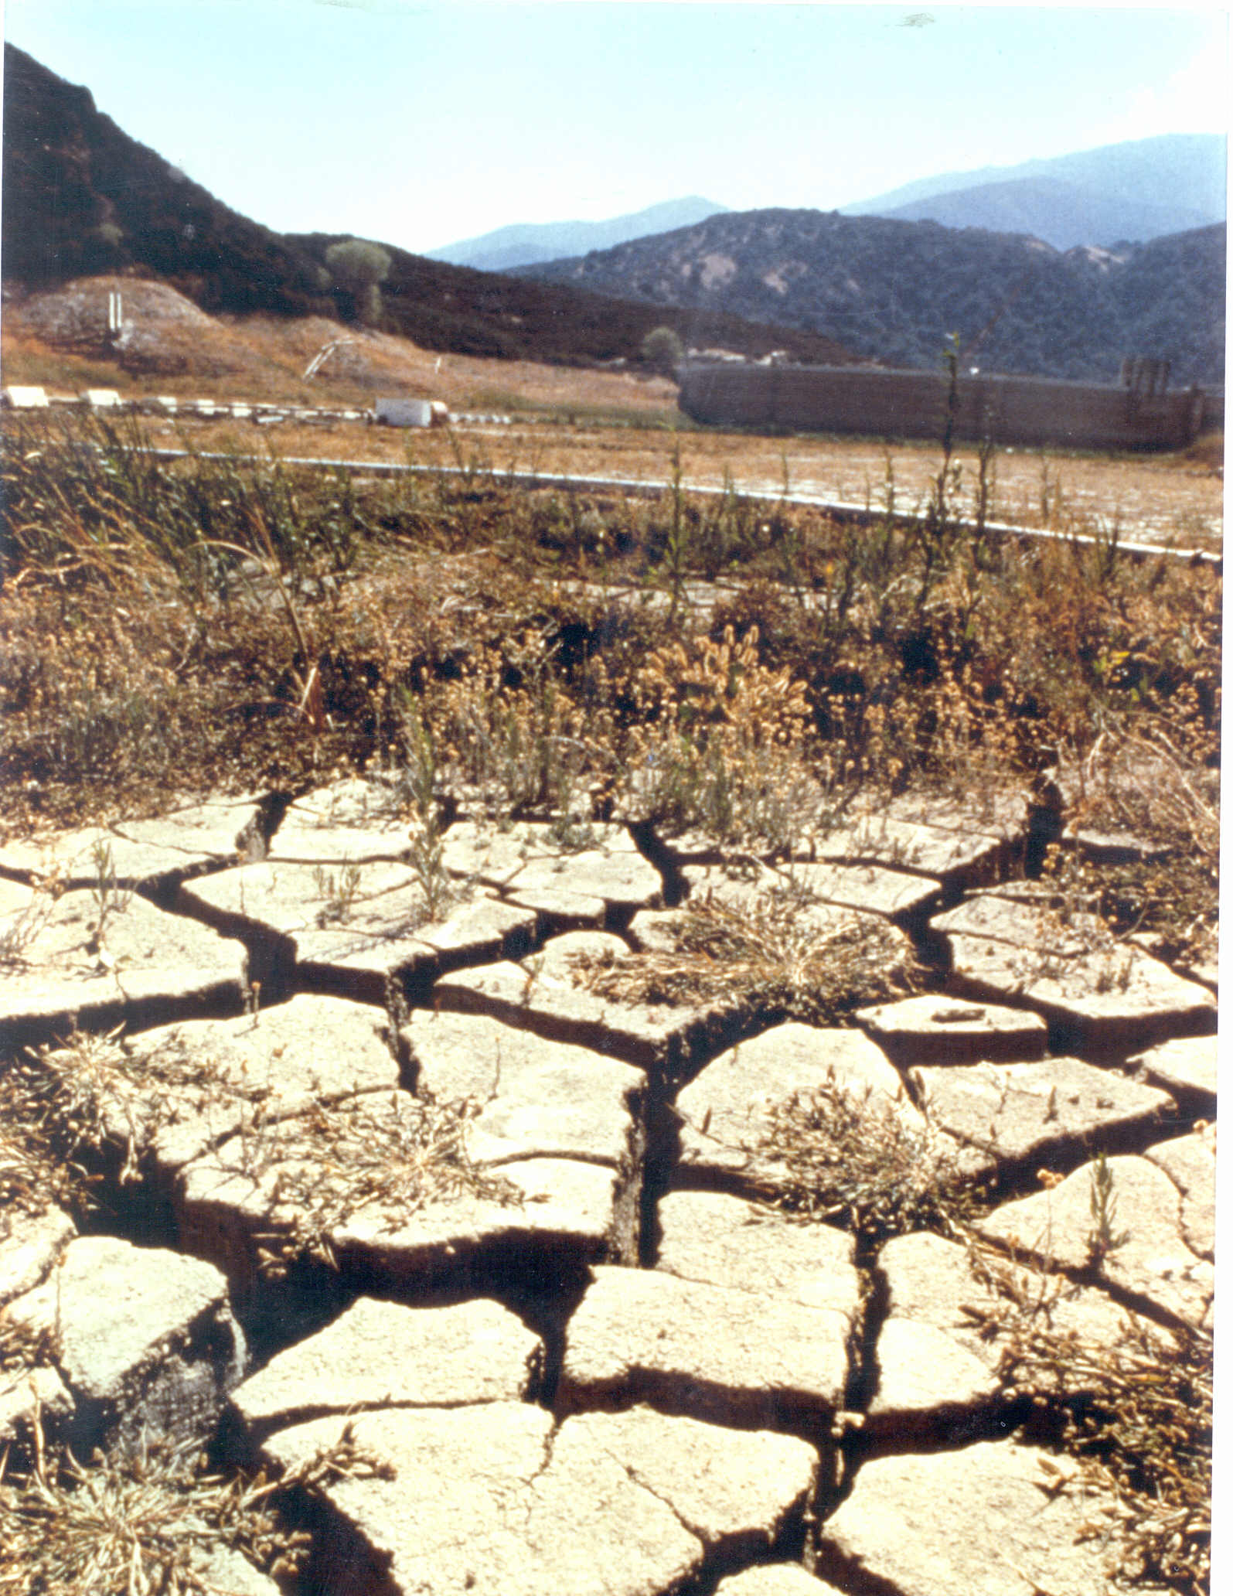
Drought in Santa Barbara
1987-1991 - Last Major Drought
Driest 3 years on record
February 11, 2014 –Stage One Drought
May 20, 2014 – Stage Two Drought
Notes:
(94 years of records) at Gibraltar Reservoir

Slide 3
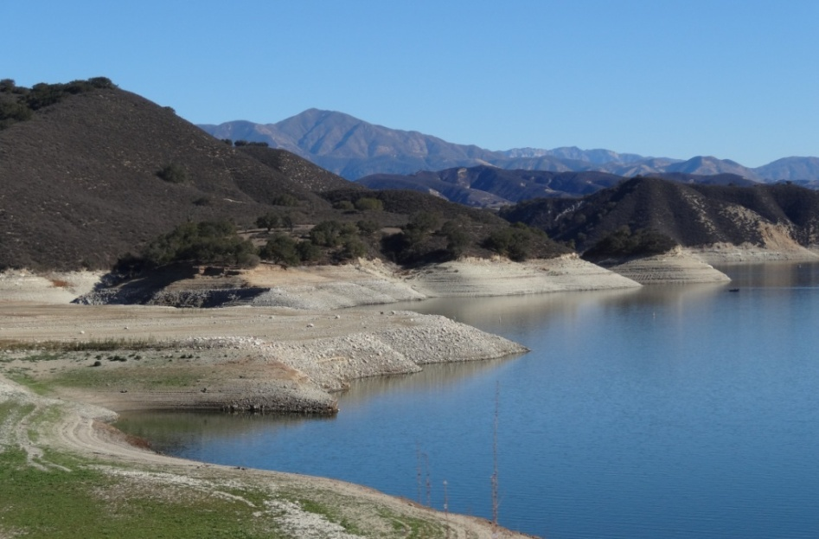
Water Supply Outlook
National Weather Service Forecast - Weak El Nino for the coming 3 months – equal chances of above, normal, and below average rainfall
Planning for continued dry conditions
Notes:
Purpose of discussing the El Nino Cycle is to address a lot of questions I and others at the City continue to get from the public concerning the increased probability of an El Nino Cycle next year.

Slide 4
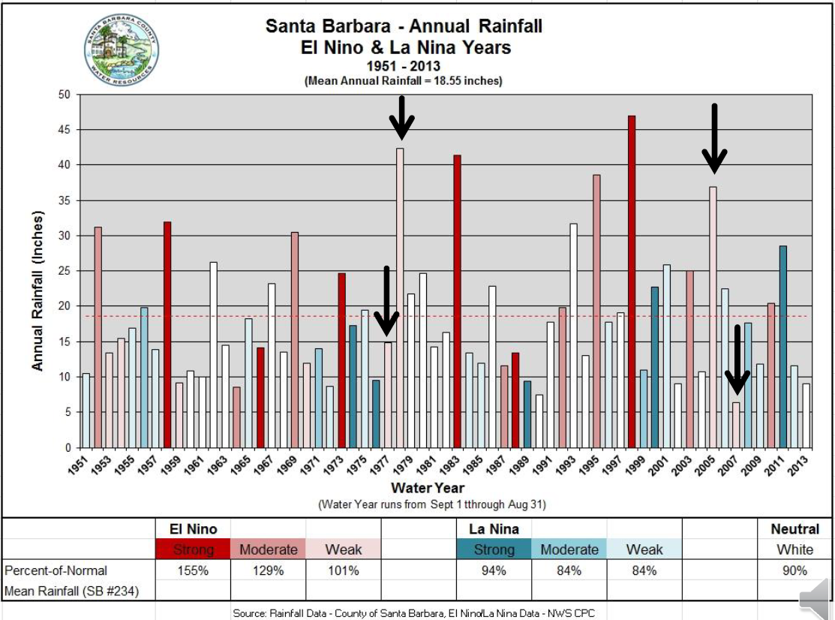
Eric Boldt, NOAA, ENSO Update 11/6/14

Slide 5
Current Supply Strategy
(based on no reservoir inflows, no State Water)
Current Water Year
Notes:
Take the time to walk Council through the Current Supply Strategy
[For context, we are about to enter Year 4 (Oct. 1) ]
Our Current Supply Strategy takes a conservative approach and assumes no reservoir inflows and no state water.
In Year 4 and Year 5 we are planning on the ability to purchase water and have it delivered through the state water system.
This strategy also assumes we will be producing 7,500AF of desalinated water in Year 6. To reduce the risk if Water Supply Conditions improve, the initial contract for desal will be for 3,125.
Shows extraordinary conservation as a water supply….the cheapest water supply available.

Slide 6
Desalination Timeline
(based on no reservoir inflows, no State Water)
Desalination Facility Online
Consider Award of DBO Contract
Pre-Design
Desalination Critical to meeting Demand
Notes:
Our Current Supply Strategy takes a very conservative approach and assumes no reservoir inflows and no state water.
In Year 4 and Year 5 we are planning on the ability to purchase water and have it delivered through the state water system.
This strategy also assumes we will be producing 6,000AF of desalinated water in Year 6.
Even with Desal conservation will be critical to meeting demands. Without Desal in year 6 under this planning scenerio we would be looking at over a 60% shortage.
Also shown on this graphic is extraordinary conservation as a water supply….the cheapest water supply available.

Slide 7
WY 14 Monthly Demands
June:15%
July: 20%
Aug: 25%
Sep: 26%
Notes:
Discuss water usage as compared to normal usage and water usage compared with May 2013. [Be ready for the question as to which line represents “normal”. The green line is close but my understanding is that it includes an extra 300 AFY above our current “normal year” demand.]

Slide 8
WY 15 Monthly Demands
Oct: 20%
Notes:
Discuss water usage as compared to normal usage and water usage compared with May 2013. [Be ready for the question as to which line represents “normal”. The green line is close but my understanding is that it includes an extra 300 AFY above our current “normal year” demand.]

Slide 9
Water Use by Customer/Tier

Slide 10

Conservation Outreach
Leverage the Influencer Groups:
Partners in Water Conservation advisory group
Collaborate with irrigation manufacturers, irrigation supply stores, nurseries, botanic garden
  Workshops, signage, newsletters

Slide 11
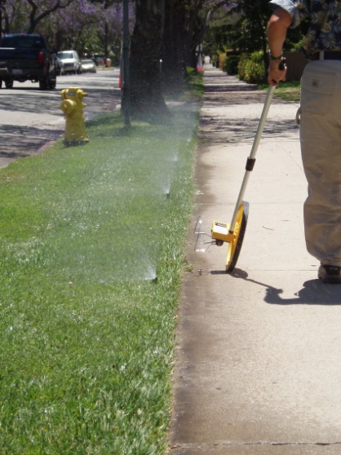
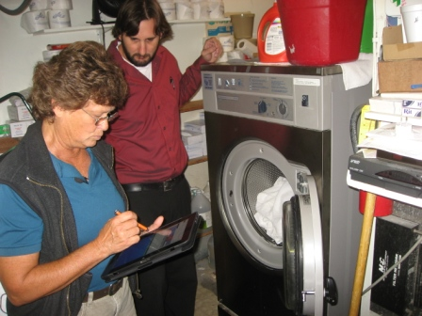
Conservation Outreach
Focus on Markets with Most Savings:
HOAs and large turf landscapes – irrigation evaluations, rebate opportunities
CII Survey and Incentive Program
Drought Forum with property management companies and landscapers

Slide 12
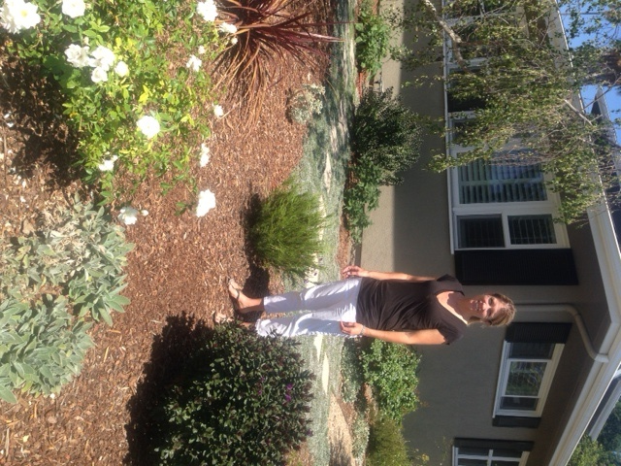
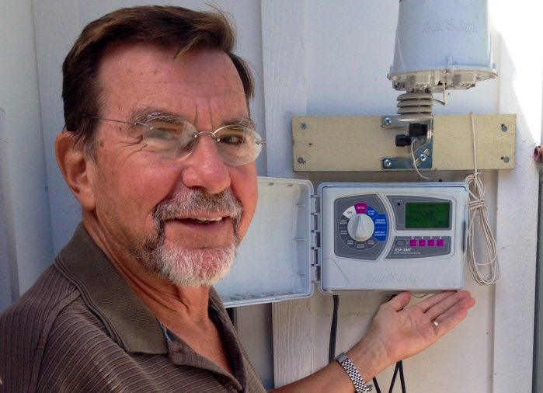
Conservation Outreach
Water Wise Citizen Spotlight
  Profile success stories of residents and businesses
  Release one per month via press release, bill insert, website, social media, etc.
  Promote where you want to go

Slide 13
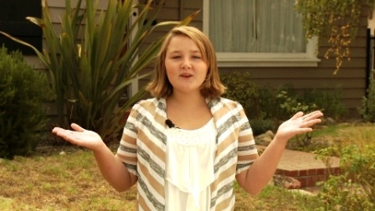
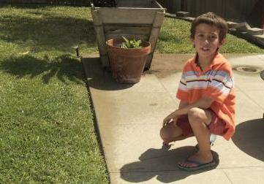

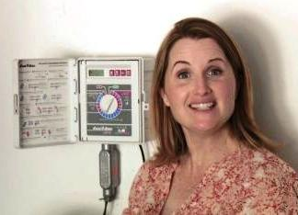
Action Oriented Advertising
Specific, simple ways to save water
Emotional connection
Easy to apply

Slide 14
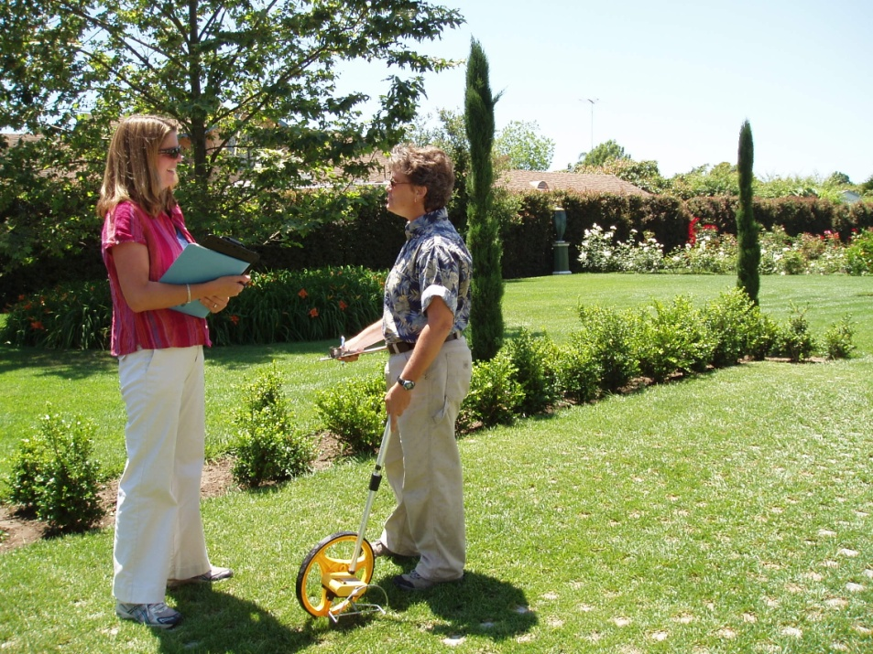
Get a Free Water Checkup
City staff will visit your home or business and:
Evaluate water use indoor and out
Check efficiency of irrigation system and scheduling
Provide information on rebates and programs

Slide 15
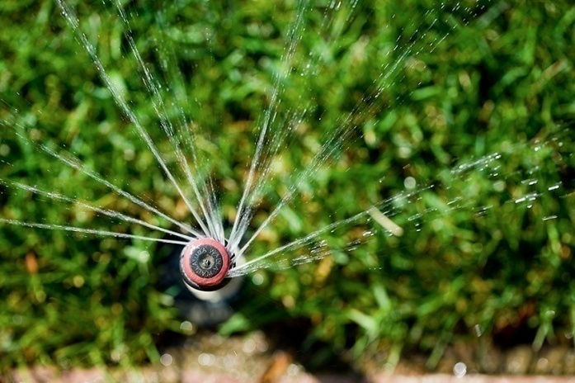
Smart Landscape Rebate Program
For City of Santa Barbara Water Customers
Rebate Covers:
  Irrigation equipment
  Water wise plants and mulch
  Smart irrigation controller
  Graywater materials
  Pool covers- up to $300
50% of the cost of materials
Up to $1,000 for single family homes
Up to $2,000 per meter serving irrigated area ($4,000 per site) for commercial, multi-family, and HOAs.

Slide 16
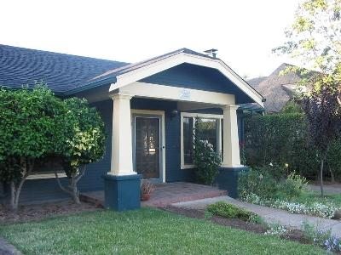
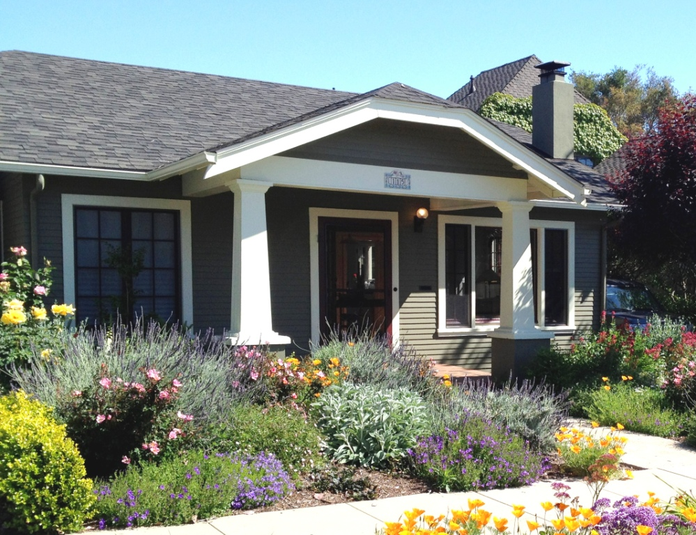
Before and After

Slide 17
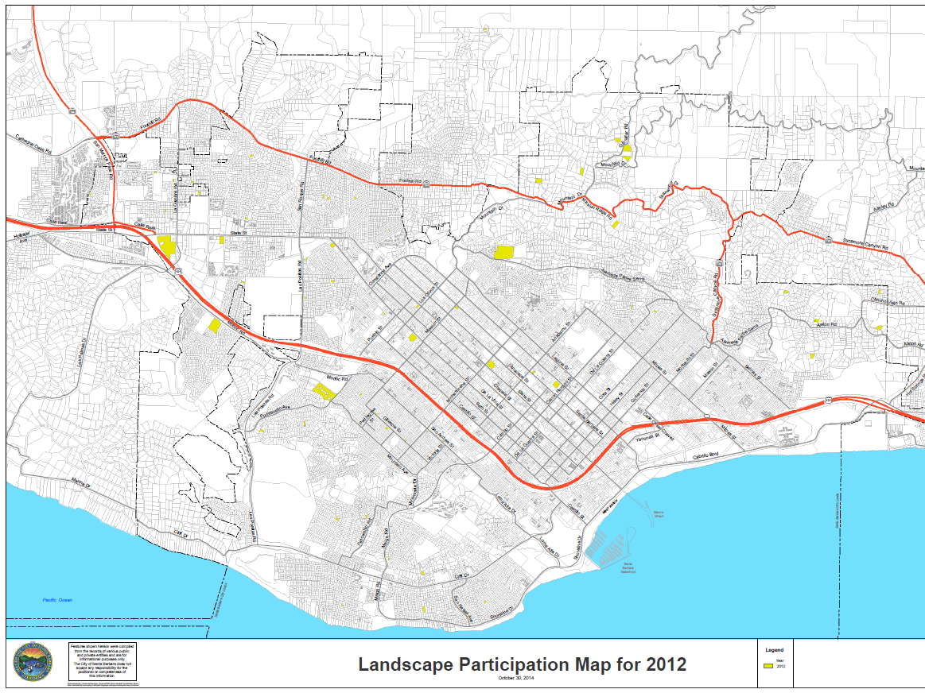

Slide 18


Slide 19
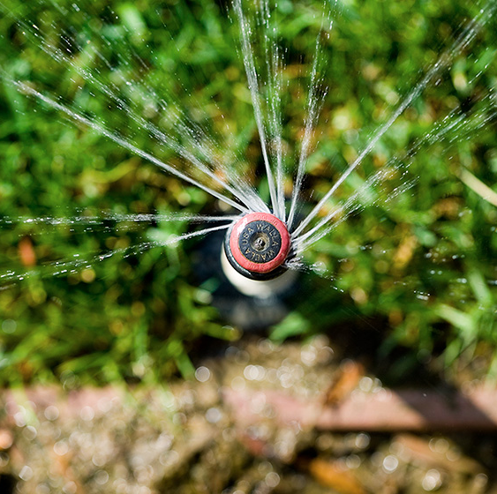
Low Precipitation Nozzles
  Easily retrofit for generic pop-up spray heads
  Apply water more efficiently and evenly
  Reduces water use by ~20%
  Part of the landscape rebate program
  FreeSprinklerNozzles.com
Notes:
See vendor displays here today.

Slide 20
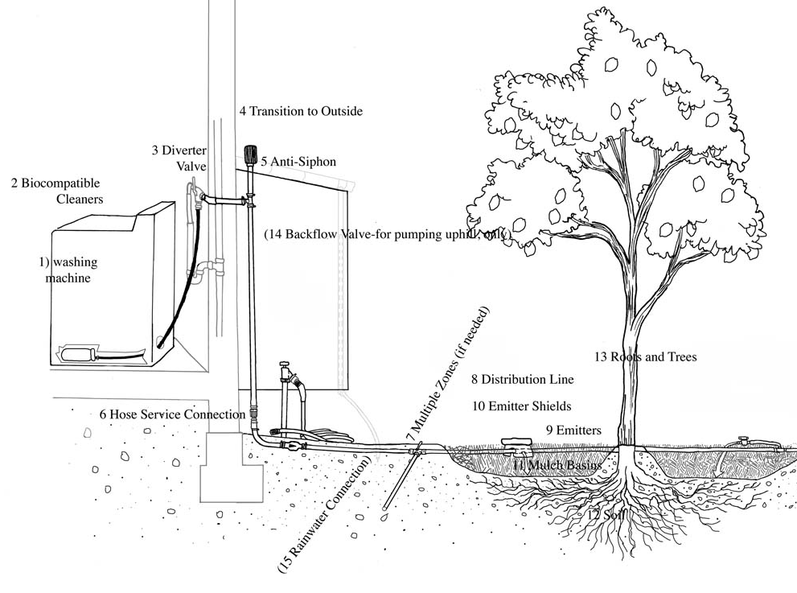
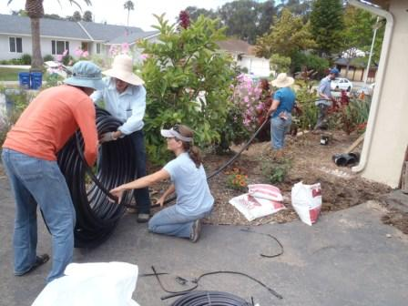
Graywater
Laundry to landscape systems do not require a permit and are simple to install
Part of the Smart Landscape Rebate
Sponsored workshops through Sweetwater Collaborative

Slide 21
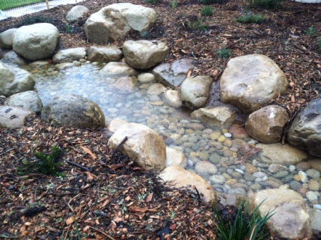
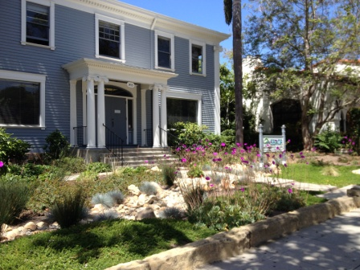
Rain Gardens
Slow, sink, spread
Spencer Adams Park, 1216 De La Vina
Next Week:
Rainwater Lecture Nov 18th at 6:00
SBOAR, 1415 Chapala St

Slide 22

For More Information
(805) 564-5460
SantaBarbaraCA.gov/WaterWise

Slide 23
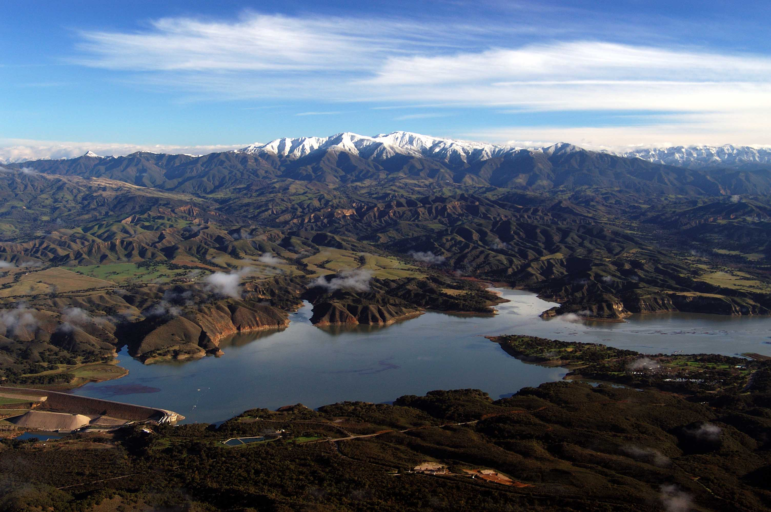
Vision for a Wetter Tomorrow

