Slide 1
Ventura’s Sustainable Water Future
Shana Epstein
Ventura Water General Manager
October 14, 2015

Slide 2
Water Supply Today
10-30% Ventura River
25-35% Lake Casitas
35-55% Groundwater
Highly Variable
Drought Impact

Slide 3
Ventura’s Current Water Resources

Slide 4
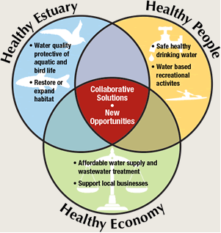
Potential Restrictions on Current Supply
Water Quality
Habitat Protection
Sustainability Groundwater
Management Plan
Drought
Floods
Regulations

Slide 5
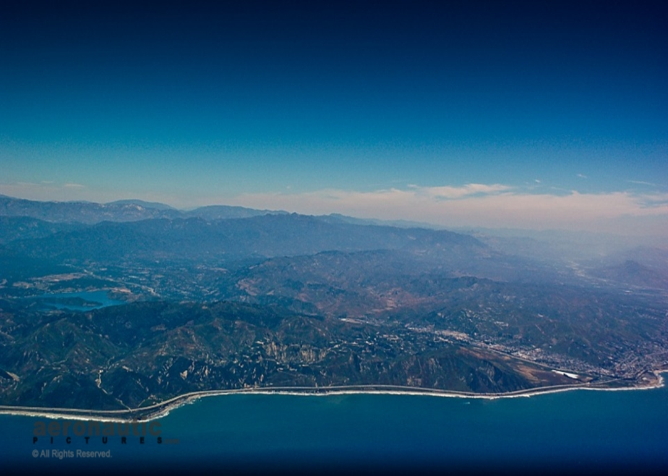
Sustainable Water Future
Demand Side Management
Water Re-use
Potable
Tertiary
Desalination
Water Purchases
State Water
Ag Demand Side Management

Slide 6
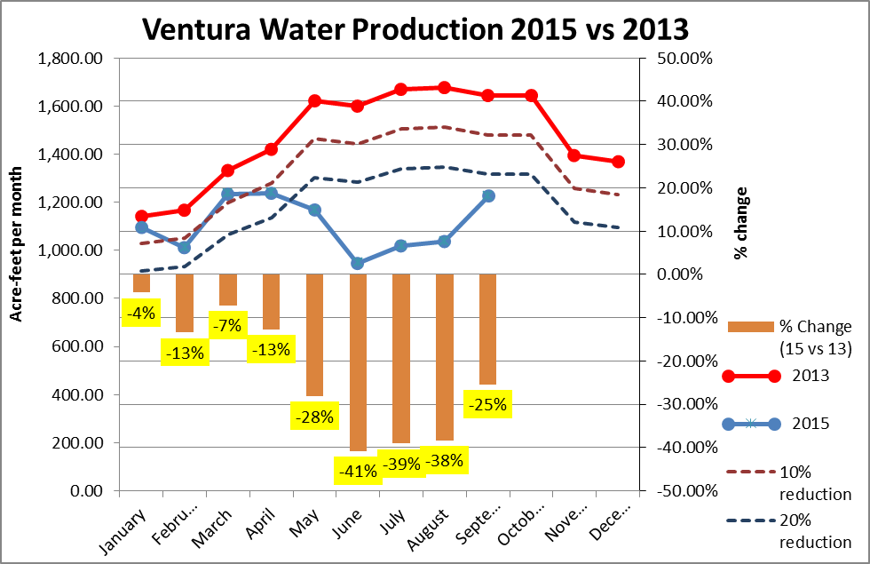
Ventura Conserving
Water Rates
Tiered Rate Structure
Water Shortage
Incentive Programs
Water Surveys
Classes
Communication
Traditional
Social Media

Slide 7
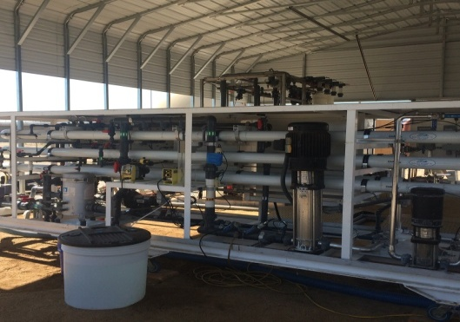
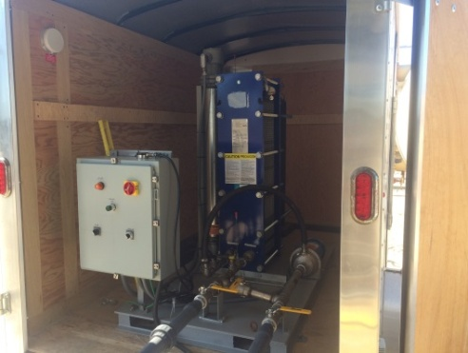
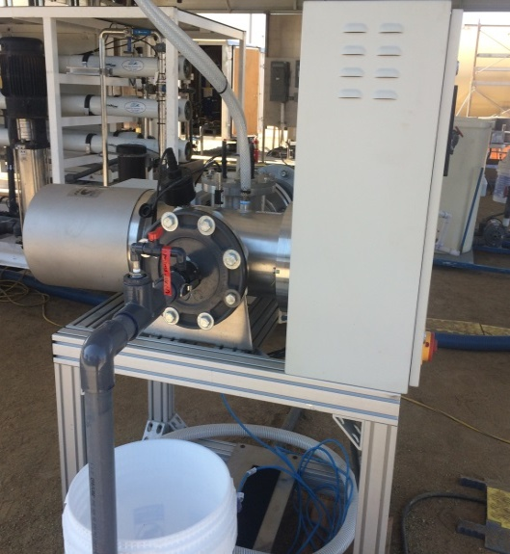
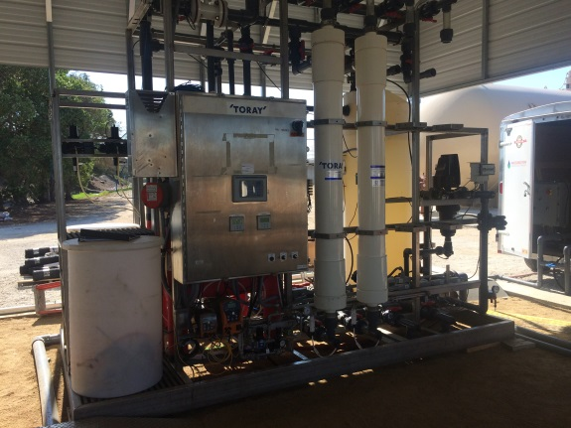
VenturaWaterPure Demonstration Facility Provides Opportunities
Visit State-of-the-Art Purification Facility
Learn about the Water Cycle and How Reuse Fits-In
Answer Questions about Potable Reuse Technologies and Where it is Being Applied
Demonstrate the Water Quality and Public Safety of the Supply
Notes:
The VenturaWaterPure Demonstration Facility provides the opportunities to
Visit a state of the art purification facility
Learn about the water cycle and how reuse fits in to Ventura’s water supply.
Answer questions about technologies, potable reuse and where else it is being applied
Demonstrate the safety of the supply produced

Slide 8
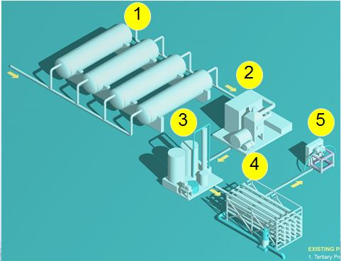
Water Purification Consists of a System of Treatment Barriers
Existing Sand Filters
Pasteurization
Membrane Ultrafiltration
Reverse Osmosis
Ultraviolet Light/ Advanced Oxidation
Notes:
In this rough overview of the VenturaWaterPure Demonstration Facility we can see the levels of barrier treatment processes that make up advanced treatment
The existing mixed media tertiary filters provide treated effluent water that is very low in turbidity.
The pasteurization process then provides disinfection to remove bacterial and viruses.
Ultrafiltration Membranes then provide a removal of microorganisms and particles to those larger than a human hair.
Reverse Osmosis removes salts, viruses and chemicals left in the process
With Ultraviolet Light and advanced Oxidation remaining pollutants are destroyed by breaking down cell walls and denaturing their DNA

Slide 9
VentureWaterPure – The Ways of Water

Slide 10
For More Information Contact Ventura Water at
Customer Care 805.667-6500, office hours: Monday -Friday from 9am to 4:30pm closed alternate Fridays
City of Ventura Website at www.venturawater.net
Follow Ventura Water on

