Slide 1
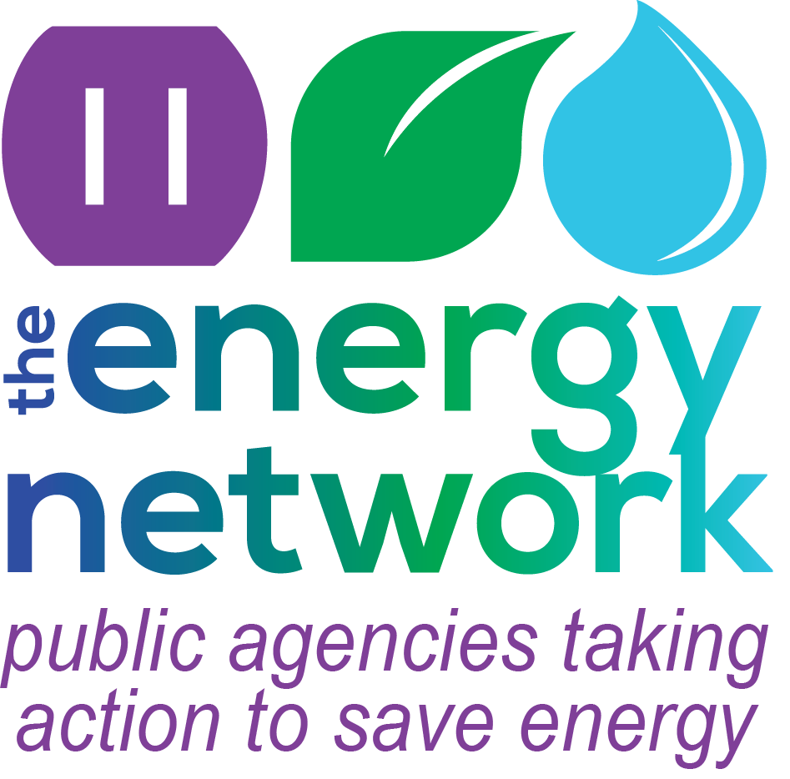
The Energy Network:
An Integrated Approach to Delivering Energy Savings to Public Agencies

Slide 2
What is The Energy Network?

Slide 3
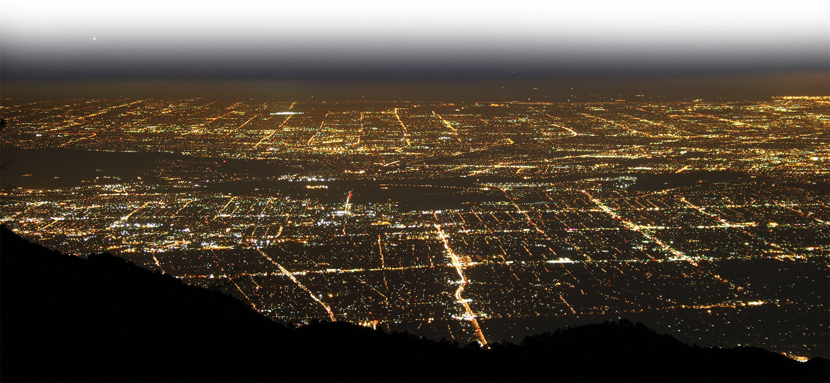
What is The Energy Network?
The Energy Network is a program that strives to achieve an unprecedented level of energy savings across Southern California by helping public agencies identify and implement projects

Slide 4
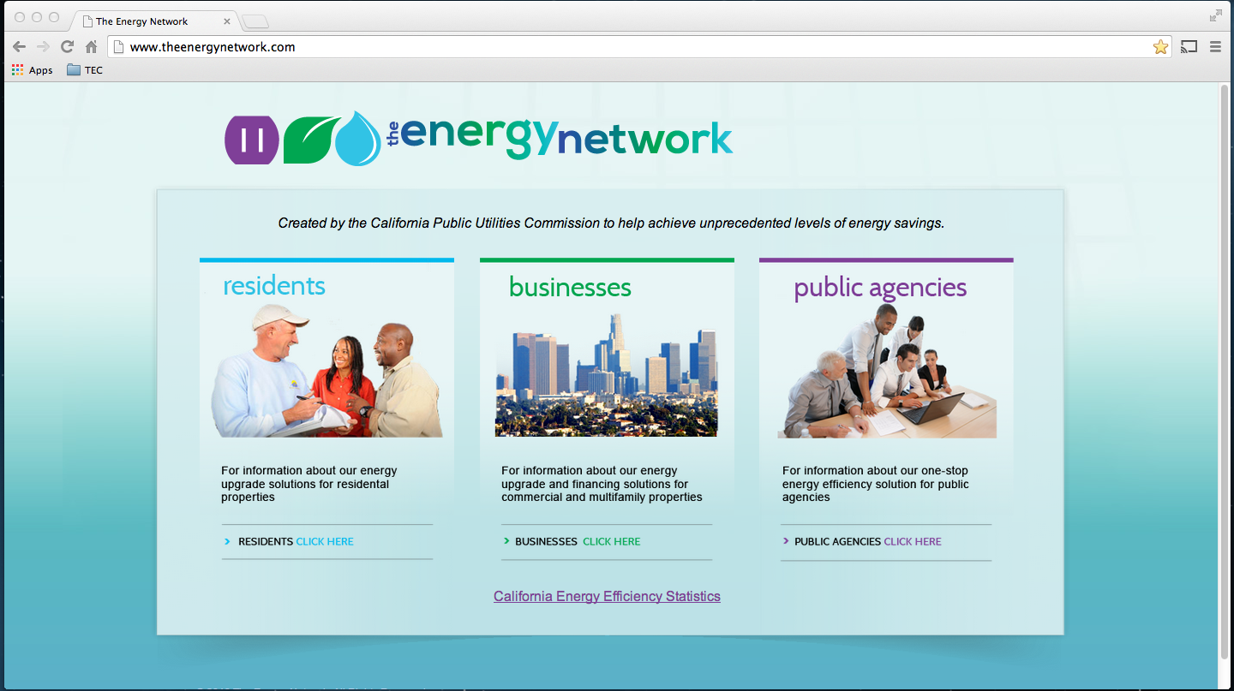
What is The Energy Network?
The Energy Network Offers public agencies, businesses and homeowners tools and resources that lead to energy efficiency

Slide 5
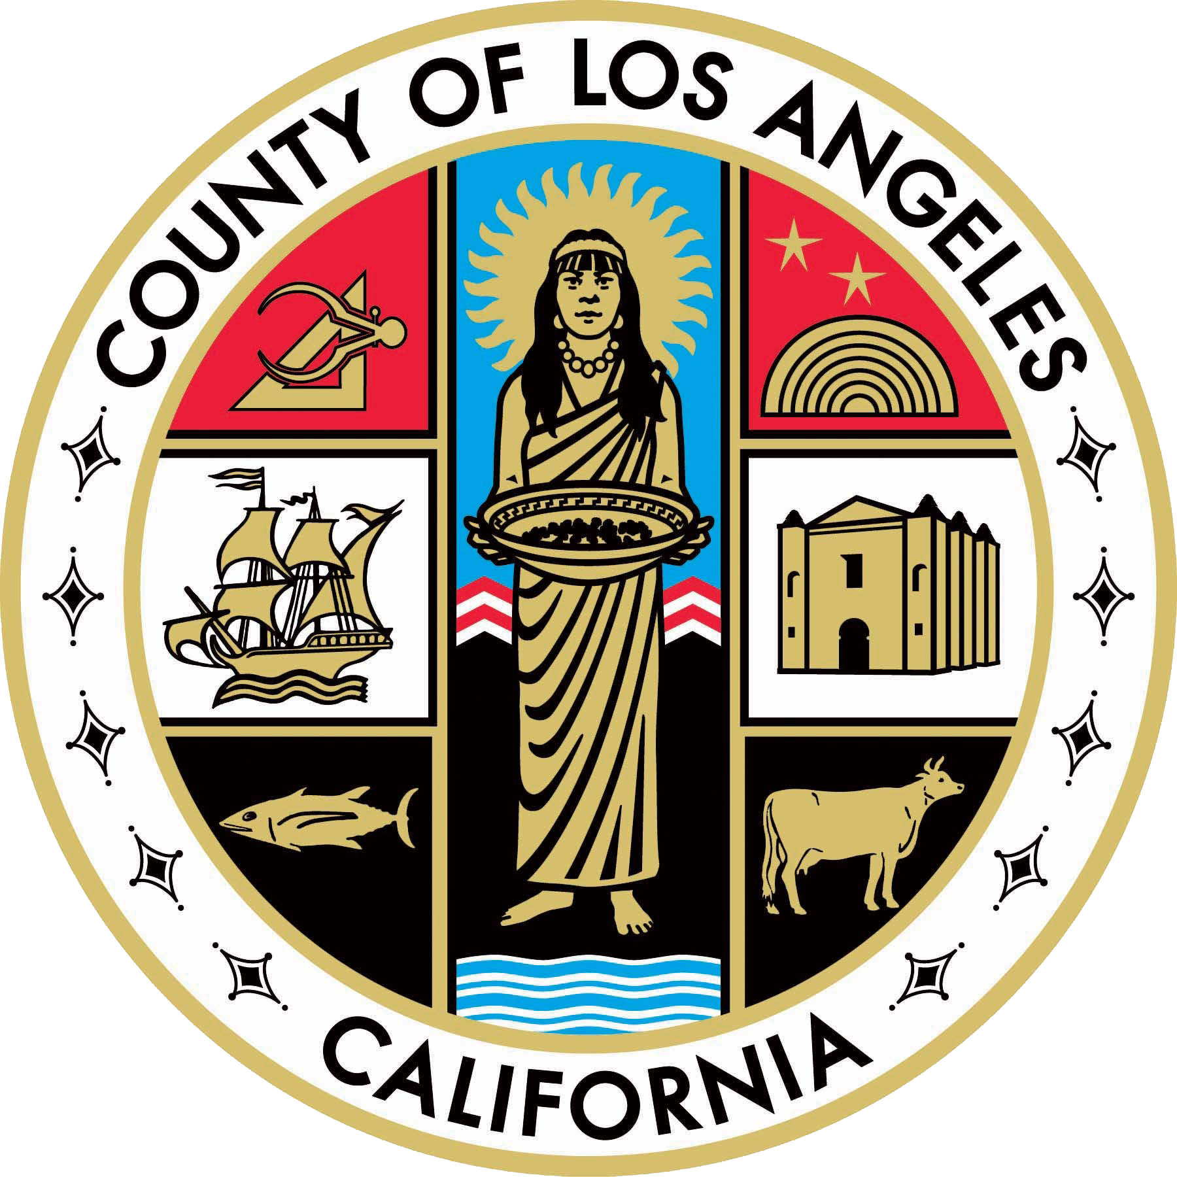
What is The Energy Network?
The program is administered by the County of Los Angeles and funded by California utility ratepayers under the auspices of the CPUC

Slide 6
Who is in The Network?

Slide 7
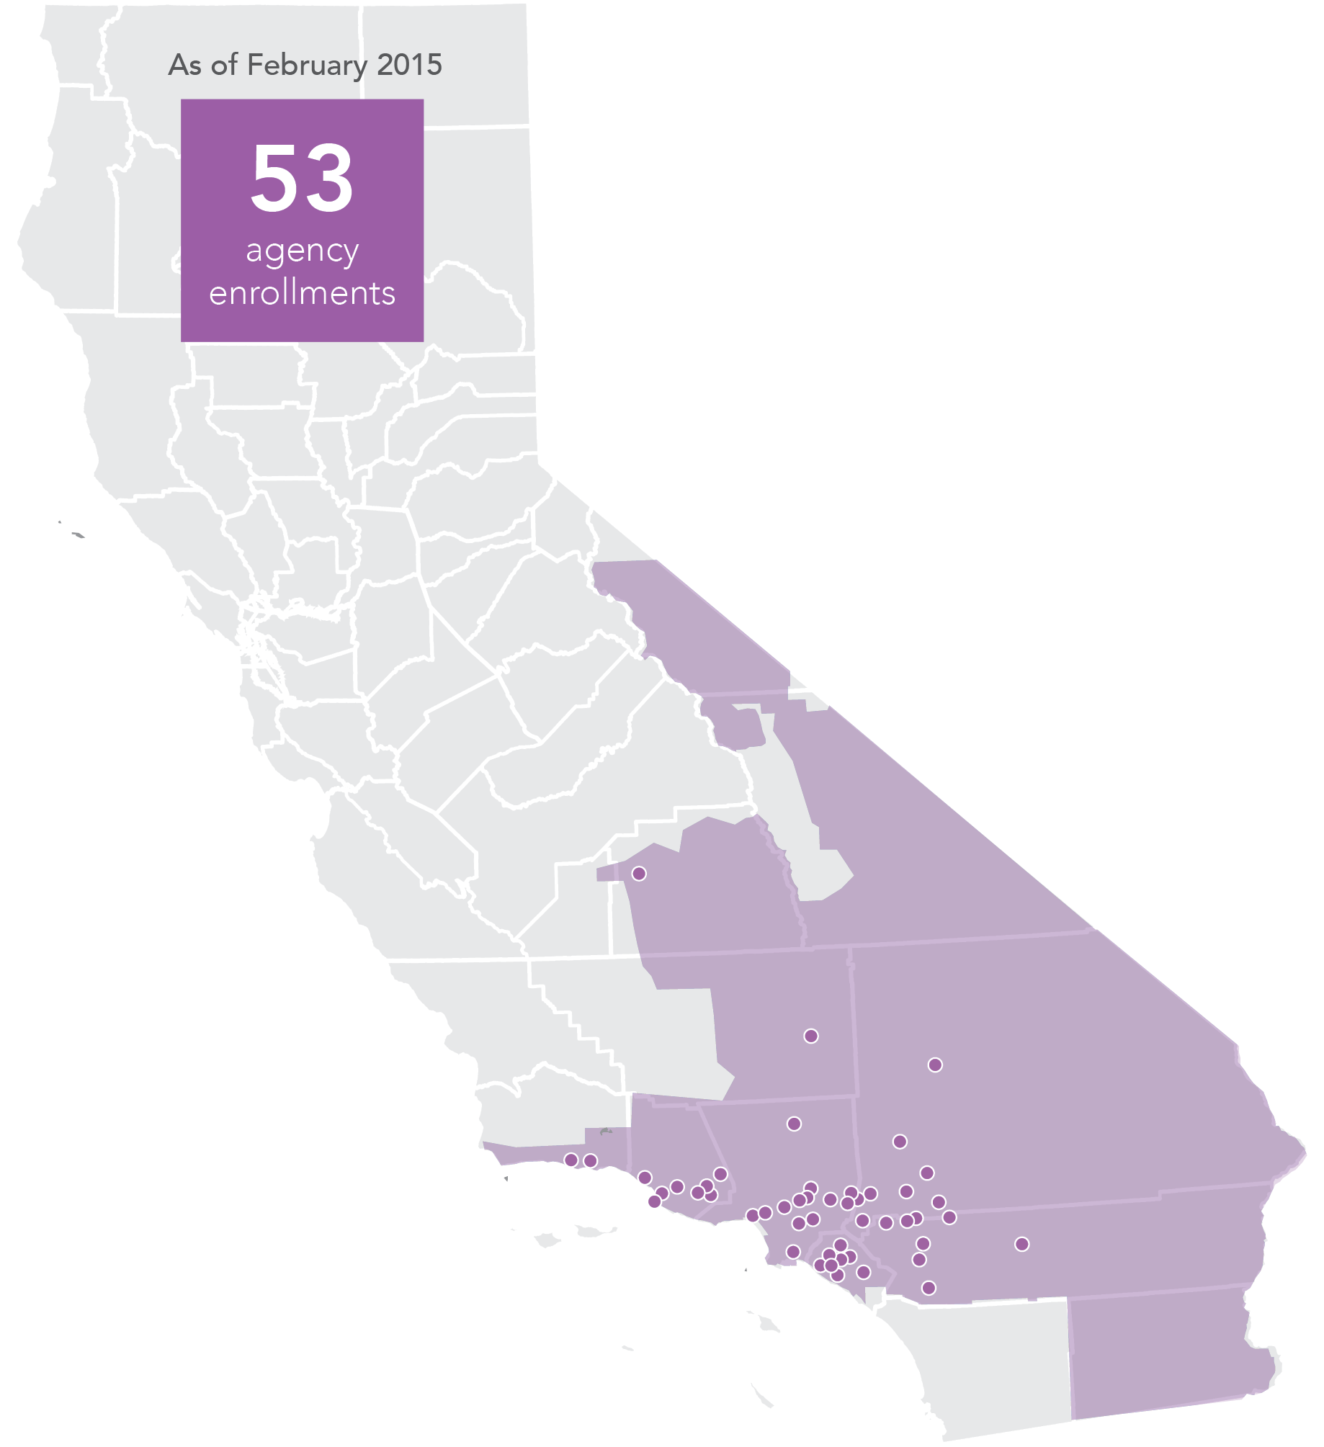
Who Is in The Energy Network?
As of September 2015
64
Agency Enrollments
2
Counties
13
Water Agencies
43 Cities
64
Agencies
2 School Districts
4 Special Districts

Slide 8
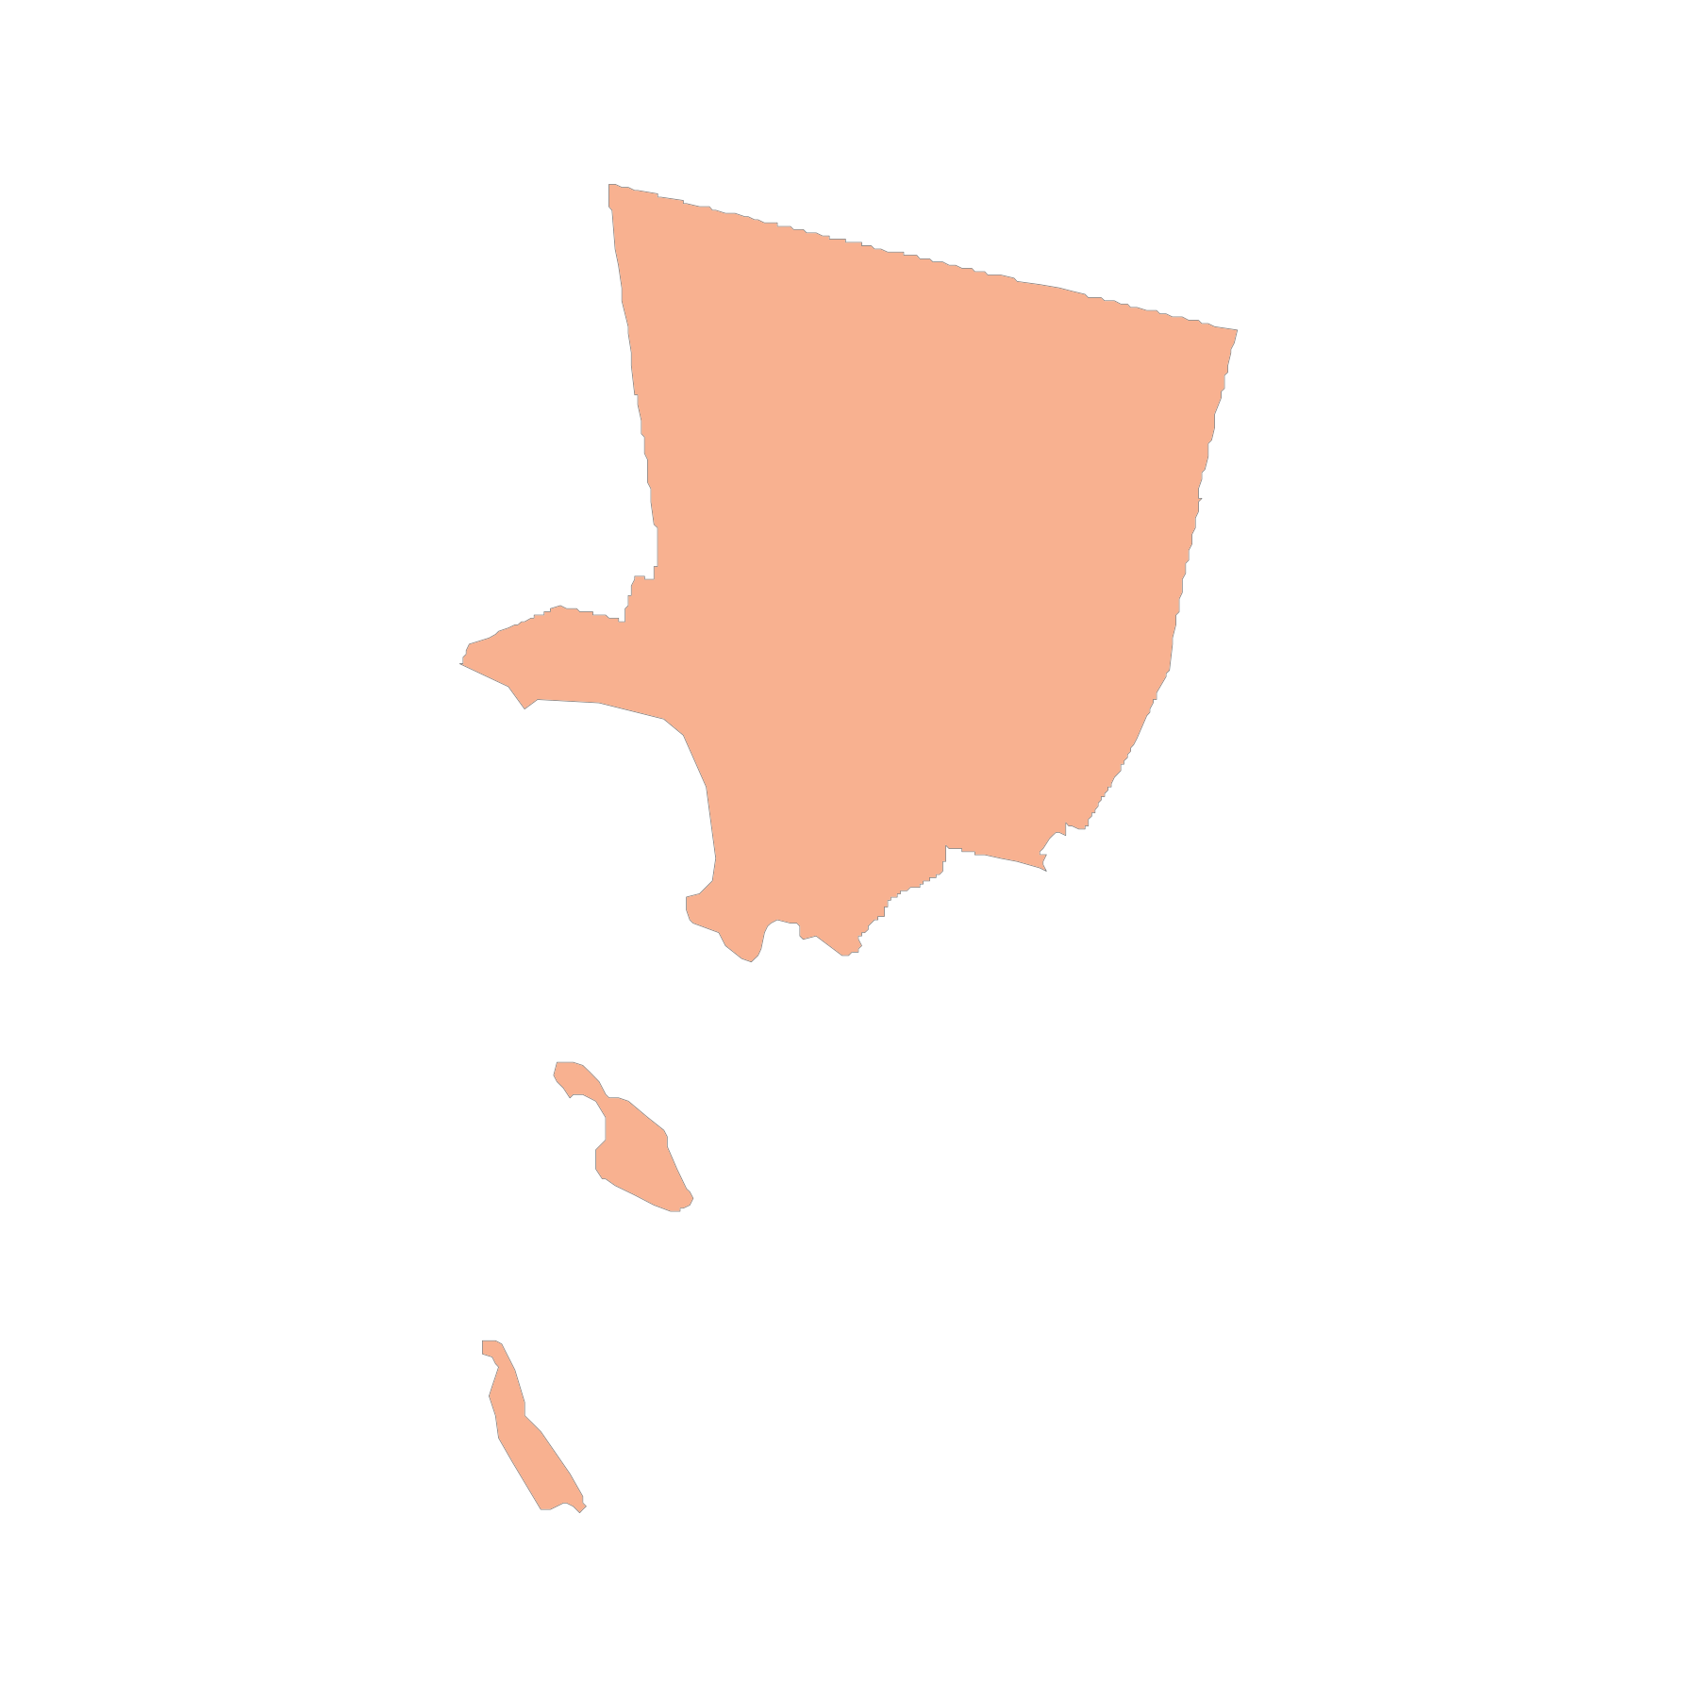
Los Angeles County
City of Alhambra
City of Arcadia
City of Claremont
City of Covina
City of Culver City
City of Downey
City of Long Beach
City of Los Angeles
City of Temple City
City of Palmdale
City of Pomona
City of Santa Monica
City of Whittier
County of Los Angeles

Slide 9
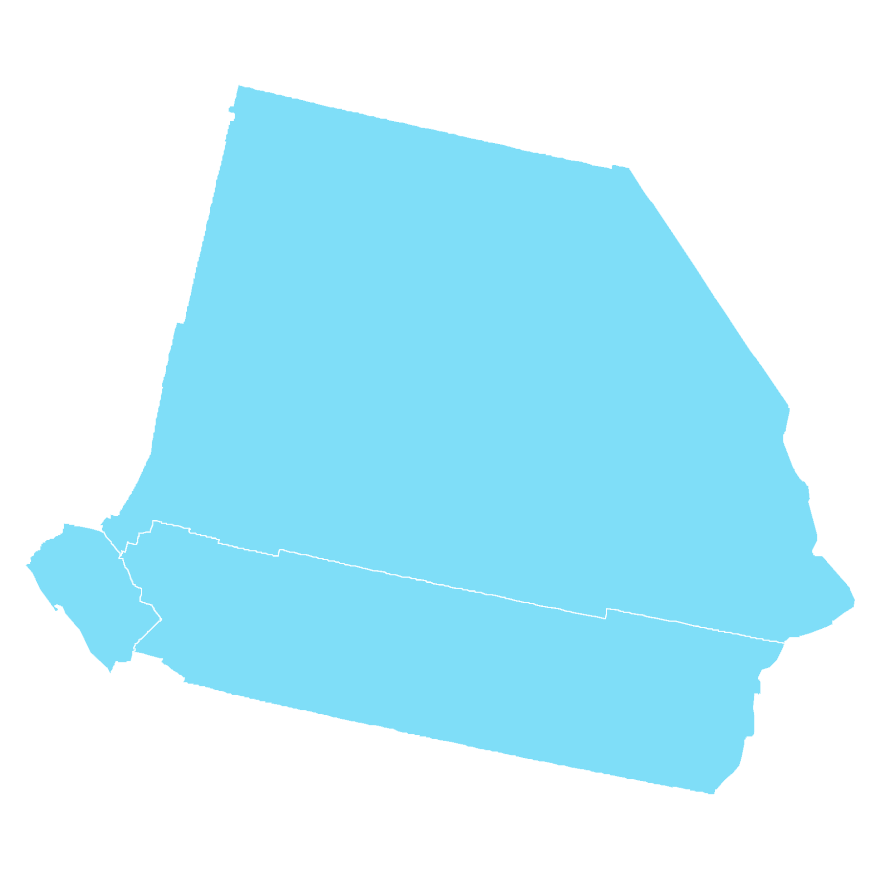
Orange County & Inland Empire
City of Barstow
City of Beaumont
City of Brea City of Hesperia
City of Huntington Beach
City of Irvine
City of Mission Viejo
City of Montclair
City of Moreno Valley
City of Murrieta
City of Newport Beach
City of Orange
City of Perris
City of Rancho Mirage City of Rialto
City of San Bernardino
City of Santa Ana
County of Orange
Cucamonga Valley Water District
Eastern Municipal Water District
Inland Empire Utilities Agency
Jurupa Community Services District
Lake Arrowhead Community Services District
Orange County Sanitation District
Running Springs Water District
Western Municipal Water District
Western Riverside County Regional Wastewater Authority
Yucaipa Valley Water District

Slide 10
Water Agencies
City of Los Angeles Bureau of Sanitation
Orange County Sanitation District
Inland Empire Utilities Agency
Cucamonga Valley Water District
Las Virgenes Municipal Water District
Western Municipal Water District
Western Riverside County Regional Wastewater Authority
Yucaipa Valley Water District
United Water Conservation District
Eastern Municipal Water District
Jurupa Community Services District
Lake Arrowhead Community Services District
Running Springs Water District
Ojai Valley Sanitary District

Slide 11
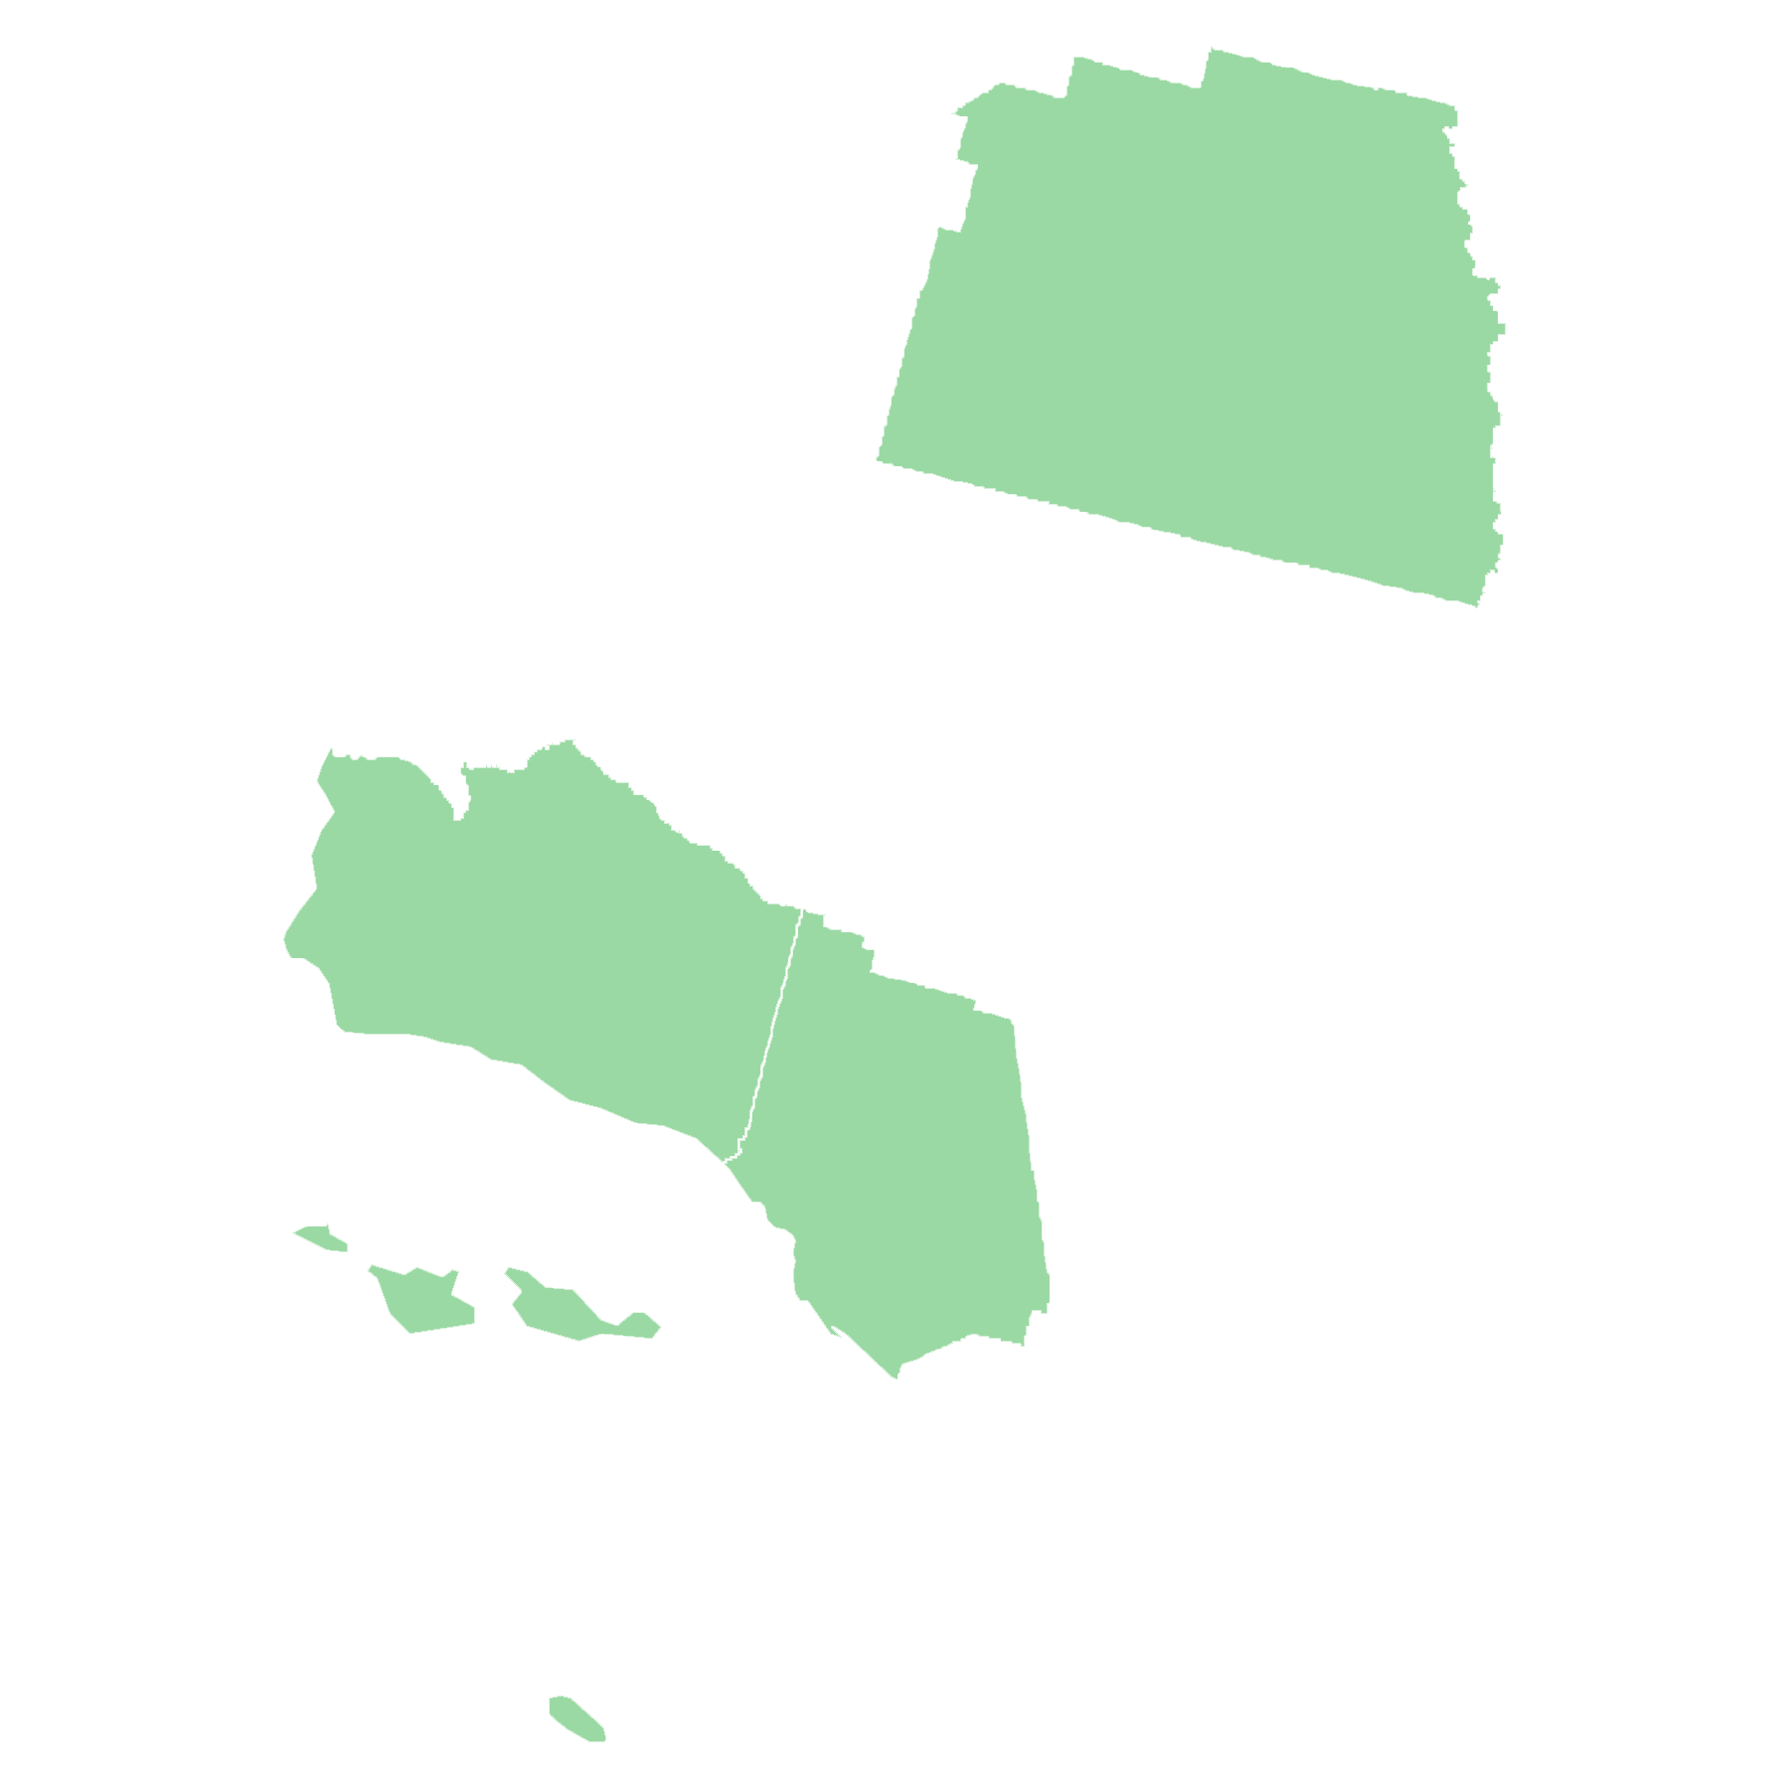
Kern, Santa Barbara, Tulare, Ventura Counties
City of Camarillo
CIty of California
City of Carpinteria
City of Goleta
City of Oxnard
City of Santa Barbara
City of Simi Valley
City of Thousand Oaks
City of Ventura
City of Visalia
Carpinteria Sanitation District
Conejo Recreation and Parks District
Conejo Valley Unified School District
Kern County
Ojai Valley Sanitary District
The Port of Hueneme, Oxnard Harbor District
United Water Conservation District
Ventura Unified School District
Goleta Sanitary District

Slide 12
What Can The Network Do For Public Agencies?

Slide 13
What Can The Network Do For Your Agency?
Project management
Energy use analysis
Energy audits
Project design and specifications
Construction management support
Expedited construction
Financial services
Energy management tools
Objective third party review
Trusted unbiased energy advisor
A full range of energy efficiency services:

Slide 14
What Has The Network Done For Public Agencies throughout SoCal?

Slide 15
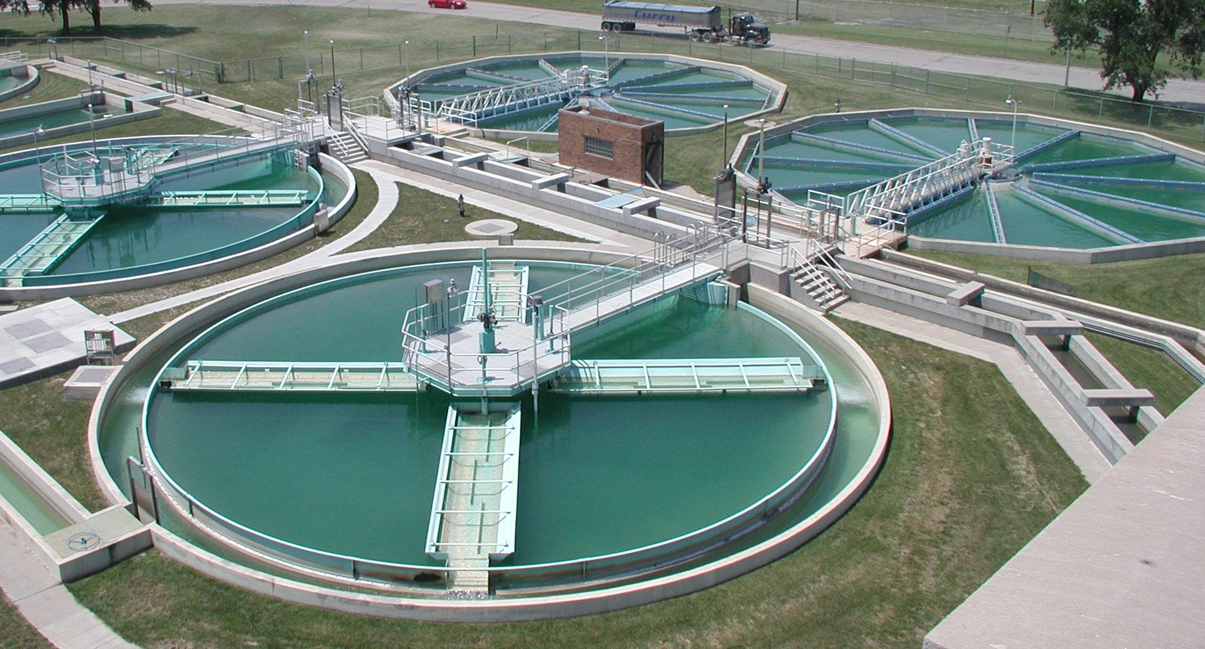
Areas of Expertise
Lighting
Mechanical
Streetlights & Outdoor Lighting
Water & Wastewater

Slide 16
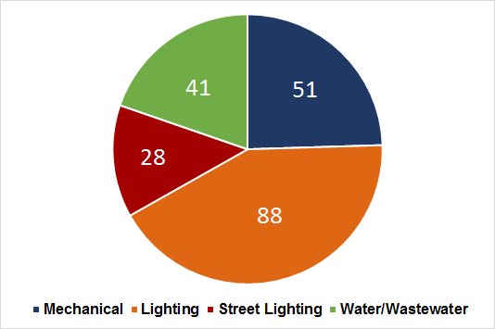
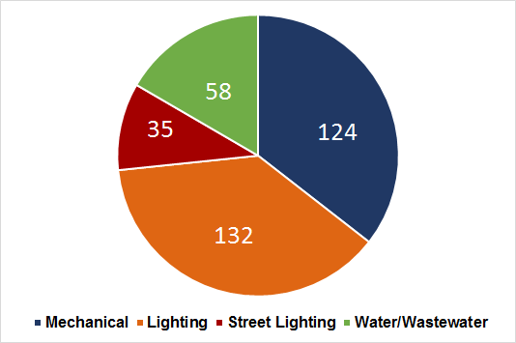
Areas of Expertise
Total Number of Active Projects (as of Sept 2015) | 208
Total Number of Projects Identified | 349

Slide 17
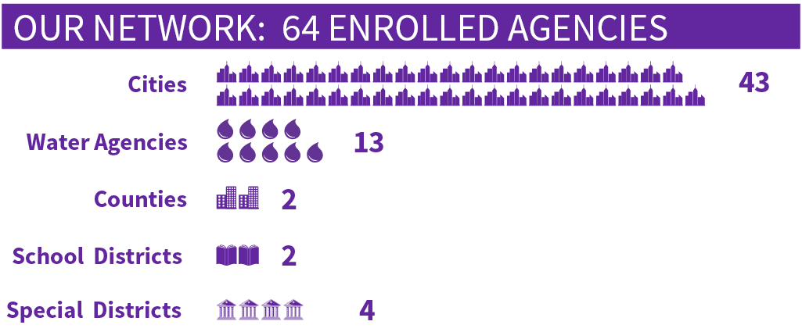
Collective Achievements
(As of Sept 2015)

Slide 18
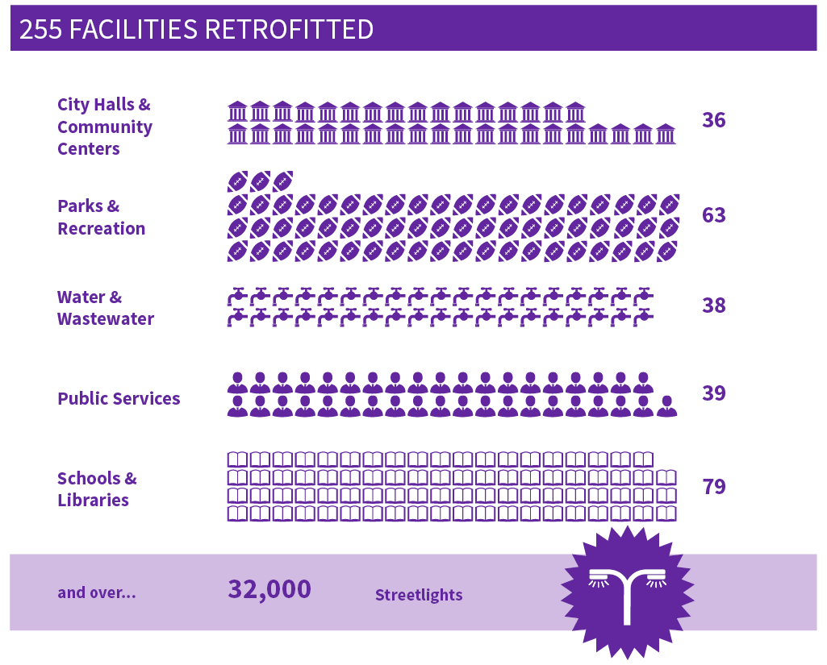
Collective Achievements
(As of Sept 2015)

Slide 19
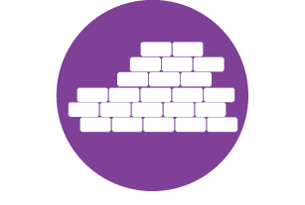
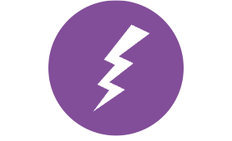
Collective Achievements
Together, Agencies in The Network have Collectively Achieved...
29K+ Tons of Greenhouse Gas Avoided | 1,063 Jobs Created | $94M Construction Value | 83M kWh Savings
(As of Sept 2015)

Slide 20
The Collaboration Ecosystem
COGs
&
LGPs
Non Profits
&
NGOs
Public
Agency
Public Agencies
Public Agencies
Non-Profits
&
NGOs
Public Agency
Joint Power Authorities
Special Districts
Joint Power Authorities

Slide 21
Barriers to Collaboration
The same barriers that hinder an agency form starting a project, also are barriers to interagency collaboration.
Limited resources
Limited knowledge
Limited staff time
Limited information
May not know the right questions to ask
May not know who to contact as a counterpart at another agency

Slide 22
The Energy Network’s Contribution
An unprecedented program providing a replicable, yet customizable, approach to resource-intensive asset management projects in public agencies.
Aggregating procurement and maximizing the buyer’s purchasing power.
Leveraging collective knowledge and experience across public agencies to improve sustainability and efficiency in utility management.

Slide 23
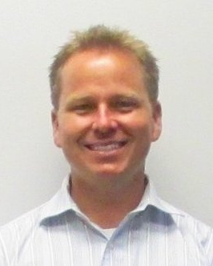
Panelists
Alelia Parenteau
Energy Analyst
City of Santa Barbara
Korey Lawson
Project Manager, Staff Engineer
AESC, Inc.
John Demers
Chief Operations Officer
Port of Hueneme, Oxnard Harbor District

Slide 24
The Energy Network
Thank you!
Douglas G. O’Brien
Program Manager
805-302-2035
dobrien@energycoalition.org

