Slide 1
Renewable Natural Gas
Central Coast
Sustainability Summit

Slide 2
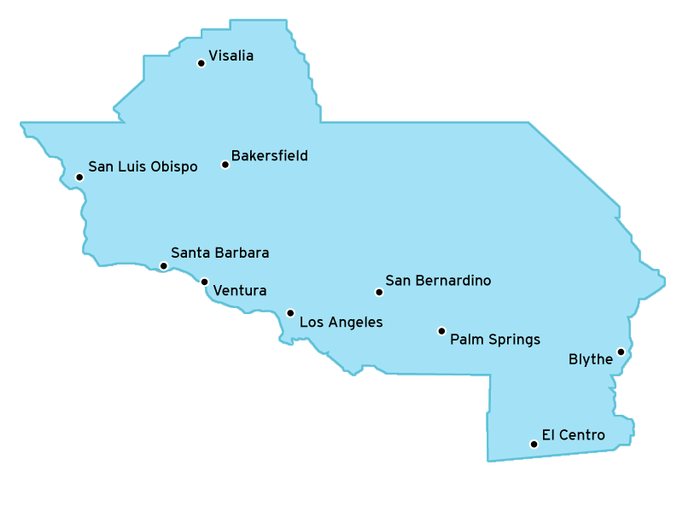
Southern California Gas Company
Largest natural gas distribution utility in US
Service territory of 20,000 square miles
Serving 20.9 million consumers through 5.8 million meters in more than 500 communities
Workforce of 8,500 employees
Notes:
Appendix
Here’s a quick overview of SoCalGas. For more than 140 years, we’ve been providing safe and reliable service to our customers.
We are the largest natural gas distribution utility in the U.S. with a service territory of 20,000 square miles.
We serve nearly 21 million consumers through 5.8 million meters in more than 500 communities with a workforce of 8,000 employees.
The safety of our customers, employees and the communities we serve is our top priority.

Slide 3
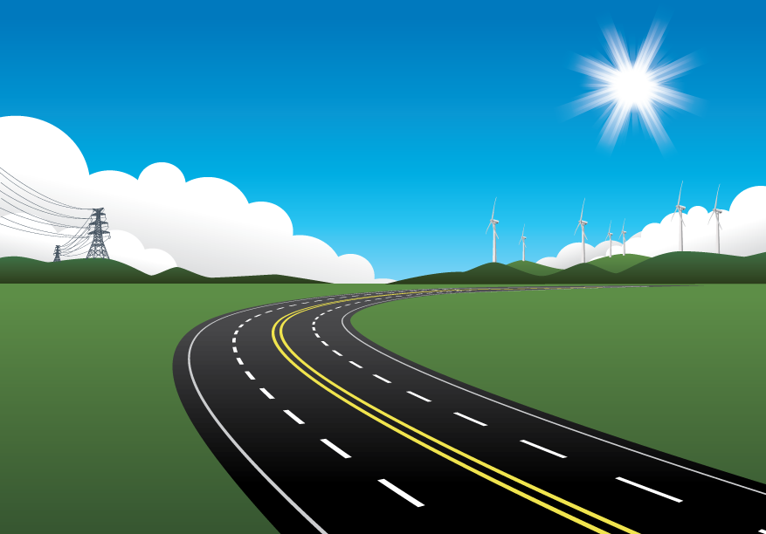

CA Climate Change Policy: Make Room for
“Near-Zero” End Uses and Low Carbon Gas
California focused on electrifying end uses and “de-carbonizing” electricity
  Electrify transportation
  Electrify energy end uses
  De-carbonize generation
SoCalGas focused on “near-zero” end use technology and exploring “de-carbonizing” the pipeline
  Near-zero NGV’s
  Near-zero gas technology
  New methane and hydrogen feedstocks/blends
Notes:
California’s Climate Change Policy: Make Room for “Near-Zero” End Uses and Low Carbon Gas
Regulators focus on “de-carbonizing” electricity.
SoCalGas focused on “de-carbonizing” the pipeline.
Over the mid- to longer-term, the use of renewable natural gas from existing agricultural feedstocks, waste water, and landfills, as well as hydrogen blends, will further lower the GHG profile of all natural gas applications. Purpose grown crops and algae will expand the potential of renewable natural gas, lowering its GHG profile even further.
New and smaller-scale hydrogen reformation technology can facilitate meeting today’s growing demand for hydrogen supply and refueling from the local natural gas distribution system. And tomorrow’s new power-to-gas technologies, like batteries, will help us store our excess renewable electric generation within the gas supply and delivery infrastructure, as well as enable us to directly use a low- to zero-carbon fuel for those natural gas applications we commonly use today.
In 2050, SoCalGas will remain a local distribution company managing customer demand for natural gas, renewable natural gas, low carbon gas, hydrogen and blends. There will continue to be demand for gas supply for a variety of residential, commercial and industrial uses, as well as for growing demand for transportation uses. The methane molecule may be compressed, liquefied, conditioned, reformed, decarbonized or blended, but it will continue to be delivered by pipeline to meet a growing complexity of energy demand from a growing complexity of end use applications.

Slide 4
De-carbonizing the pipeline
1
2
Biogas
Power-to-Gas
Landfills
Diverted Landfill
Waste Water Treatment Plants
Dairy Digester
Excess renewable energy converted into synthetic natural gas for storage

Slide 5


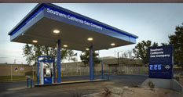


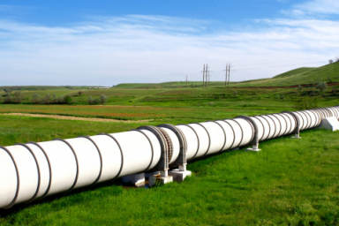
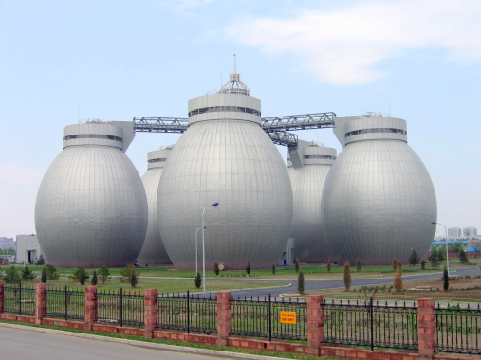
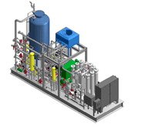
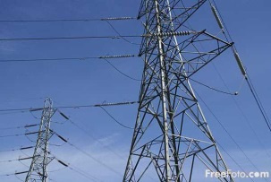
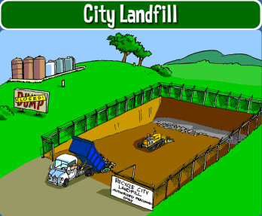
What is Biogas?
Photosynthesis
Food crops and other plants
On-site Vehicle Fueling
CO2 From Biogas Combustion
Animal/Organic
Waste
Farm Waste
Food Waste and Waste Water
Fertilizer/Soil Amendments
Pipeline Injection
Anaerobic Digester
Biogas
On-site Electric Generation or other heat use
Biogas
Biogas Conditioning
Notes:
Landfills
Largest source of biogas
Rule 30 revisions approved earlier this year allowing landfill gas on the pipeline
Landfill Diverted Organic waste
Fed into digester
Applicable Market: ~8.8 million tons of organic waste/year with an estimated biogas production of 72 million cubic feet per day
Wastewater Treatment Plants (WWTP)
Dairy Facilities
1.1 million milking cows
Over 800 dairies
Estimated biogas production - 71 million cubic feet per day

Slide 6
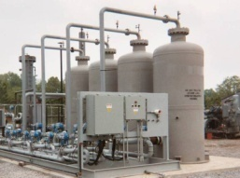
Biomethane Market: Differences Between Biogas & Renewable Natural Gas (RNG)
Onsite Use
“Condition” biogas to remove trace constituents to acceptable levels
Power Generation
Conditioned Biogas
Biogas
Boiler, Other
Offsite Use
Pipeline Injection
Renewable Natural Gas
(aka Biomethane, Pipeline Quality Gas or Conditioned/Upgraded Biogas)
Biogas Conditioning/ Upgrading Facility
Illustration for Landfill Diverted Waste | Biogas | “Conditioned” Biogas | RNG*
Gas Composition and Heating Value
CH4 | 62.0% | 62.0% | 98.5%
CO2 | 37.6% | 37.6% | 0.8%
O2, H2, N2, Others | 0.4% | 0.4% | 0.7%
Heating Value (btu/scf) | 625 | 625 | 990+
Two of the Key Trace Constituents
H2S | 300 ppm | 1 ppm | 1 ppm
Siloxanes | 4,000 ppb | 70 ppb | Non-detectable
6
  * Gas composition and trace constituent limits will/may differ by utility

Slide 7
CARB’s Low Carbon Fuel Standard
State determined carbon intensity scores for wastewater, landfill, and dairy gas lower than electricity

Slide 8
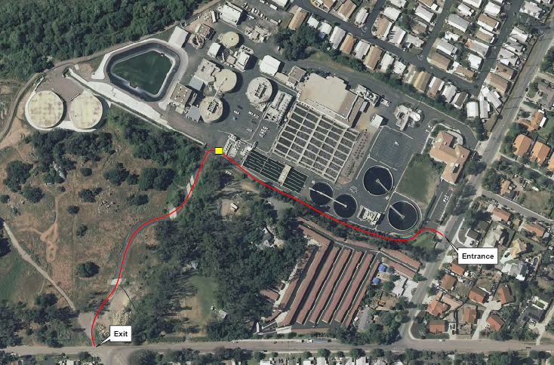
SoCalGas Biogas Upgrading Demonstration Project at the Hale Avenue Resource Recovery Facility (HARRF)
HARRF Information
  Wastewater treatment facility located in Escondido, CA
  Average Daily Flow ~ 15.6 MGD
  Biogas was being flared prior to start of demonstration project
  Biogas Production ~ 95 million cubic feet per year
  Biogas contains enough energy to supply ~1,200 homes

Slide 9
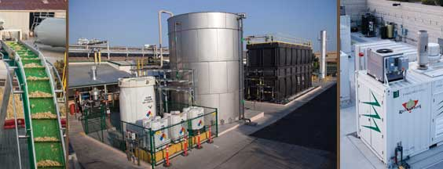
Gills Onions Waste to Energy
First food processing facility in the world to convert 100% of their daily onion waste into renewable energy and cattle feed
Advanced Energy Recovery System (AERS) began in 2009
Extracts juice from onion peels →fed into high-rate anaerobic reactor→produces methane-rich biogas → feeds 2 300-kW fuel cells
Notes:
Oxnard, CA
The resulting electricity is used to power the onion processing plant, saving an estimated $700,000 annually in electrical costs.
Additional savings come from the elimination of $400,000 in annual costs associated with hauling onion waste to farm fields. Greenhouse gas emissions are reduced through the elimination of hundreds of truck trips on California roadways that moved this waste stream each year. The result is increased energy independence, elimination of a significant waste stream, reduced operational costs and a smaller carbon footprint, with an estimated reduction of 14,500 metric tons of CO2e (equivalent) emissions per year.
The combination of the energy produced, cost savings generated and grant funding for renewable energy projects will result in a full payback of the $10.8 million total system cost in less than six years.

Slide 10
Biogas Conditioning Tariff
Summary: The BCS Tariff is a new utility tariff that allows SoCalGas to design, install, own, operate & maintain biogas conditioning/upgrading equipment on or adjacent to the customers premise
  SoCalGas will not own the biogas entering or the upgraded biogas leaving the biogas conditioning/upgrading facility
  For pipeline injection, customer must pay for all costs associated with the interconnection facilities
What is included in SoCalGas’ turnkey solution?
  100% of the upfront capital
  Biogas conditioning/upgrading facilities design
  Equipment and construction RFP
  Vendor selection and management
  Project/construction management
  Facility operation and ongoing maintenance
  Contract management
Notes:
Fun Fact: SoCalGas Biogas Conditioning Service Tariff is referenced in SB County’s Energy and Climate Action Plan:
“Southern California Gas (SoCalGas) has optional tariffs provided to customers that allow SoCalGas to construct natural gas infrastructure and equipment on customer property. These tariffs are fully compensatory services. For example, the Biogas Conditioning/Upgrading Services Tariff allows customers to plan, design, procure, construct, own, operate, and maintain biogas conditioning and upgrading equipment on customer premises”

Slide 11
Power-to-Gas
Projects are being developed in which surplus electricity is used to power electrolysers that will split water into its component parts, with the hydrogen being directly injected into natural gas pipelines for storage.
The concept has become known as “Power to Gas” or P2G
Notes:
As defined by the all knowing go-to source for every kind of information:
Wikipedia defines P2G as (read slide)

Slide 12
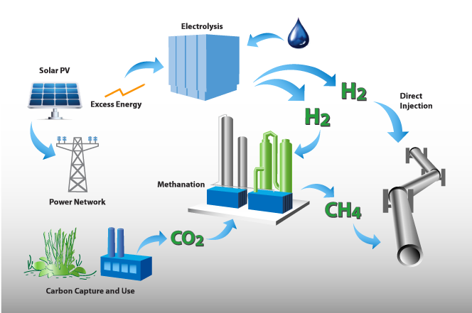
De-Carbonizing the Pipeline:
Electrolysis of Excess Renewable Electricity
(Power-to-Gas)
Notes:
Slide #14: Decarbonizing the Pipeline: Power to Gas.
Moving from geologic methane to hydrogen blends and synthetic methane.
Power-to-gas is another way of creating low/zero carbon fuel by directing renewable electricity that exceeds demand to power electrolysis of water (H₂O) – producing a stream of H2 gas and O2. The hydrogen can then be injected into the existing natural gas pipeline system and mixed with the other gas supplies, or it can be methanated from another supply of C02 and injected into the pipeline and delivered and used for all gas applications as a zero-carbon gas supply.

Slide 13
Hydrogenics Plant (Stuttgart, Germany)
Power-to-Gas Example
Nearby renewable energy powers an electrolyzer to produce H2 from water
Uses CO2 from
biogas plant
Produces methane, which is injected into pipeline
Notes:
Aggressive renewable energy penetration
Paying Sweden to offload electricity
Cycle its coal plants up and down to address duck curve , causing emissions that negate gains from solar
CA might soon be in similar generation
UC Irvine studies show that even with 50% renewable penetration by 2050, ozone concentrations in SoCal actually get worse due to fast ramping peaker plants
Offload to Nevada?
Projects are being developed in which surplus electricity is used to power electrolysers that will split water into its component parts, with the hydrogen being directly injected into natural gas pipelines for storage.
The concept has become known as “Power to Gas” or P2G
Power-to-Gas
Excess Renewables (no offloading to Nevada)
Through electrolysis, pull out the Hydrogen
Pump hydrogen into natural gas pipeline (testing up to 10-20%)
Or combine with Carbon source (Power Plant)
Create synthetic methane (CH4) and pump into natural gas pipeline (for electric generation, fuel cells, typical uses)
Imagine pipeline infrastructure as huge battery (infrastructure already paid for by YOU)

Slide 14
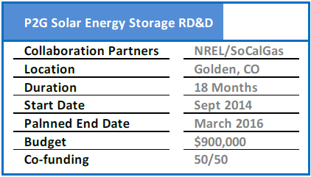
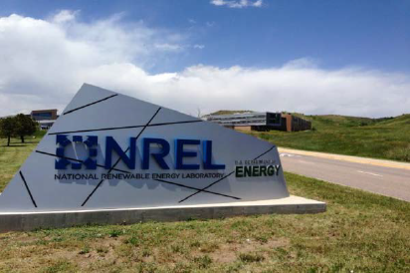
SoCalGas/National Renewable Energy Laboratory Project
Objective:
Enable higher penetrations of renewable energy generation using the natural gas pipeline system for energy storage
The project has two primary elements:
  Electrolyzer/methanation hardware characterization and testing in a full-up grid-simulation environment
  Modeling of P2G economics based on value provided to the grid in various operating scenarios
Deliverables:
Design, build, install, test and demonstrate systems for
  Electrolysis
  Methanation

Slide 15
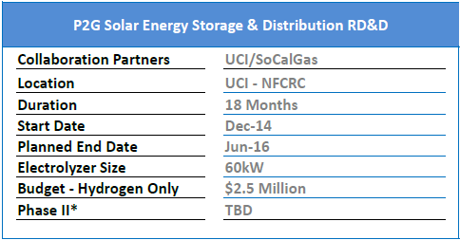
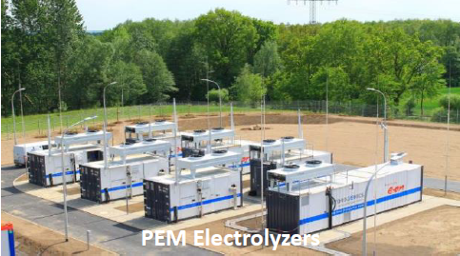
SoCalGas/UC Irvine Project
Purpose:
Develop a deep understanding of the physical, chemical and energy dynamic attributes of H2 blending necessary to achieve commercial P2G deployments for storage and distribution of excess wind and solar energy
This is logical next step from SoCalGas/NREL that focuses on P2G grid integration
Deliverables:
Design, build, install and test systems for:
PV and electrolysis integration
H2 blending and pipeline injection
Determine impacts of H2 injection on natural gas system components

Slide 16
Massive Energy Storage
Hydrogen energy can successfully store energy
Where can we storage the gas?
  Why not use the natural gas infrastructure?
Southern California Gas Company Storage
Alison Canyon (2,435,262,000 m3)
Honor Rancho (685,271,400 m3)
La Goleta (608,815,500 m3)
Playa del Rey (67,960,800 m3)
Notes:
Energy transport and storage is increasingly important
Existing natural gas infrastructure offers a high transport and storage capacity
Power to hydrogen and injection in the gas grid is attractive, especially if the local power grid capacity is insufficient
Many types of power generation is already connected to the gas grid (fuel cells, CHP)
Interaction between gas grids and power grids will increase
Smart communication and control systems are mandatory to create smart grids

Slide 17
THANK YOU
Geoffrey Danker, AICP
Senior Policy & Planning Advisor
gdanker@semprautilities.com

