Slide 1
Embedded energy of “new” water
Joshua Haggmark, Water Resources Manager
UCSB Sustainability Summit
October 14, 2015

Slide 2
Introduction
Water and Energy are the two most fundamental ingredients of Modern Civilization
No “New” Water, only untapped Sources – New Supplies
Water Supply Diversity – Balancing Vulnerabilities
Finding the Energy to drive diversity
Notes:
“New” water – a play on words because there is no such thing as new water, only new potential supplies. What I will be discussing today is the need to continue to diversify our water supply and with that will come the need for additional energy to power diversity.

Slide 3
Internal City Electrical Demand

Slide 4
Embedded Energy in Urban Water
Extract, store and convey raw water
Water treatment
Water distribution
Wastewater collection
Wastewater treatment
California Energy Commission estimates, 5% of all the energy consumed in CA was used on water. ¹

Slide 5
Climate Change
“Scientific studies indicate that extreme weather events such as heat waves and large storms are likely to become more frequent or more intense with human-induced climate change.” -U.S. Environmental Protection Agency. 2014. Climate change indicators in the United States, 2014. Third edition. (28)
Climate Change = Increased weather variabilities
Drier and wetter times
Paradigm Shift in Water Supply Planning

Slide 6
Water Supply Diversity
1980s
Current
Cachuma
Gibraltar/
Mission Tunnel
Ground-water
Cachuma
Gibraltar/Mission Tunnel
Desalination
Recycled Water
Conservation Program
State Water Project
Ground-water
Climate Change Resiliency

Slide 7
Potable Supplies

Slide 8
Average Electrical and Water Use
Single Family Residential Home
10,908 kWh/Year¹
.3 Acre-ft/Year²
Cater Water Treatment Plant
~220 kWh/acre-ft³
Water Distribution
~111 kWh/acre-ft³
Wastewater Collection
~15kWh/acre-ft³
El Estero Wastewater Treatment Plant
~549kWh/acre-ft³
Notes:
We haven’t yet come to a consensus on the energy requirements associated with Ortega. The treatment energy noted in this slide is from the UCSB embedded energy report and reflects energy expenditures at Cater.

Slide 9
Surface Water
Cachuma and Gibraltar Reservoirs
Gravity-fed, low energy demand
Vulnerabilities:
Rainfall Dependent
Water Quality
Siltation
Environmental Concerns
Isolated from South Coast
~220 kWh/acre-ft¹
Notes:
Kwhr/acre ft numbers are all taken from the UCSB study. They do NOT include treatment or distribution

Slide 10
Groundwater
Basins
Storage Unit 1
Storage Unit 3 – Non Potable
Foothill Basin
Local Supply
Vulnerabilities:
Limited Supply
Contamination
Seawater Intrusion
Infrastructure Maintenance
400-1,200 kWh/acre-ft¹
Includes energy requirements for pumping and possible treatment. Higher end of range represents significant treatment.
1. Equinox Center (2010). San Diego’s Water Source: Assessing the Options
Notes:
-the 991 number does not include treatment at Ortega or distribution. This number seems quite high especially compared to SD’s numbers. We are working updated numbers for groundwater pumping and treatment.

Slide 11
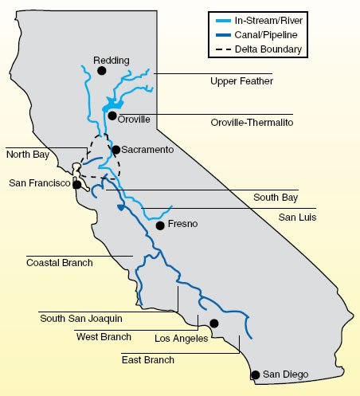
State Water
Water is pumped from the Sacramento Delta down to Santa Barbara
Vulnerabilities:
Natural Disasters
Rainfall Dependent
Environmental Concerns
3,139kWh/acre-ft¹
Notes:
2919kWh/AF for conveyance and

Slide 12
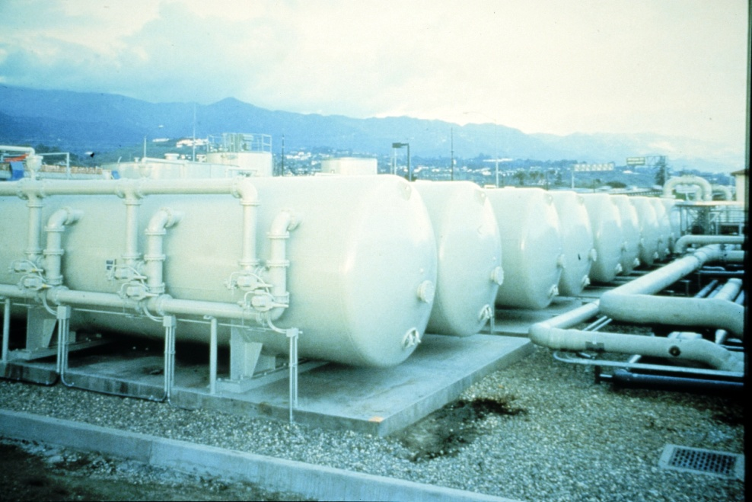
Desalination
Online in fall 2016
Initial Start-up Capacity 3,125 AF/yr
Local Supply
High Quality Water
Vulnerabilities:
Energy Usage
Environmental Concerns
4,414 kWh/acre-ft¹
1. IDE’s maximum guaranteed electrical usage

Slide 13
Desal Electrical Usage

Slide 14
Non-Potable Recycled Water
Built in 1988 and one of the first in the State
New Recycled Water Plant coming online
Improved water quality to meet current and future regulations
Increased electrical demand
Vulnerabilities:
Limited Uses
Parallel Infrastructure
Subsidized
~1000 kWh/acre-ft (estimate for new plant)
Elings Park
Notes:
The 1066 number assumes RW treatment and pumping accounts for 15% of El Estero energy consumption. (It is total treatment energy, not just additional treatment energy expenditures above normal effluent.)
Subtract 566kWH from 1066kWh = 500 kWH/AF for Recycled Water – Seems low given the technology

Slide 15
Conservation
Water Usage going into the drought - 20% below usage in the mid-80’s.
State Mandated Drought Goal – 12%
Since declaring a Stage 2 – Averaging greater than 25% reduction
Leader in Conservation
Water Budgets for Irrigation Customers
Free Water Check-ups
Tools and Rebates
~0 kWh/acre-ft¹
www.WaterWiseSB.org
1. Equinox Center (2010). San Diego’s Water Source: Assessing the Options

Slide 16
Potable Reuse Potential “new” water for Santa Barbara
Direct and Indirect Potable Reuse
Feasibility Study Now Underway
Regulations
Potable Reuse
Not without its own energy requirements
1,500-2,000 kWh/acre-ft¹
IPR would require additional energy for groundwater extraction and treatment
DPR energy requirements are still uncertain until regulations are developed
1. Equinox Center (2010). San Diego’s Water Source: Assessing the Options

Slide 17
Embedded Energy Range
Energy values include treatment and distribution. Based on San Diego’s water supply and distribution system.
Notes:
-The range shown in the GW bar reflects different treatment needs –low end is no treatment high end is RO treatment.
-Important to note that these numbers are tailored to San Diego’s system. They do provide a helpful frame of reference.

Slide 18
Summary
Diversity of water supplies add resiliency to a water supply portfolio by reducing dependency on any one source
Each supply comes with their own set of trade offs
Typically, energy is the trade off for reliability
Potable reuse, not a matter of if but when, will require significantly more energy then surface water
Climate Change = Increased weather variabilities

Slide 19
Santa Barbara and Sustainability
Commitment to sustainable energy sources:
El Estero Cogen Plant
Provides 60% of the plant’s power needs
Gibraltar Hydroelectric plant
1657 MWh/year
Solar at the Public Works Corporate Yard
539 MWh/year
Potential Future Energy:
Micro turbines in the distribution system
Solar at reservoir sites
Purchasing Power from Sustainable Sources - Community Choice Aggregate
Notes:
Pic→ cogen
Be sure to mention that Water Resources has put $50k on behalf of the City towards the feasibilty study of central coast Community Choice Energy consortium

Slide 20
Questions?

