Slide 1
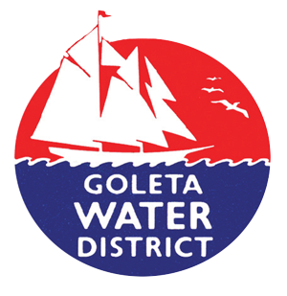
Maximizing Water Supply Sustainability for the Goleta Valley
2015 Central Coast Sustainability Summit
October 2015
Ryan Drake
Water Supply and Conservation Manager
Notes:
Recycled Water: Saving Every Drop Twice Conservation is Critical Sustainable Water Management: Investigating Recycled Water Potential

Slide 2
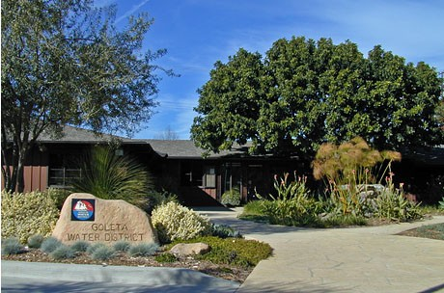
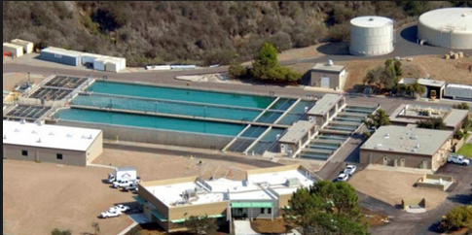
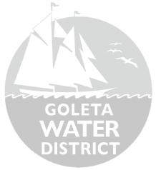
Goleta Water District
Established in 1944
5-member elected Board
Provides water to more than 87,000 people in the Goleta Valley
270 miles of pipeline, 7
active wells, 8 reservoirs
Service area spans
29,000 acres
Corona Del Mar Water
Treatment Plant
Notes:
GWD investment in water supplies, infrastructure, and ongoing conservation has resulted in both a robust and diverse water supply portfolio and the lowest per capita water use on the South Coast, presently at 50 gallons per capita per day.

Slide 3
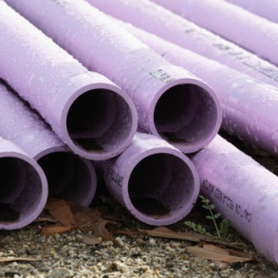
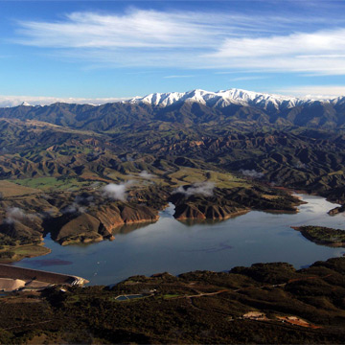
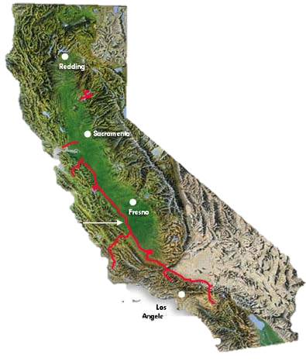
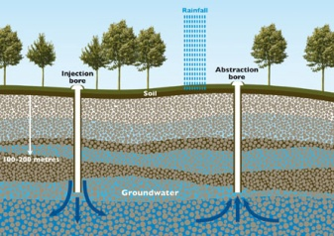
Normal Water Supply Sources*
*Normal Year
Notes:
Snapshot of District water supplies
The District’s water supply portfolio is made comprised of 4 sources: Lake Cachuma, Groundwater, State Water, Recycled Water.
The numbers you see here are normal year supply numbers which can vary in wet or dry years. For example, in the current water year, which started October 1, 2015, the District has about ¼ of its normal Cachuma supply available to it in the form of carryover water (0% allocation this year). Cachuma water available the District is using approximately 4,000 AF of stored State Water, 3,000 AF of groundwater, and roughly 6,500 AF to meet the higher than normal demand we have seen during this extended dry period. The unused portion of our Cachuma entitlement (almost 3,000 AF) will be available to the District in the next water year.

Slide 4
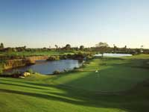
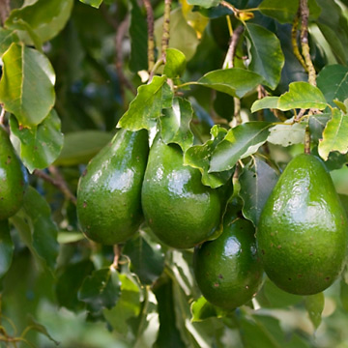
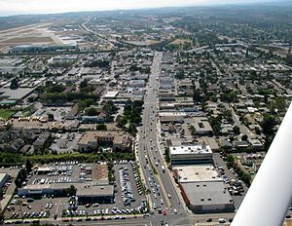
Water Uses in the Goleta Valley
Landscape
Irrigation
11%
Agriculture
21%
Urban
68%
Notes:
Snapshot of District water Use
The District primarily serves Urban customers (residential, commercial, and institutional). The District also serves agriculture which makes up 21% of total water use primarily for avocados and citrus. Remaining use is for landscape and recreation irrigation for common space, local parks, and athletic fields.
The District’s water supply portfolio is made comprised of 4 sources: Lake Cachuma, Groundwater, State Water, Recycled Water, and exceeds normal demand which can range from approximately 12,000 AF to 14,000 AF in normal years.
The numbers you see here are normal year supply numbers which can vary in wet or dry years. Note how the District is shifting to majority Groundwater with little Lake Cachuma and State Water.

Slide 5
Recycled Water in the Goleta Valley
Notes:
Since 1995 the Goleta Water District, in partnership with Goleta Sanitary District, has delivered approximately 1,000 AF of recycled water per year.
This partnership began as a result of the devastating drought in the early 1990s. Recognizing the need for a source of drought proof water supply, Goleta Water District built and agreed to pay to maintain the recycled water plant. Goleta Sanitary District operates the plant, and the Goleta Water District handles the distribution system that serves recycled water to customers.

Slide 6
What is Recycled Water?
Wastewater treated to different levels for various intended uses ranging from landscape irrigation, toilet flushing, and groundwater recharge
Treatment involves chemical mixing, flocculation, carbon filters, and disinfection
Flocculation Tank
Contact Tank
Secondary Effluent
UCSB
Golf Courses
Schools
Mixing Tank
Filters
Storage

Slide 7
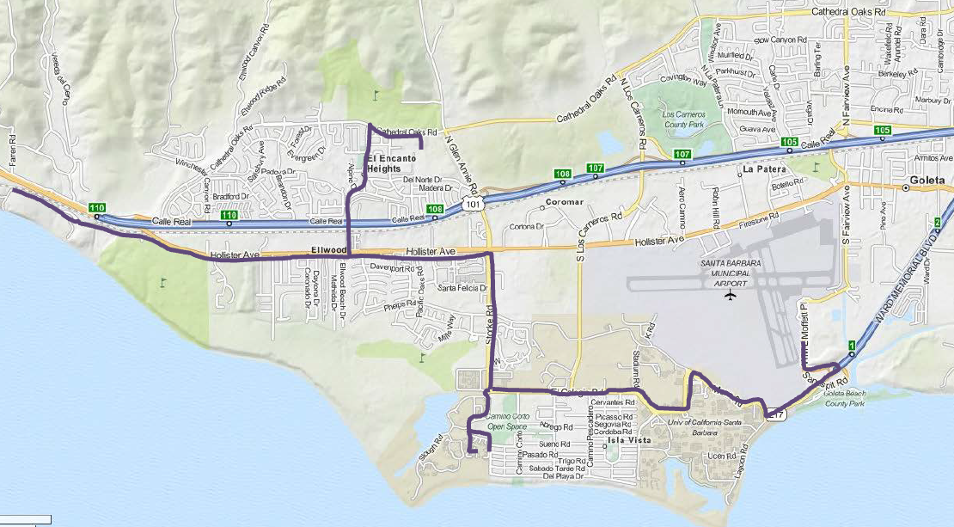
Goleta Recycled Water System
As a result of the drought in the 1990s, the Goleta Water District and the Goleta Sanitary District recognized the need
for a drought-proof water supply.
Notes:
Since 1995 the Goleta Water District, in partnership with Goleta Sanitary District, has delivered approximately 1,000 AF of recycled water per year.
This partnership began as a result of the devastating drought in the early 1990s. Recognizing the need for a source of drought proof water supply, Goleta Water District built and agreed to pay to maintain the recycled water plant. Goleta Sanitary District operates the plant, and the Goleta Water District handles the distribution system that serves recycled water to customers.
Today:
Over 9.5 miles of steel RW mains
Delivers approximately 1,000 AFY of water to 30 customers, including UCSB, golf courses, parks, primarily for landscape irrigation
Treatment train by Goleta Sanitary District, including 3.3 mg reservoir
2 RW booster pump stations to distribute water
System originally constructed in the 1990s
Currently delivers approximately 1,000 AFY

Slide 8
Collaborative Partnership to Serve Community
Since 1995, 1,000 AF treated and
distributed annually
Goleta Water District built and pays to
maintain the recycled water plant at
Goleta Sanitary District
Recycled Water Treatment
Distribution to Users
Notes:
This relationship serves as an example of how agencies can work together to reduce waste and increase water supplies to serve a parched state.

Slide 9
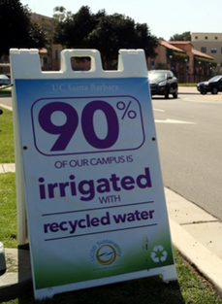
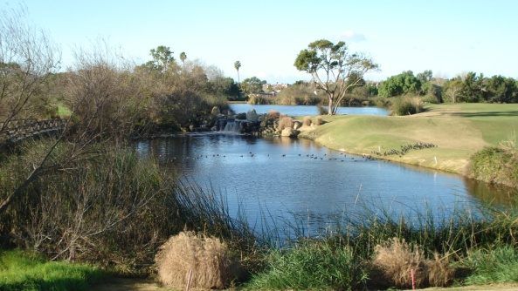
Recycled Water Distribution
Treatment capacity of 3,000 AFY, of which 1,000 AF is used each year
UCSB recycled water use saves 19.5 million gallons of potable water each year!
Approved Uses in Goleta Valley
Landscape Irrigation
Toilet Flushing
Industrial Cooling
Hauling and Dust Control
Large Customers:
UCSB – 90% of Campus Irrigation 19.5 million gallons
Sandpiper Golf Course & Glen Annie Golf Course
Goleta Union School District
Goleta Beach Park
US Post Office
Notes:
The recycled water project currently has a seasonal treatment and distribution capacity of approximately 3,000 AFY, of which 1000 AF is used each year. Recycled water costs $707 per acre-foot.
Current capacity: The recycled water project (treatment and distribution) currently has a seasonal treatment and distribution capacity of approximately 3,000 AFY. The recycled water plant has a design capacity of 3 million gallons per day (mgd), which is about 9 acre-feet per day.
Every gallon of recycled water is a gallon of potable water that we’ve been able to save for essential uses, improving supply reliability and keeping costs lower for customers.
The largest customers are UCSB, Sandpiper Golf Course, and Glen Annie Golf Course. UCSB uses recycled water for 90% of its campus irrigation, which saves approximately 19.5 million gallons of potable water every year.

Slide 10
Future of Recycled Water Use
As the drought continues, wastewater not currently being used represents a significant drought-proof source of potential water supply.
Increasing focus on advanced treatment rather than distribution build out.
Potential opportunities for:
Direct Potable Reuse
Indirect Potable Reuse
Notes:
As the drought continues, GWD and GSD are cooperating to look at new technologies and opportunities to fully utilize recycled water. The wastewater not currently being used represents a significant drought-proof source of potential supply for the community.
The expansion of traditional “purple pipe” systems that distribute recycled water to users through a parallel system is often cost prohibitive. In response, other communities are increasingly focusing on advanced treatment technologies rather than simply expanding the distribution system build-out in order to fully utilize recycled water.

Slide 11
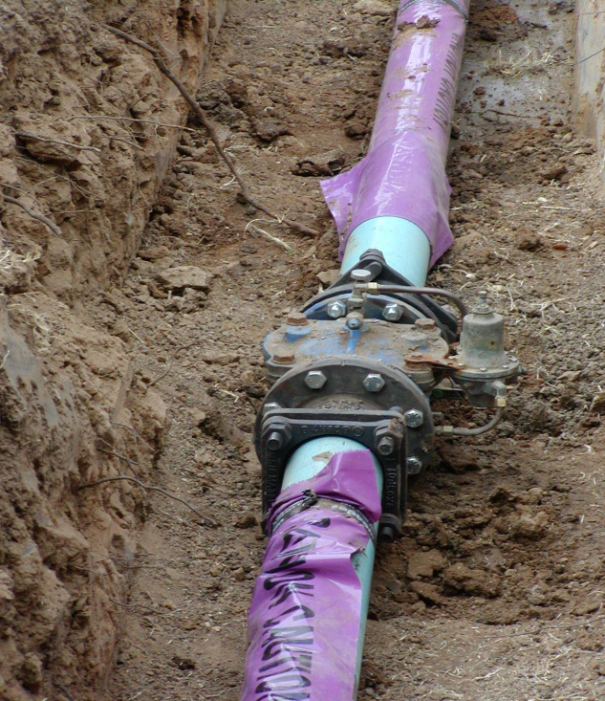
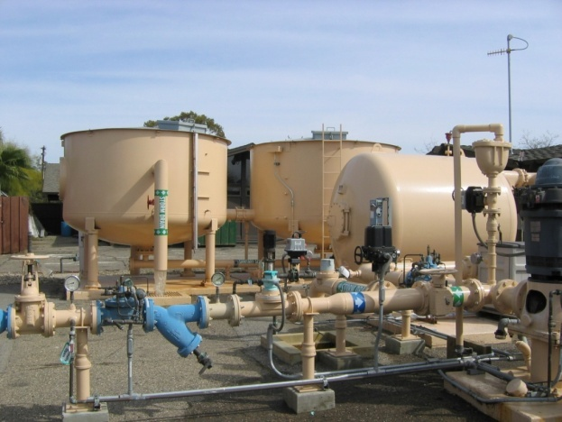
Direct Potable Reuse (DPR)
DPR introduces highly treated wastewater either to:
The potable water treatment plant, or
The distribution system (blending with potable)
Benefits:
Reliable water supply
Less wastewater discharged into the ocean
Less costly – Treatment system at existing Recycled Water Plant can be upgraded
Notes:
“Water should not be judged by its history, but by its quality” Dr. Lucas van Vuuren

Slide 12
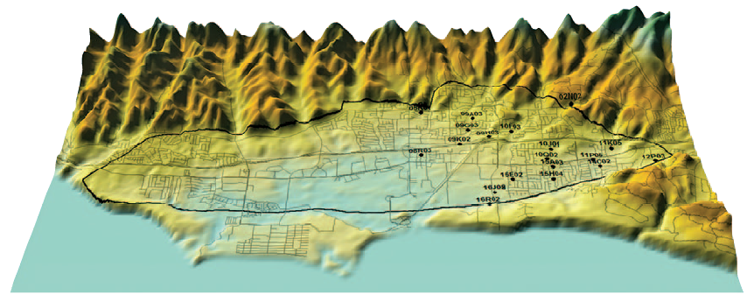
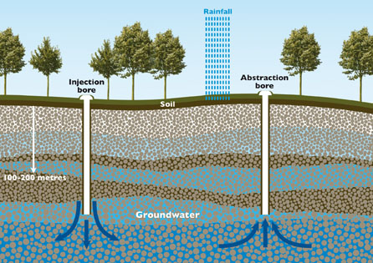
Stage II Demand Reduction Strategy
Indirect Potable Reuse (IPR)
Highly-treated wastewater discharged directly into groundwater or a surface reservoir with the intent of being extracted for potable water supplies.
Benefits:
Stored Water Supply
Natural underground
treatment
Prevents groundwater
overdraft or diversions of
natural water sources

Slide 13
Recycled Water Expanded Use Feasibility Study
Goleta Water District and Goleta Sanitary District currently planning a feasibility study to determine potential for:
Direct potable reuse of recycled water
Indirect Potable Reuse to recharge groundwater basin
Or, to serve as a possible supplemental source of potable water for customers.
Feasibility studies will examine water quality, water production relative to cost, and more through pilot projects.

Slide 14
More Information Online
www.GoletaWater.com
www.GoletaSanitary.org
www.WaterWiseSB.org

