Slide 1
Leveraging Cross-Sector Partnerships to Accelerate Tri-County Energy Impacts
October 14, 2015
Notes:
My name is Angie Hacker and I’m the Division Chief of the Energy and Sustainability Initiatives at Santa Barbara County, and one of the programs I oversee is emPower Central Coast, the Tri-County’s building efficiency and clean energy program… Who has heard of us? Actually who hasn’t heard of us? My team is going to track you down to study how on earth you’ve managed to hide from our ample outreach efforts.
I’ve also taught an energy course here at UCSB and it’s great to be back on campus. I appreciate the opportunity to be here with you all today on a panel about energy issues in the Central Coast. My presentation is going to focus specifically on how we leverage cross-sector partnerships to accelerate energy impacts here in our region.
1

Slide 2
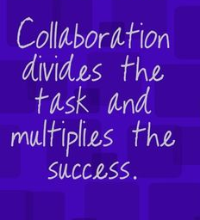
Purpose of Presentation
Collaboration was a key topic of this year’s solicitation for proposals
This presentation will:
Share emPower’s experience building and maintaining a regional collaboration
Offer insights to aspiring collaborations
Extend an invitation for collaborators
Notes:
I was happy that regional collaboration was a key topic of this year’s solicitation for proposals, because it is the underpinning of how and why emPower works. It’s also an essential tenant of my personal approach to getting anything done, particularly on matters of significance like cutting our emissions and energy use, creating jobs or protecting this community from the unique vulnerabilities presented by climate change.
In this presentation, my aim is to share emPower’s experience building and growing a regional collaboration of partners. In the process we have developed some insights that I think can be helpful to others in our region that want to do the noble and tough work of collaborating. I’m also hoping to inspire a bit of the spirit of collaboration here, because in short, I believe our community is more than capable of doing so, and we won’t achieve our big goals if we don’t. And by the end I’ll have an invitation for you.
2

Slide 3
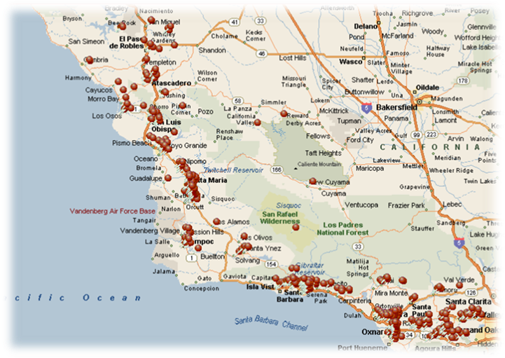
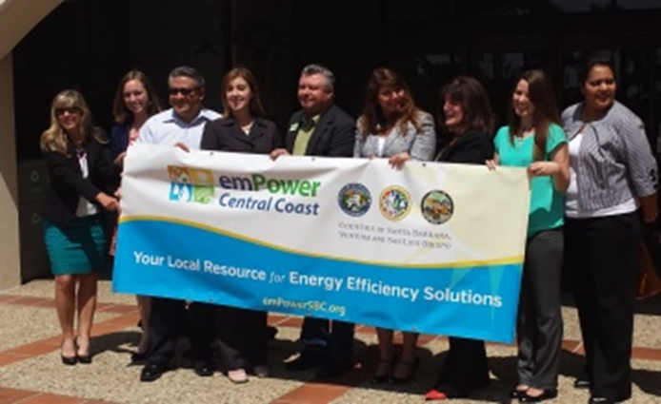
Program Background
Originally launched in November 2011
Relaunched as Tri County program in July 2014
Serve 28 jurisdictions (1.4M population, 315K SF homes)
In July 2015, we became the Division of Energy and Sustainability Initiatives
Notes:
As many of you know, emPower was launched in November 2011 under Santa Barbara County Board leadership and direction. It was charged to help residents and building professionals overcome obstacles to saving energy while also creating jobs.
Our innovative program model led to state and national recognition, and also to additional funding opportunities that allowed us to share our existing services and infrastructure in partnership with our neighbors in Ventura and SLO in July 2014. The theory was that we were going to generate greater impacts and efficiencies by deploying a program consistently throughout the Tri-County. We now serve 28 jurisdictions with a total population of 1.4M and 315,000 single family homes, of which many of a due for substantial energy retrofits.
Given our ongoing accomplishments, the County recently entrusted our team with significant new programs as the Division of Energy and Sustainability Initiatives this past July.
3

Slide 4
We emPower Clean Communities
…By helping residents and building professionals complete energy improvements
But we certainly don’t do it alone…
Notes:
So what does emPower do? Well we emPower clean communities. We do that primarily by helping residents and building professional complete energy improvements through a suite of 12 services including high dollar utility incentives and our unique, low cost financing option with 2 local credit unions, education, and free onsite Energy Coach advising services.
But we certainly don’t do it alone.
4

Slide 5
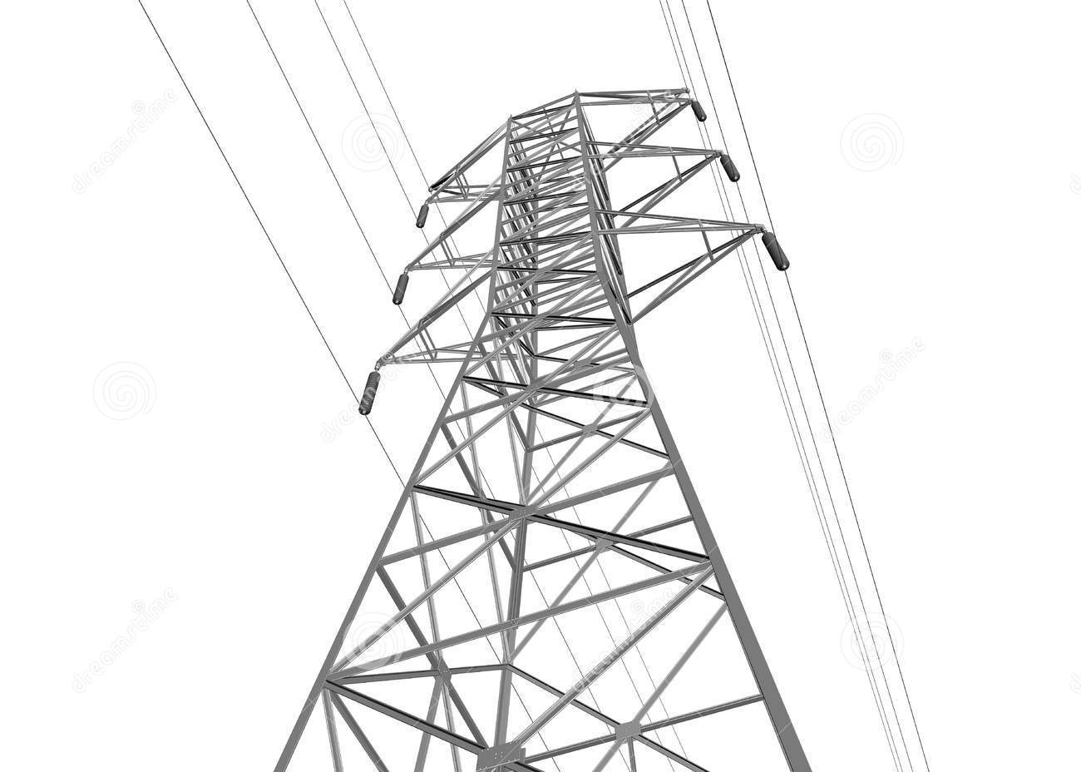
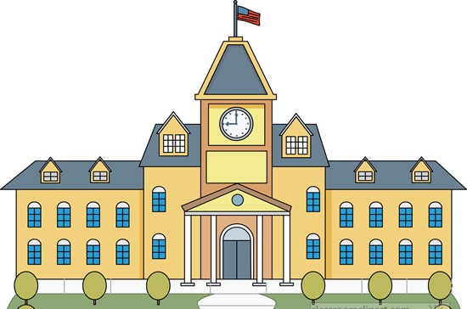
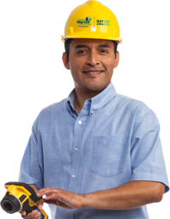
Collaborating across sectors
Internal Support
Utility Partners
Funders
Municipal Partners
Decision Makers
Workforce/ Trainers
Community Residents
Educational Institutions
Consultants/ Experts
Realtors
Financial Institutions
Non-profit Providers
Contracting Companies
Trade/Business Associations
Notes:
We’ve invited collaboration from various sectors who can help us develop market solutions that can make saving energy more affordable and accessible.
5

Slide 6
A Pathway to Efficiency
Organize resources and services across partners into a pathway
Notes:
It’s not enough to just pull partners together, or even enter into sometimes very complicated formal agreements. As lead, our job was to leverage and organize all the resources and expertise available through these partners to create a logical pathway to affordable completion of energy improvements.
This work is not easy.
We aren’t just getting input, or advocating together, we are operating services that are interdependent and require careful coordination.
6

Slide 7
Lessons Learned: Effective Collaboration
Know Your Goal
e.g. save energy, create jobs
Get a small team together to ID the real problem
Devise possible solutions that address problem
Do
X Don’t
Plow ahead with a diffuse set of ideas and principles
Recruit a large group yet
Notes:
7

Slide 8
Lessons Learned: Effective Collaboration
2. Align Your Support
e.g. CEO/Board, $$, paid staff
Get the authority you need early (i.e. elected officials)
ID funding and resources
Appoint someone take the lead (someone has to write the first drafts)
Do
X Don’t
Expect volunteers or busy people to staff all the work
Expect work to be divvied evenly among partners
Challenges: Funds and direction come with strings which can limit effectiveness. Overreliance on one funding source is risky.
Notes:
8

Slide 9
Lessons Learned: Effective Collaboration
3. Have a Plan
e.g. financing
Craft and communicate a clear path forward with tangible milestones
Stay focused on key objectives
Be okay with testing in a limited service area
Do
X Don’t
Group plan (instead invite partners to review and input)
Try to serve everything to everyone at once
Notes:
9

Slide 10
Lessons Learned: Effective Collaboration
4. Engage Stakeholders
e.g. contractors, community orgs
Genuinely seek meaningful input
Include individuals with different views
Communicate a compelling vision and value proposition, and think in terms of mutual benefit
Regularly communicate with partners (consistency matters)
Do
X Don’t
Simply check off your stakeholder outreach box
Notes:
Contractors (CIC), Robin, Community Partners
10

Slide 11
Lessons Learned: Effective Collaboration
5. Help Your Partners Participate
e.g. Lender Guide, Portals
Accept that building something new is not going to be easy
Make it as simple as possible to allow your partners to participate
Treat partners like customers
Do
X Don’t
Expect that partners are all equally invested
Notes:
11

Slide 12
Lessons Learned: Effective Collaboration
6. Commit to Quality Execution
e.g. trainings, procedures
Create culture of careful execution and high standards
Hold both leads and partners accountable with metrics and reports
Do
X Don’t
Let loose or sloppy processes risk the integrity of the program
Challenges: Overseeing work and maintaining a brand across organizations. Balancing autonomy vs standardization, motivation vs enforcement. Not in control of capacity/turnover.
Notes:
12

Slide 13
Lessons Learned: Effective Collaboration
7. Keeping the Momentum
e.g. share story = $, qrtly mtgs
Use data to evaluate progress
Revisit shared goals
Commit to continuous improvement
Celebrate and share successes
Be nimble and willing to adjust hypothesis and resources
Be willing to have authentic dialogue, especially when its hard
Scale up what works!
Do
X Don’t
Leave it up to leads to know about or solve all problems
Challenges: Balancing long terms goals vs immediate progress.
Notes:
13

Slide 14
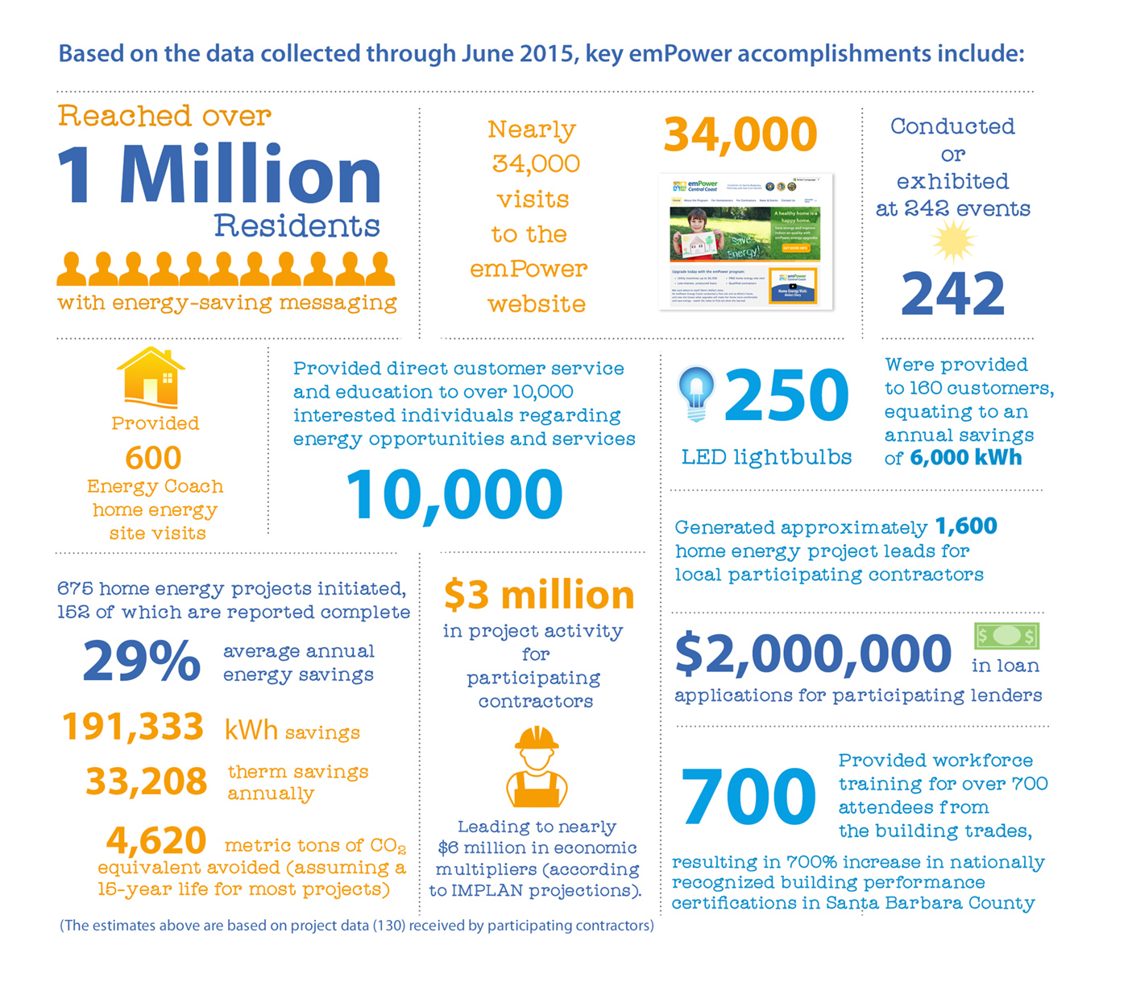
Benefits of Collaboration
Scalability/Replicability
Leverage resources
Broader reach
Reduce redundancy
More ideas
Greater impacts
Notes:
Our resources and reach alone would not have cut it. There are thousands of upgrades needed in the central coast. We didn’t have the funds to pay for them all directly, so we needed to leverage our limited resources against others to transform a market that can support energy improvements in the long run.
Reached over 1 million residents with energy saving messaging
Helped 11,000 customers learn how to get started
Conducted 265 educational events
Conducted 670 Energy Coach site visits
Trained hundreds of building professionals
Given 1,700 leads to 34 participating contractors, who have initiated over 700 projects and already earned $3M in project income
170 completed projects are saving 29% energy on average
Projects less expensive due to low rates, high rebates and lower contractor acquisition costs
We applying this collaborative approach as we tackle new initiatives that include implementing 50 emission reduction measures as part of the County’s newly adopted Energy and Climate Action Plan, which sets aggressive emission reduction targets by 2020. We are also applying this target to what has recently become a Tri-County effort to study the feasibility of the community choice energy program.
14

Slide 15
An invitation
Central Coast collaboration can be what leads to the scalable, replicable and inspirational innovations that can protect us from the impacts of climate change
We are building a “Whole Community Approach” to connect consumers to the rights services and resources to meet their needs
If your organization is working on solutions, we welcome your partnership
Provide me with your business cards before you go
Notes:
My final thought is thought is that we don’t’ collaborate because its easy or fun, but because quite frankly its the only way to accomplish such significant aims. To protect ourselves from the unique vulnerabilities to the Central Coast of climate change, we can’t just stay in our silos chasing local kWhs and therms and alienating potential partners. We have to innovate in ways that are scalable, replicable and inspirational to communities larger than our own. I believe the central coast, as a caring, smart community with a history of environmental stewardship and wonderful institutions like UCSB, is uniquely capable of creating and testing these game changing ideas. We did it with emPower, and I know this community is capable of much much more.
But we need your help. As we seek to expand our services further, we are building a “whole community approach” to connect consumers to the right services and resources to meet their needs. If your organization is working on solutions, we welcome your partnership.
Feel free to share what you’re doing during this session. What pilot is working that should be scaled up? What opportunity exists that no one has made use of? And please provide me with your business cards, and we will be back in touch to learn how we can collaborate with you.
15

Slide 16
A New Paradigm for Local EE Service Delivery
Fragmented, confusing, one- size-fits-all programs are stalling CA’s progress
Programs like emPower can do more to provide aggregated, right-sized, and comprehensive access to local energy services to all consumers based on specific needs and interest
Service to service providers
Notes:
Not as glamorous as financing, but complex and necessary

Slide 17
Thank you
Notes:
The emPower team would like to thank you for your time and continued support.
17

