Slide 1
The Inflation Reduction Act of 2022
Jamal Lewis, Rewiring America
October 19, 2022
Notes:
@RG

Slide 2

The Inflation Reduction Act will jumpstart the electrification movement.
The IRA leverages rebates, tax credits, low-cost financing, and domestic manufacturing incentives to lower costs and increase adoption of:
Heat pumps, heat pump clothes dryers, electric stoves, and upgraded panels;
Electric vehicles; and
Solar and storage.
At the same time, it offers powerful incentives for the continued decarbonization of our electricity supply.
Notes:
IRA will jumpstart elec. Movement.
Do so in 4 main ways:
On the consumer side, you have rebates, tax credits, and low cost financing.
On the supply side, you have tax credits, incentives, financing, and workforce development funding.

Slide 3

High-Efficiency Electric Home Rebates (HEEHRA)
$4.5B through FY2031
Funding available in 2022, but implementation will take time
Point-of-sale rebates up to $14,000 for LMI households that install new, efficient electric appliances (QEPs)
Contractors can receive an additional $500 incentive
Administered by State energy offices & Tribes
Home Energy Performance-Based, Whole-House Rebates
$4.3B through FY2031*
Funding available in 2022, but implementation will take time
Rebates for energy-saving retrofits, including heat pumps
$8,000 cap / 80% coverage for LMI households
$4,000 cap / 50% coverage otherwise
*Plus an additional $200M for workforce development
The Inflation Reduction Act:
Consumer Rebates
Notes:
High-Efficiency Electric Home Rebates (HEEHRA)
$4.5B through FY2031
Point-of-sale rebates up to $14,000 for LMI households that install new, efficient electric appliances - (QEPs)
Includes heat pump HVAC systems, HPWHs, electric cooking appliances, heat pump clothes dryers, and enabling measures - upgraded circuit panels, insulation, and wiring
Costs cover purchase & installation: 100% covered for low income; 50% for moderate income
Includes $500 contractor incentive
Administered by state energy offices & Tribes
MAX ALLOWABLE
$14,000
PER QEP:
HPWH - $1,750
HP space heating - $8,000
Electric stove - $840
HP clothes dryer - $840
Breaker Box - $4,000
Insulation, air sealing, ventilation- $1,600
Electric wiring *new*- $2,500
Home Energy Performance-Based, Whole-House Rebates
$4.3B through FY2031
Rebates for energy-saving retrofits, including heat pumps
$8,000 cap / 80% coverage for LMI households
$4,000 cap / 80% coverage otherwise

Slide 4
25C: Residential Energy Efficiency Tax Credit
Extended through FY2031, new credits start in 2023
Provides 30% tax credit for residential efficiency and electrification upgrades, up to $3,200 per year
  Annual credit for heat pumps and heat pump water heaters capped at $2,000
  Annual credit for other upgrades — electrical panel (if installed in conjunction with a heat pump), insulation, doors and windows — capped at $1,200
  Covers purchase and installation
Annual credit limit resets every year
Nonrefundable
25D: Residential Clean Energy Credit
Extended through FY2031, new credits retroactive to 2022
Provides 30% tax credit for geothermal heat pumps, solar panels, and battery storage*
  Uncapped
  Covers purchase and installation
Nonrefundable
Carry-forward ability applies
*battery storage credits available starting 2023
The Inflation Reduction Act:
Consumer
Tax Credits
Notes:
25C: Residential Energy Efficiency Tax Credit
Estimated value: $12.5B through FY2031
Old version of 25C (which expired last year) is retroactive to all of 2022; new version starts next year
Allows households of any income* to deduct up to 30% of the cost of efficiency home upgrades (install included)
Including heat pumps, breaker box upgrades, insulation
For most items: deductions are capped at $600 per item & up to $1,200 per household per year
Exception: deductions for heat pump water heaters and heat pump space heaters can be up to $2,000 each
Insulation also caps out at $1,200, not $600
*Non-refundable
25D: Residential Clean Energy Credit
Estimated value: $22B through FY2031
New version retroactive to all of 2022
Allows households of any income* to deduct 30% of the cost of:
Geothermal heat pumps
Solar panels
Battery storage
Solar water heating, fuel cells, and property wind energy installations
*Non-refundable
30D: Clean Vehicle Credit
Estimated value: $7.5B through FY2031; starts 2023
Revokes unit-per-manufacturer cap on tax credits
$7,500 tax credit for new EVs tied to critical mineral, battery component, and final assembly requirements
Credits are income limited and MSRP limited
$150K single, $225K head of household, $300K joint filers
Credits will be transferable to dealers in exchange for a point-of-sale rebate, starting in 2024
25E: Credit for Previously-Owned Clean Vehicles
Estimated value: $1.4B through FY2031; starts 2023
$4,000 tax credit for used EVs
Credits are income limited and MSRP limited
$75K single, $112.5K head of household, $150K joint filers
Credits will be transferable to dealers in exchange for a point-of-sale rebate, starting in 2024

Slide 5
30D: Clean Vehicle Credit
Starts in 2023
Transferable to dealers for a point-of-sale rebate starting in 2024
Revokes unit-per-manufacturer cap on tax credits; now unlimited
Max credit: $7,500
Credit tied to manufacturing requirements and income/MSRP limits
Income limits: $150K single; $225K head of household; $300K joint filers
MSRP limits:
  Vans, SUVs, pickup trucks: $80,000
  All other vehicles: $55,000
25E: Credit for Previously-Owned Clean Vehicles
Starts in 2023
Transferable to dealers for a point-of-sale rebate starting in 2024
Credit amount: $4,000
Income limits: $75K single; $112.5K head of household; $150K joint filers
MSRP limit: $25,000
30C Alternative Fuel Refueling Property Credit
Extended through 2032
Provides 30% tax credit for residential EV chargers, up to $1,000/charger
Starting in 2023, credit restricted to rural or low-income communities
The Inflation Reduction Act:
Consumer
Tax Credits
Notes:
25C: Residential Energy Efficiency Tax Credit
Estimated value: $12.5B through FY2031
Old version of 25C (which expired last year) is retroactive to all of 2022; new version starts next year
Allows households of any income* to deduct up to 30% of the cost of efficiency home upgrades (install included)
Including heat pumps, breaker box upgrades, insulation
For most items: deductions are capped at $600 per item & up to $1,200 per household per year
Exception: deductions for heat pump water heaters and heat pump space heaters can be up to $2,000 each
Insulation also caps out at $1,200, not $600
*Non-refundable
25D: Residential Clean Energy Credit
Estimated value: $22B through FY2031
New version retroactive to all of 2022
Allows households of any income* to deduct 30% of the cost of:
Geothermal heat pumps
Solar panels
Battery storage
Solar water heating, fuel cells, and property wind energy installations
*Non-refundable
30D: Clean Vehicle Credit
Estimated value: $7.5B through FY2031; starts 2023
Revokes unit-per-manufacturer cap on tax credits
$7,500 tax credit for new EVs tied to critical mineral, battery component, and final assembly requirements
Credits are income limited and MSRP limited
$150K single, $225K head of household, $300K joint filers
Credits will be transferable to dealers in exchange for a point-of-sale rebate, starting in 2024
25E: Credit for Previously-Owned Clean Vehicles
Estimated value: $1.4B through FY2031; starts 2023
$4,000 tax credit for used EVs
Credits are income limited and MSRP limited
$75K single, $112.5K head of household, $150K joint filers
Credits will be transferable to dealers in exchange for a point-of-sale rebate, starting in 2024

Slide 6
179D Energy Efficient Commercial Buildings Deduction
Extended through FY2031
Provides tax deduction to commercial buildings that achieve at least a 25% reduction in site energy use intensity
Incentives vary based on savings and prevailing wage requirements
  Max credit: $5/sq. ft.
45L New Energy Efficient Home Credit
Extended through 2032
Credits available for single-family and multi-family new homes
  $2,500 for homes meeting EPA’s ENERGY STAR requirements
  $5,000 for homes meeting DOE’s Zero Energy Ready Homes
LIHTC properties can use 45L without basis adjustment
The Inflation Reduction Act:
Commercial
Tax Credits

Slide 7
30C Alternative Fuel Refueling Property Credit
Extended through 2032
Provides 30% tax credit for commercial EV chargers
Increases incentive from $30,000 per property to $100,000 per item
Starting in 2023, credit restricted to rural or low-income communities
45W Credit for Qualified Commercial Clean Vehicles
Extended through 2032
Provides 30% tax credit for commercial clean vehicles
Credit limit:
  $7,500 for vehicles under 14,000 lb.
  $40,000 otherwise
Sourcing/manufacturing/assembly requirements do not apply
The Inflation Reduction Act:
Commercial
Tax Credits

Slide 8
Improving Energy Efficiency or Water Efficiency or Climate Resilience of Affordable Housing (f.k.a. GREAHT)
$1B through FY2028, with authority to subsidize up to $4B of loans
Grants and loans to:
  Improve energy or water efficiency
  Improve indoor air quality
  Install low-emission technologies, including zero-emission electricity generation, energy storage, and building electrification
Funding designated for private affordable housing and federally subsidized housing (including Section 8)
Assistance for Latest and Zero Building Energy Code Adoption
$1B through FY2029
Administered to states and local governments
Purpose: to adopt and enforce residential/commercial building codes
  Plans shall include “active training and enforcement programs” to “achieve full compliance with any building energy code adopted”
The Inflation Reduction Act:
Additional Buildings Incentives

Slide 9
Greenhouse Gas Reduction Fund (a.k.a., the Accelerator)
$27B through FY2024
  $15B for low-income and disadvantaged communities
Grants to create/support national, state, and local green banks to:
  Provide low-cost financing to projects that enable communities to deploy or benefit from zero-emission technologies
Funding will leverage private capital with a ~5:1 ratio
Department of Energy’s Loan Programs Office (LPO)
$3.6B through FY2026
Provides authority to guarantee up to $40B of loans
Guarantees loans for projects that avoid, reduce, or sequester air pollutants or anthropogenic greenhouse gas emissions
Potential impacts:
  LPO can finance “innovative” projects like virtual power plants (VPPs), including household electrification
  LPO can provide subsidized loans to onshore manufacturing facilities for electrification projects (limitations apply)
  If State entities first provide funding, LPO can finance non-innovative technologies and projects
The Inflation Reduction Act:
Low-Cost Financing
Notes:
Greenhouse Gas Reduction Fund (a.k.a., the Accelerator)
$27B through FY2024
$15B reserved for for low-income and disadvantaged communities
Low-cost financing for projects that enable communities to deploy and/or benefit from zero-emission technologies
$7B will fund tech (largely rooftop solar) for low-income communities
$20B will be deployed to green-bank-like entities (a national green bank and state green banks)
$8B for disadvantaged communities
Funding will leverage private capital with a 5:1 ratio
Consumer impact: intention is that funding will be used by green banks to finance residential electrification & efficiency upgrades
Funding for the Department of Energy’s Loan Programs Office (LPO)
$3.6B through FY2026, with authority to guarantee up to $40B of loans
Loan guarantees for projects that avoid, reduce, or sequester air pollutants or anthropogenic greenhouse gas emissions
Consumer impacts:
LPO can finance “innovative” projects like Virtual Power Plants, including household electrification and demand response
If state entities supplement LPO funding, LPO can also fund standard, residential heat pump deployment
Non-Consumer impact:
LPO can provide subsidized loans for onshoring of domestic manufacturing facilities
Funding for the Defense Production Act (DPA)
$500M through FY2024
Funding to bolster the domestic manufacturing of heat pumps and critical minerals

Slide 10
Department of Energy’s Loan Programs Office (LPO)
$3.6B through FY2026
Provides authority to guarantee up to $40B of loans
LPO can provide subsidized loans to:
  Onshore manufacturing facilities
  Fund virtual power plants
  Finance non-”innovative” projects if State entities provide initial funding
Funding for the Defense Production Act (DPA)
$500M through FY2024
To bolster the domestic manufacturing of heat pumps and the processing of critical minerals
The Inflation Reduction Act:
Manufacturing Incentives
Notes:
Innovative clean energy solicitation
VPPs

Slide 11
48C Advanced Energy Project Credit
$10B appropriated ($4B reserved for legacy energy communities)
30% tax credit for projects that expand or establish certain energy manufacturing facilities — including heat pump manufacturing
Credits awarded competitively, not automatically
45X Advanced Manufacturing Production Credit
Created and extended through 2032
A new PTC for the domestic production and sale of qualifying solar, wind, and battery components
Cannot be combined with 48C
Clean Energy Tax Credits (ITC and PTC)
Extended through FY2031
ITC: 30%; PTC: 2.6 cents/kWh (in 2022 dollars)
Direct pay for non-taxable entities, transferability otherwise
10% credit bonuses for domestic content and projects located in legacy energy communities
Additional ITC bonus up to 20% for facilities placed in service in low-income communities
Bonuses are stackable → ITC could reach up to 70%
The Inflation Reduction Act:
Manufacturing Incentives

Slide 12
State-Based Home Energy Efficiency Contractor Training Grants
$200M through FY2031
Financial assistance to states to develop and implement workforce programs
Training & education to contractors involved in energy efficiency or electrification upgrades, including through IRA rebate programs
Contractor Incentives
High-Efficiency Electric Home Rebates (HEEHRA): $500
Home Energy Performance-Based, Whole-House Rebates: $200 for projects in disadvantaged communities
Prevailing Wage Incentives
The full value of the following tax credits is tied to prevailing wage and apprenticeship requirements:
  45L New Energy Efficient Home Credit
  179D Energy Efficient Commercial Buildings Deduction
  30C Alternative Fuel Refueling Property Credit
  48C Advanced Energy Project Credit
  Clean Energy Tax Credits (PTC and ITC)
The Inflation Reduction Act:
Workforce and Labor Incentives

Slide 13
Climate Pollution Reduction Grants
$5B through FY2026
  $4.75B implementation grants and $250M in planning grants
Planning grants to at least one entity in each state; implementation grants are competitive
Grants for programs that will achieve or facilitate the reduction of greenhouse gas air pollution
Environmental And Climate Justice Block Grants
$3B through FY2026
Competitive grants to local governments, Tribes, and community–based nonprofits in disadvantaged communities
Potential uses include investments in zero-emission technologies and related infrastructure and workforce development
Greenhouse Gas Reduction Fund (a.k.a., the Accelerator)
$27B through FY2024
  $15B for low-income and disadvantaged communities
Low-cost financing for projects that enable communities to deploy and/or benefit from zero-emission technologies
The Inflation Reduction Act:
Environmental Justice Grants

Slide 14
Electrification Rebates and Tax Credits
Renters can take advantage of the following incentives:
  High-Efficiency Electric Home Rebates
  Home Energy Performance-Based, Whole-House Rebates
  25C Residential Energy Efficiency Tax Credit
  25D Residential Clean Energy Credit
  30D EV Credit and 25E Used EV Credit
Renters can utilize rebates and tax credits for portable electrification upgrades so they don’t leave any value behind
  Electric vehicles
  Electric or induction stoves
  Heat pump clothes dryers
  Some heat pumps and heat pump water heaters
Affordable Housing Investments
The IRA includes $1B, with authority to subsidize up to $4B of loans, for affordable housing energy upgrades
  Funding designated for private affordable housing and federally subsidized housing (including Section 8)
The new 45L New Energy Efficient Home Credit will enable more LIHTC-supported energy-efficient affordable housing
The Inflation Reduction Act:
Incentives for Renters

Slide 15
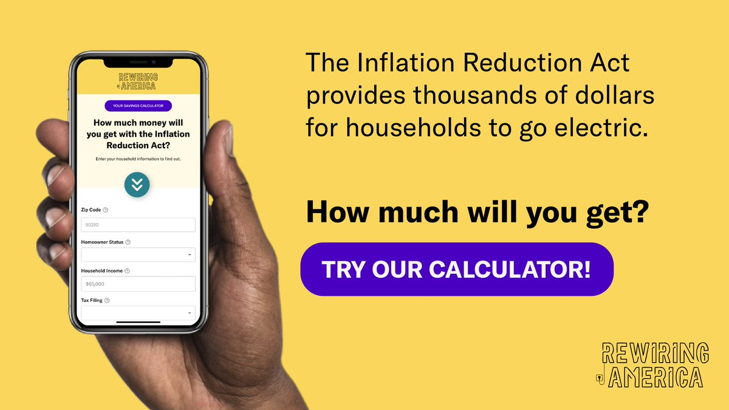
Notes:
https://www.rewiringamerica.org/app/ira-calculator

